Slide 1
“The Revelation of Jesus Christ, which God gave Him to show His servants - things which must shortly take place. And He sent and signified it by His angel to His servant John.”
Revelation 1:1

Slide 2
Style
Apocalyptic – “an uncovering, laying bare” To reveal something.
Revelation is a book of signs and symbols that pertains to things that were to take place during the time in which it was written.
“The Revelation of Jesus Christ, which God gave Him to show His servants - things which must shortly take place. And He sent and signified it by His angel to His servant John” (Rev. 1:1).

Slide 3
Style
“An apocalypse is a book that uses visions and dramatic word pictures to convey information about God’s activity, particularly regarding the oppression of God’s people by their enemies” (Roberts 16-17).
Ezekiel, Daniel, Zechariah, the Lord’s discussion of the destruction of Jerusalem (Matt. 24; Mark 13; Luke 21).
The purpose of Apocalyptic Literature was both to reveal and to conceal.

Slide 4
Style
Revelation was written to encourage Christians who were suffering greatly for their faith.
Why were they suffering?
Did God care (Rev. 6:10)?
Revelation “pulls back the curtain,” allowing these Christians to see that their sufferings were caused by a greater spiritual conflict in the heavenly realm (12:7-17), and that through Christ they have the victory (17:14).

Slide 5
Style
The recipients of Revelation would have understood its message because they were familiar with the style.
Book was initially carried from one church to another.
The entire book would have been read in one sitting, and then the messenger would have taken it to the next city.

Slide 6
Style
The signs and symbols were used to convey “big picture” ideas.
One will grasp the meaning of Revelation when he looks at the big picture, not when he places each vision under a microscope and tries to assign a meaning to every single symbol.
We do not watch a movie in bits and pieces. We watch the entire movie, understand its message, and move on.
Do the same with the book of Revelation.

Slide 7
Numbers
Two – strength, two witnesses confirm truth (11:3-12).
Three – divine: Father, Son, Holy Spirit.
Four – the world, four corners, north, south, east, west.
Seven – perfect divine number, that which is whole.
Six – failure, one less than the perfect number.
Ten – completeness, ten fingers and toes.
One Thousand – complete or full period of time.
Twelve – God’s people
144,000 – multiple of completeness and God’s people, represents the full number of God’s people on earth at any given time.

Slide 8
Theme – Overcoming With the Lamb
“These will make war with the Lamb, and the Lamb will overcome them, for He is Lord of lords and King of kings; and those who are with Him are called, chosen, and faithful” (Rev. 17:14).
The assurance of victory for those who suffer for the cause of Christ.

Slide 9
Addressed To:
The seven churches of Asia (1:4, 11).
The number seven is symbolic. These seven churches stand in representation of all local congregations.
The letter is universal in nature; it applies to every church of every age.
Writer:
It is “the revelation of Jesus Christ,” but it was delivered to the apostle John and he wrote down what he saw.

Slide 10
Date of Writing
Early Date (A.D. 54-68) makes the Jews the enemy, identifies Jerusalem as “Babylon,” and makes the fall of Jerusalem in A.D. 70 the thrust of the book.
Late Date (A.D. 95-96) makes the Roman government the enemy, Rome is “Babylon,” and the fall of Rome is the thrust of the book.
We will take the Late Date in our study.

Slide 11
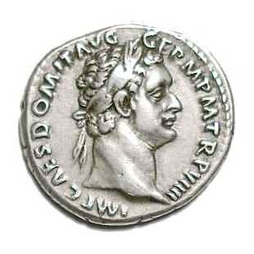
Christians in the 90’s A.D.
Domitian was the emperor of Rome and proclaimed himself to be “Lord God Caesar.” He insisted that he be worshiped as god.
Faithful Christians who refused to worship Caesar as god were treated as both “unbelievers” and as traitors to the Roman Empire.

Slide 12
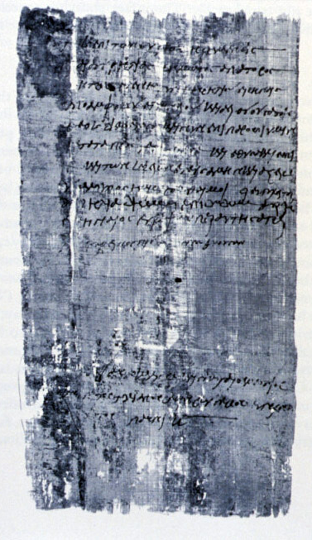
Christians in the 90’s A.D.
The Emperor Cult required all people to burn a pinch of incense to the emperor as god. Upon doing so, they would be given a certificate allowing them to engage in commerce. Christians who refused to do so suffered want (Rev. 13:15-17).

Slide 13
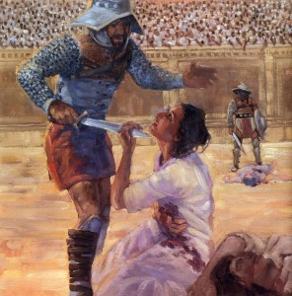
Christians in the 90’s A.D.
Many Christians were being put to death during Domitian’s reign.
As such, there was great pressure to deny the faith in order to survive.
Revelation was written to encourage saints to remain faithful under such extreme circumstances.

Slide 14
Truths Gleaned From Revelation
God is in complete control of the affairs of this world.
God is worshipped in Heaven.
God will bring judgment upon evil.
God’s kingdom will stand and He will vindicate His people.
The faithful will have to exercise patience and endurance in this life.
There is complete victory in Christ.

Slide 15
In Our Study
We will take the Late Date.
We will emphasize the style and the purpose of the book.
Our classes will primarily be a lecture format, with time for questions and discussion at the end of the class.
We will move quickly so as to get the overall “big picture” of the book.

