Slide 2
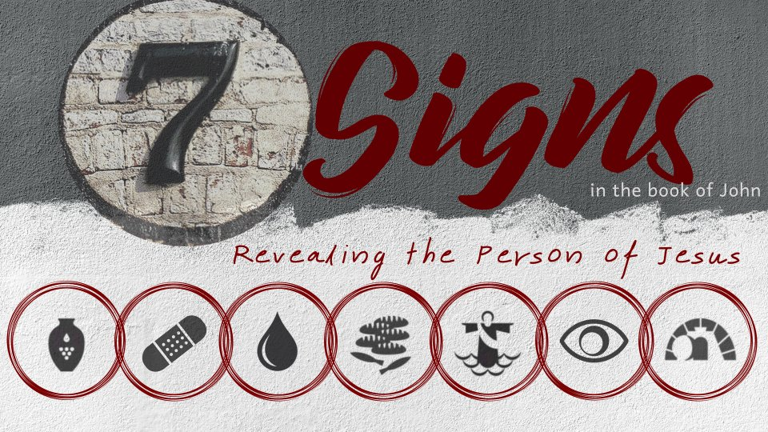
Healing the Man Born Blind
John 9

Slide 3
The Sign
Now as Jesus passed by, He saw a man who was blind from birth.
And His disciples asked Him, saying, “Rabbi, who sinned, this man or his parents, that he was born blind?”
John 9:1-2

Slide 4
The Sign
Jesus answered, “Neither this man nor his parents sinned, but that the works of God should be revealed in him.
I must work the works of Him who sent Me while it is day; the night is coming when no one can work.
As long as I am in the world, I am the light of the world.”
John 9:3-5

Slide 5
The Sign
When He had said these things, He spat on the ground and made clay with the saliva; and He anointed the eyes of the blind man with the clay.
And He said to him, “Go, wash in the pool of Siloam” (which is translated, Sent). So he went and washed, and came back seeing.
John 9:6-7

Slide 6
The Impact of the Sign
The Blind Man’s Neighbors - vs. 8-12
The Pharisees - vs. 13-16; 10:19-21
The Blind Man’s Parents - vs. 18-23
The Blind Man’s Faith

Slide 7
The Progression of the Blind Man’s Faith
“a man called Jesus” - v. 11
“He is a prophet” - v. 17
Identifies himself as a “disciple” - v. 26
Confesses Jesus is “the Son of God,” calls Him “Lord” and worships Him - vs. 35-38

Slide 8
What This Sign Tells Us About Jesus
Water into wine – power over quality.
Healing nobleman’s son – power over distance.
Healing lame man – power over time.
Feeding the 5,000 – power over quantity.
Walking on water – power over nature.
Healing blind man – power over darkness.

