Slide 1
L

Slide 2
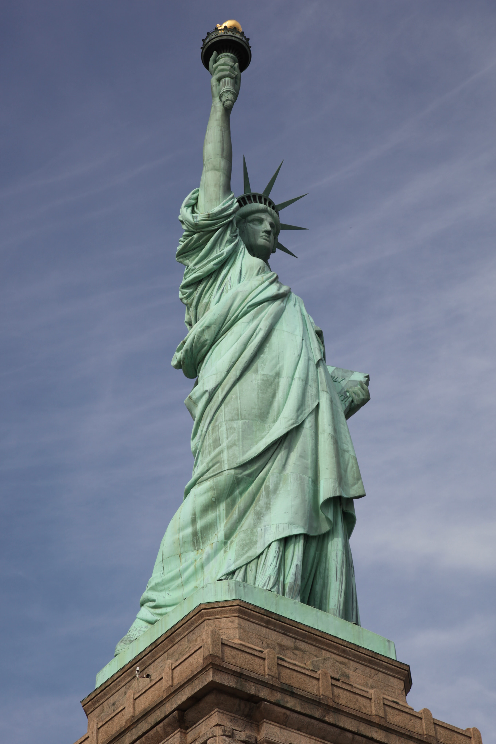
Photo by Marianna from Pexels

Slide 3
LIBERTY
Photo by Marianna from Pexels

Slide 4
GIVE ME
LIBERTY
Photo by Marianna from Pexels

Slide 5
GIVE ME
LIBERTY
OR GIVE ME DEATH
Photo by Marianna from Pexels

Slide 6
GIVE ME
LIBERTY
OR GIVE ME DEATH
the state of being free within society
from oppressive restrictions imposed
by authority on one’s way of life, behavior, or political views
Photo by Marianna from Pexels

Slide 7
GIVE ME
LIBERTY
OR GIVE ME DEATH
the state of being free within society
from oppressive restrictions imposed
by authority on one’s way of life, behavior, or political views
the state of not being
imprisoned or enslaved
Photo by Marianna from Pexels

Slide 8
GIVE ME
LIBERTY
OR GIVE ME DEATH
the state of being free within society
from oppressive restrictions imposed
by authority on one’s way of life, behavior, or political views
the state of not being
imprisoned or enslaved
a right or privilege
Photo by Marianna from Pexels

Slide 9
GIVE ME
LIBERTY
OR GIVE ME DEATH
the state of being free within society
from oppressive restrictions imposed
by authority on one’s way of life, behavior, or political views
the state of not being
imprisoned or enslaved
a right or privilege
the power or scope to act as one pleases
Photo by Marianna from Pexels

Slide 10
LIBERTY

Slide 11
LIBERTY
Matthew 17:24-26

Slide 12
LIBERTY
Matthew 17:24-26
1 Corinthians 7:39

Slide 13
LIBERTY
Matthew 17:24-26
1 Corinthians 7:39
7:21,22

Slide 14
LIBERTY
Matthew 17:24-26
1 Corinthians 7:39
7:21,22
social or civil liberties have no bearing
on one’s relationship to Christ

Slide 15
LIBERTY
Matthew 17:24-26
1 Corinthians 7:39
7:21,22
social or civil liberties have no bearing
on one’s relationship to Christ
1 Corinthians 12:13 • Galatians 3:28
Ephesians 6:8 • Colossians 3:11

Slide 16
LIBERTY

Slide 17
LIBERTY
WHAT MAKES US FREE?

Slide 18
LIBERTY
WHAT MAKES US FREE?
John 8:30-36

Slide 19
LIBERTY
WHO MAKES US FREE?
John 8:30-36

Slide 20
LIBERTY
WHO MAKES US FREE?
John 8:30-36
“It is not that [Jesus’] claims have no bearing on questions of social justice, but that the pursuit of social justice alone will always prove vain and ephemeral unless the deeper enslavement is recognized and handled.” (D. A. Carson, commentary on John, p. 350)

Slide 21
LIBERTY
WHO MAKES US FREE?
John 8:30-36

Slide 22
LIBERTY
WHO MAKES US FREE?
John 8:30-36
Romans 6:16-23

Slide 23
LIBERTY
WHO MAKES US FREE?
John 8:30-36
Romans 6:16-23
8:1,2,18-21

Slide 24
LIBERTY
WHO MAKES US FREE?
John 8:30-36
Romans 6:16-23
8:1,2,18-21
Galatians 3:26-4:7

Slide 25
LIBERTY

Slide 26
LIBERTY
IN SUBJECTION TO JESUS

Slide 27
LIBERTY
IN SUBJECTION TO JESUS
Galatians 5:1

Slide 28
LIBERTY
IN SUBJECTION TO JESUS
Galatians 5:1
4:9

Slide 29
LIBERTY
IN SUBJECTION TO JESUS
Galatians 5:1
4:9
2:3-5

Slide 30
LIBERTY
IN SUBJECTION TO JESUS
Galatians 5:1
,13
4:9
2:3-5

Slide 31
LIBERTY
IN SUBJECTION TO JESUS
Galatians 5:1
,13
4:9
2:3-5
1 Corinthians 9:19-23

Slide 32
LIBERTY
IN SUBJECTION TO JESUS
Galatians 5:1
,13
4:9
2:3-5
1 Corinthians 9:19-23
1 Peter 2:15,16

Slide 33
LIBERTY
IN SUBJECTION TO JESUS
Galatians 5:1
,13
4:9
2:3-5
1 Corinthians 9:19-23
1 Peter 2:15,16
,20-24

Slide 34
LIBERTY

Slide 35
LIBERTY
Photo by Marianna from Pexels

Slide 36
LIBERTY
2 Peter 2:18-20
Photo by Marianna from Pexels

Slide 37
LIBERTY

Slide 38
GIVE ME
LIBERTY

Slide 39
GIVE ME
LIBERTY
OVERCOMING DEATH

