Slide 2
The Importance of Word Order in Scripture
John 3:16

Slide 3
Word Order is Important
Changing word order can completely change the meaning of a sentence.
“She only loves him.” ➔ “Only she loves him.”
“A free WiFi zone.” ➔ “A WiFi free zone.”

Slide 4
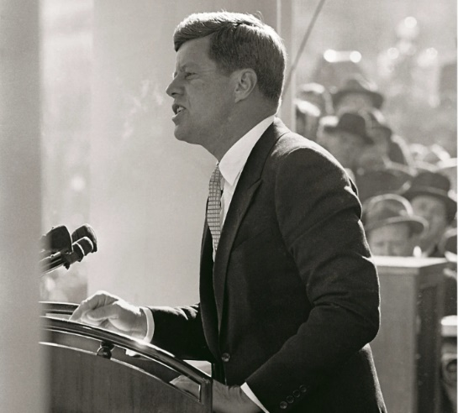
Word Order is Important
“Ask not what your country can do for you - but what you can do for your country.”

Slide 5
Word Order is Important
“Ask not what your country can do for you - but what you can do for your country.”
“Ask what your country can do for you, not what you can do for your country.”

Slide 6
Satan Moves God’s Words
“But of the tree of the knowledge of good and evil you shall not eat, for in the day that you eat of it you shall surely die” (Gen. 2:17).
“Then the serpent said to the woman, ‘You will not surely die’” (Gen. 3:4).

Slide 7
For God so loved the world that He gave His only begotten Son, that whoever believes in Him should not perish but have everlasting life.
John 3:16
Jesus is God’s unique Son.
God didn’t give one of many; He gave His one and only!

Slide 8
For God only loves. He gave His Son, that we will have everlasting life.
John 3:16
God is love (1 John 4:7-11).
This does not mean there is no anger, judgment, or condemnation.
Such is not a balanced or Biblical view of God (Rom. 11:22).

Slide 9
For God so loved the world that He only gave His Son, that whoever believes in Him should not perish but have everlasting life.
John 3:16
Every good thing (James 1:17).
Our lives (Acts 17:25).
His Word (Ps. 119:89, 105).
Our loved ones (Ps. 127:3; Prov. 18:22).
Way of escape (1 Cor. 10:13).

Slide 10
For God so loved the world that He gave His Son, that only some who believe in Him will have everlasting life. Everyone else will perish.
John 3:16
TULIP - “Limited Atonement”
God wants everyone saved (1 Tim. 2:3-4).
Water of life is offered freely to whosoever will (Rev. 22:17).
John 1:29; 1 John 2:2

Slide 11
For God so loved the world that He gave His Son, that whoever only believes in Him should not perish but have everlasting life.
John 3:16
Repentance (Acts 17:30).
Confession of faith (Rom. 10:9-10).
Water baptism (Mark 16:16; Acts 22:16).
Faithful endurance (Heb. 10:36).

Slide 12
For God so loved the world that He gave His only begotten Son, that whoever believes in Him should not perish but have everlasting life.
John 3:16
Word order matters!
Read the words of eternal life carefully!

