Slide 1
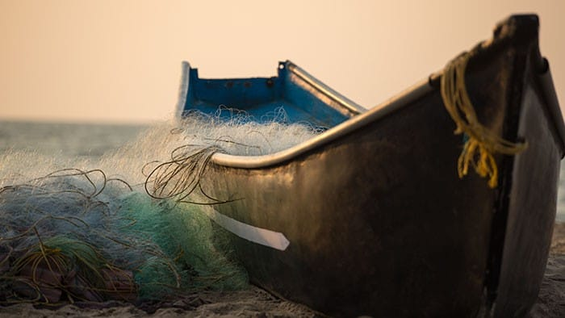
Miracles of Jesus
Water to Wine – Hanley Davis
Walking on Water – Aiden Reeder
Feeding the 5000 – Micah Blackaby
Raising of Lazarus – Mason Brenneman
Healing the Blind – Gavin Thomas
Closing Prayer – Kale Davis

