Slide 2
Things I Owe My Brethren

Slide 3
1. Love
Owe no one anything except to love one another, for he who loves another has fulfilled the law.
Romans 13:8

Slide 4
1. Love
A new commandment I give to you, that you love one another; as I have loved you, that you also love one another.
By this all will know that you are My disciples, if you have love for one another."
John 13:34-35

Slide 5
2. Provocation
And let us consider one another to provoke unto love and to good works.
Hebrews 10:24 (KJV)

Slide 6
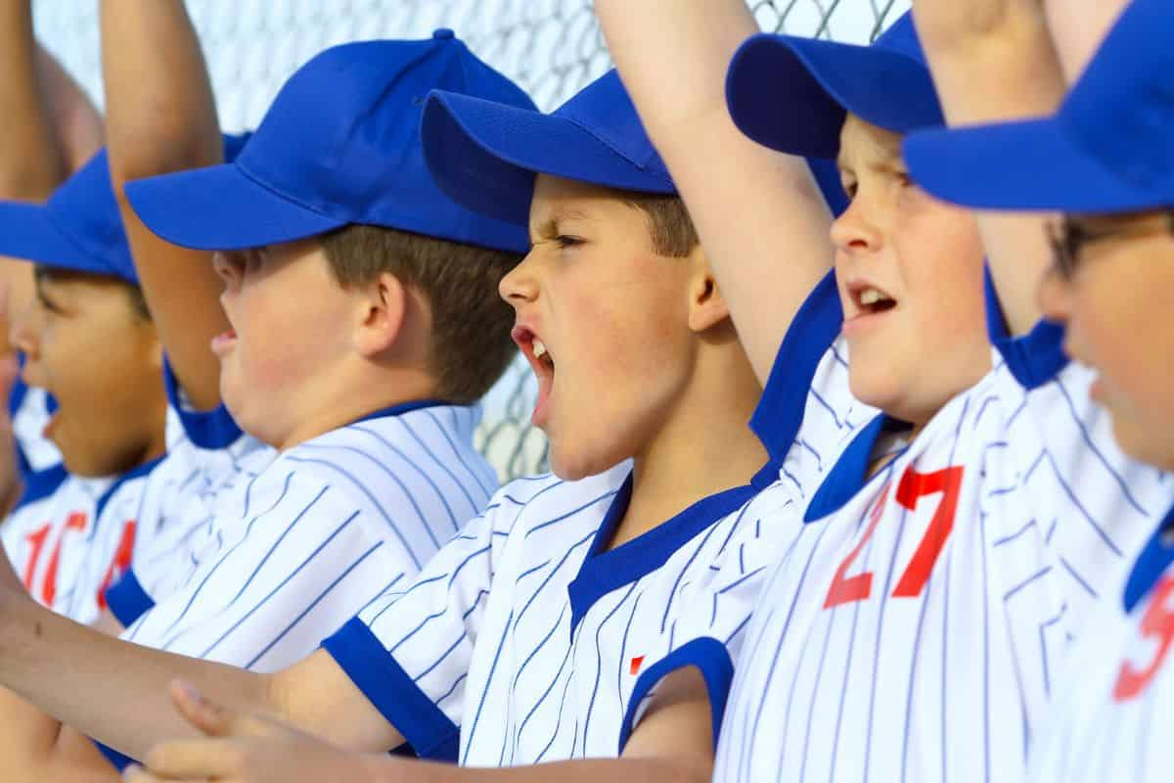
2. Provocation
And let us consider one another to provoke unto love and to good works.
Hebrews 10:24 (KJV)

Slide 7
3. Exhortation
Not forsaking the assembling of ourselves together, as is the manner of some, but exhorting one another, and so much the more as you see the Day approaching.
Hebrews 10:25

Slide 8
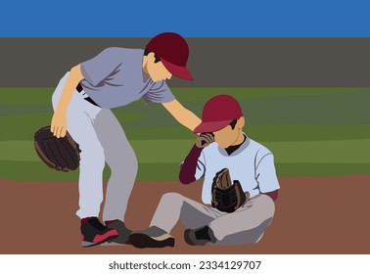
3. Exhortation
Not forsaking the assembling of ourselves together, as is the manner of some, but exhorting one another, and so much the more as you see the Day approaching.
Hebrews 10:25

Slide 9
4. Consolation
Rejoice with those who rejoice, and weep with those who weep.
Romans 12:15

Slide 10
5. Restoration
Brethren, if a man is overtaken in any trespass, you who are spiritual restore such a one in a spirit of gentleness, considering yourself lest you also be tempted.
Galatians 6:1

Slide 11
Things I Owe My Brethren
Love - sacrificial service
Provocation - cheer them on
Exhortation - encourage them to hang in there
Consolation - sit and weep with them
Restoration - go, get them, bring them back

