Slide 2
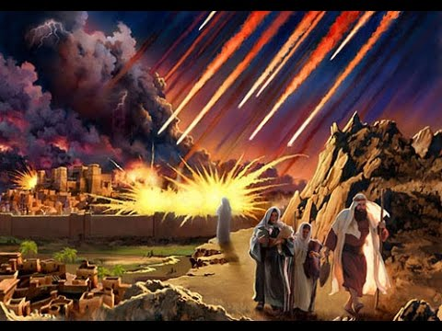
Lot
How to Make a Terrible Decision

Slide 3
Lot Had Much in His Favor
Influence of Godly Relatives - Gen. 12:4-5
Blessed with Increasing Wealth - Gen. 13:5-6
Was a Righteous Man - 2 Pet. 2:7-8

Slide 4
Lot’s Downfall
Genesis 13:7-13

Slide 5
Lot’s Downfall
Psalm 1:1
“Blessed is the man who walks not in the counsel of the ungodly, nor stands in the path of sinners, nor sits in the seat of the scornful.”
Lot
Lot pitched his tent towards Sodom (Gen. 13:12).
Lot “dwelt in Sodom” (14:12).
Lot is found “sitting in the gate of Sodom” (19:1).

Slide 6
Consequences of His Decision
He was oppressed and tormented by the wickedness of the city - 2 Pet. 2:7-8
His own moral standards had become warped and confused - Gen. 19:4-8
He lost everything!

Slide 7
Consequences of His Decision
He was oppressed and tormented by the wickedness of the city - 2 Pet. 2:7-8
His own moral standards had become warped and confused - Gen. 19:4-8
He lost everything!
He lost everything!
His sons-in-law – Gen. 19:12-14
His home and wealth
His wife – vs. 17, 26
His reputation – vs. 30-38

Slide 8
Lessons to Learn from Lot
Set the right priorities.
Providing for our family requires more than earning a living.
Increased exposure leads to increased tolerance and involvement.
Good doesn’t always rise above evil.
We reap what we sow.

