Slide 3
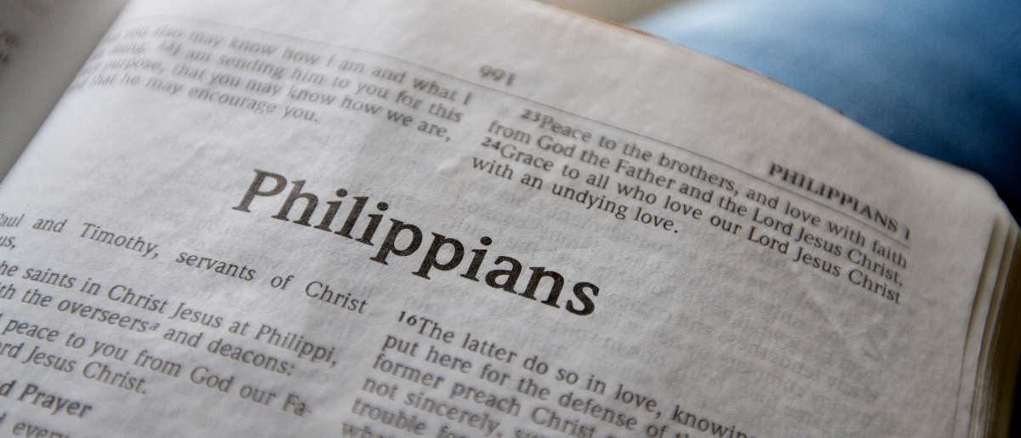
Living Worthy of the Gospel
Philippians 1:27-30

Slide 4
Only let your conduct be worthy of the gospel of Christ, so that whether I come and see you or am absent, I may hear of your affairs, that you stand fast in one spirit, with one mind striving together for the faith of the gospel
Philippians 1:27

Slide 5
Only let your conduct be worthy of the gospel of Christ, so that whether I come and see you or am absent, I may hear of your affairs, that you stand fast in one spirit, with one mind striving together for the faith of the gospel
Philippians 1:27

Slide 6
Only let your conduct be worthy of the gospel of Christ, so that whether I come and see you or am absent, I may hear of your affairs, that you stand fast in one spirit, with one mind striving together for the faith of the gospel
Philippians 1:27
politeuomai
“to behave as a citizen”

Slide 7
Only let your conduct be worthy of the gospel of Christ, so that whether I come and see you or am absent, I may hear of your affairs, that you stand fast in one spirit, with one mind striving together for the faith of the gospel
Philippians 1:27

Slide 8
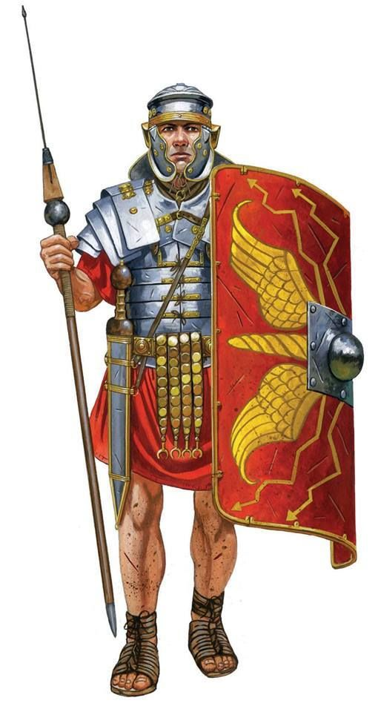
Only let your conduct be worthy of the gospel of Christ, so that whether I come and see you or am absent, I may hear of your affairs, that you stand fast in one spirit, with one mind striving together for the faith of the gospel
Philippians 1:27

Slide 9
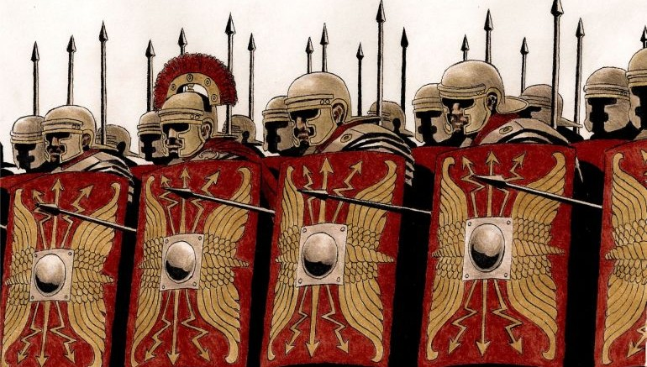
Only let your conduct be worthy of the gospel of Christ, so that whether I come and see you or am absent, I may hear of your affairs, that you stand fast in one spirit, with one mind striving together for the faith of the gospel
Philippians 1:27

Slide 10
And not in any way terrified by your adversaries, which is to them a proof of perdition, but to you of salvation, and that from God.
Philippians 1:28

Slide 11
And not in any way terrified by your adversaries, which is to them a proof of perdition, but to you of salvation, and that from God.
Philippians 1:28

Slide 12
Suffering is a Sign
That we are saved (Rom. 8:16-17).
That our opponents will be destroyed (2 Thess. 1:4-10).
That we are privileged (v. 29; Acts 5:41; 1 Pet. 4:13).
That we are in good company (v. 30; Matt. 5:10-12).

Slide 13
We can rejoice knowing we are doing our best to live a life that pleases God.
Let us rejoice in our unity at Knollwood; but let us also endeavor to protect and maintain this working unity.
“Rejoice in the Lord always, Again I will say, rejoice!”

