Slide 2
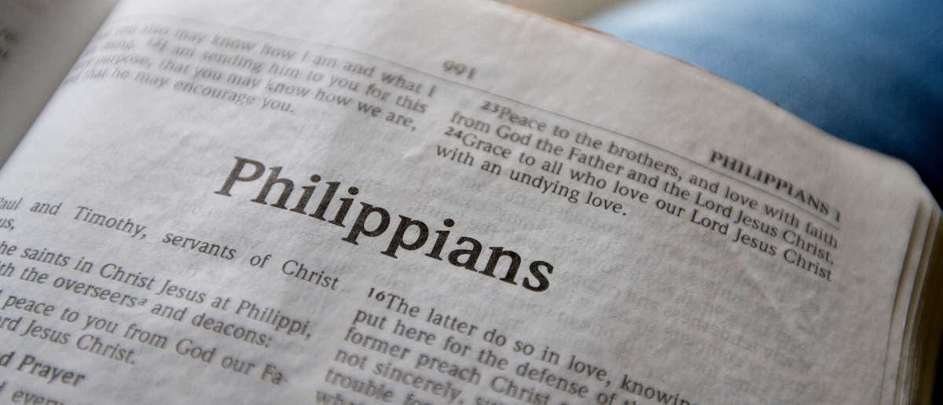
God’s Providence
Philippians 1:12-18

Slide 3
What is Providence?
“The working of God through His provision in the natural and spiritual realms; it is a working control in both which neither violates the sovereignty of the human will nor the divine natural and spiritual laws.”
Homer Hailey, Prayer and Providence, p. 114

Slide 4
I. God Worked Through Paul’s Chains
But I want you to know, brethren, that the things which happened to me have actually turned out for the furtherance of the gospel,
so that it has become evident to the whole palace guard, and to all the rest, that my chains are in Christ;

Slide 5
2. God Worked Through Paul’s Friends
and most of the brethren in the Lord, having become confident by my chains, are much more bold to speak the word without fear.

Slide 6
3. God Worked Through Paul’s Enemies
Some indeed preach Christ even from envy and strife, and some also from goodwill:
The former preach Christ from selfish ambition, not sincerely, supposing to add affliction to my chains;
but the latter out of love, knowing that I am appointed for the defense of the gospel.

Slide 7
Paul Rejoiced in the Providential Spreading of the Gospel
What then? Only that in every way, whether in pretense or in truth, Christ is preached; and in this I rejoice, yes, and will rejoice.
“Rejoice in the Lord always, Again I will say, rejoice!”

