Slide 2
The Anatomy of a Soul Winner
“The fruit of the righteous is a tree of life, and he who wins souls is wise.”
Proverbs 11:30

Slide 3
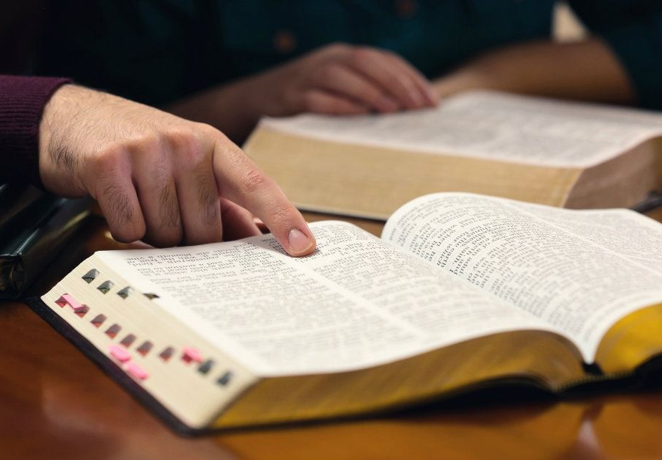
The Anatomy of a Soul Winner
Mind That Understands
Matt. 16:26; Rom. 1:16; Ezek. 33:1-9
Eyes That See
Matt. 9:36-38; John 4:35
Ears That Hear
Acts 8:29-30; 16:9, 30
Feet That Go
Mark 16:15-16
Heart That Cares
2 Kings 7:3-9

