Slide 1
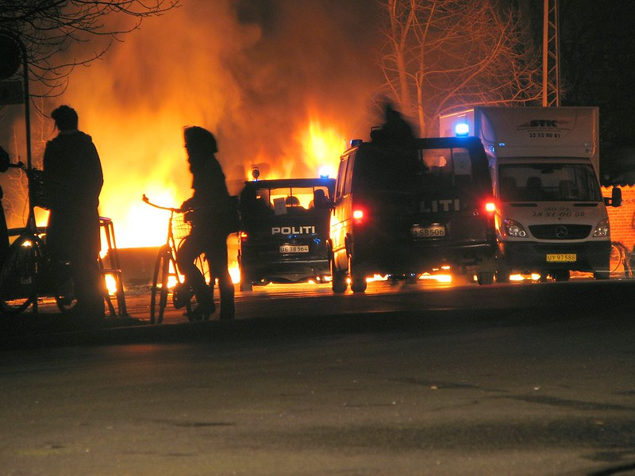
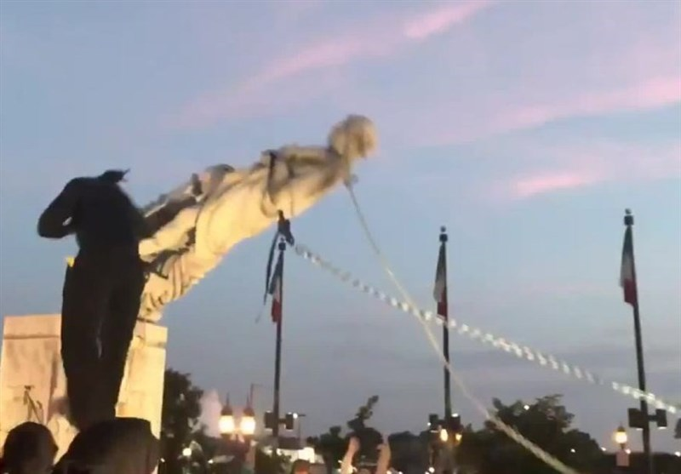
The World is Broken Wisdom from Proverbs & Ecclesiastes
This Photo by Unknown Author is licensed under CC BY-SA

Slide 2
Ecclesiastes 5:15,16
“As he came from his mother's womb, naked shall he return, To go as he came; And he shall take nothing from his labor Which he may carry away in his hand. And this also is a severe evil-Just exactly as he came, so shall he go. And what profit has he who has labored for the wind?”
Sin
Has Reached
Us All

Slide 3
Ecclesiastes 6:1
“There is an evil which I have seen under the sun, and it is common among men.”
Sin
Has Reached
Us All

Slide 4
Ecclesiastes 7:20
“For there is not a just man on earth who does good And does not sin.”
Sin
Has Reached
Us All

Slide 5
Ecclesiastes 7:14
“In the day of prosperity be joyful, But in the day of adversity consider: Surely God has appointed the one as well as the other, So that man can find out nothing that will come after him.”
Sin
Has Reached
Us All

Slide 6
Romans 3:9-11
“What then? Are we better than they? Not at all. For we have previously charged both Jews and Greeks that they are all under sin. As it is written: There is none righteous, no, not one; There is none who understands; There is none who seeks after God.”
Sin
Has Reached
Us All

Slide 7
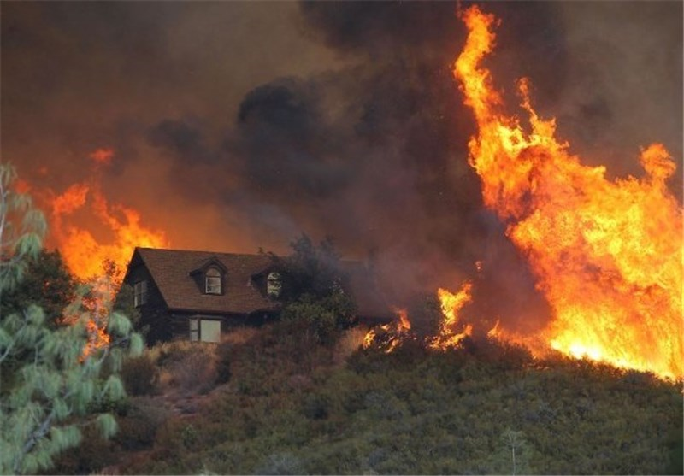
The World is Broken
Bad things happen to good people. Ecclesiastes 8:12-14; cf. Job 25:4-6
Folly often exists in high places. Ecclesiastes 10:5-7

Slide 8
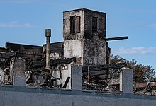
The World is Broken
Oppressive acts are committed, and the innocent have no recourse. Ecclesiastes 4:1
Justice takes too long, so long in fact that it encourages evil. Ecclesiastes 8:11
This Photo by Unknown Author is licensed under CC BY-NC

Slide 9
What Will NOT Provide Satisfaction
No satisfaction in just living. Ecclesiastes 1:2-11
No satisfaction in knowledge. Ecclesiastes 1:12-18; 1 Corinthians 1:18ff Romans 1:20 Acts 17:19-21

Slide 10
What Will NOT Provide Satisfaction
No satisfaction wisdom. Ecclesiastes 2:14-16
No satisfaction found in pleasure
Ecclesiastes 2:1-11; Luke 8:14

Slide 11
What Will NOT Provide Satisfaction
No found in culture or wealth. Ecclesiastes 5:10,19
1 Kings 10:21, 27; Ecclesiastes 6:1,2 1 Kings 8:62

Slide 12
Things That Will Provide Satisfaction
Good friends and good food. Ecclesiastes 2:24-26; 9:7,8 Proverbs 13:25; 20:13; Psalm 37:25
Kind words. Proverbs 10:19,20; 15:1; 18:21 21:23; 25:11; 29:20; 31:26;

Slide 13
Things That Will Provide Satisfaction
Good wife/ husband. Ecclesiastes 9:9 Proverbs 5:15-19; 12:4; 21:9; 22:18; 31:4ff Matthew 19:9; Hebrews 13:4

Slide 14
Things That Will Provide Satisfaction
Live in the present. Ecclesiastes 7:8,9 James 4:13,14; Ephesians 5:16

Slide 15
Things That Will Provide Satisfaction
Doing a good job.
Ecclesiastes 5:12; 9:10; Colossians 3:23
Note: Find another line of work or learn to enjoy the work you do

Slide 16
Things That Will Provide Satisfaction
Accept without complaint that “life is not always fair.”
Ecclesiastes 9:11,12; 3:11; 11:8; Psalm 33:16ff Philippians 4:13

Slide 17
Jesus Came to Provide Abundant Life
“…I have come that they may have life, and that they may have it more abundantly.” (John 10:10)
No real substance to life here. Ecclesiastes 12:13,14
Abundant life is eternal life “in Christ.” 1 John 5:11,12
Love of God makes eternal life “in Christ” possible. 1 John 4:9; John 3:16; 3:36; 5:24

Slide 18
Jesus Came to Provide Abundant Life
Ultimately, the abundant life is “in Christ.”
To be “in Christ” is to be born again. John 3:5
Seed bring forth life.” 1 Corinthians 15:36
Word is the seed of the kingdom- Luke 8:11
Life and immorality brought through the gospel—1 Timothy 1:10
Raised to walk in newness of life—Romans 6:3,4

Slide 19
1 Timothy 4:8
“For bodily exercise profits a little, but godliness is profitable for all things, having promise of the life that now is and of that which is to come.”
The Abundant
Life is
“In Christ”

Slide 20
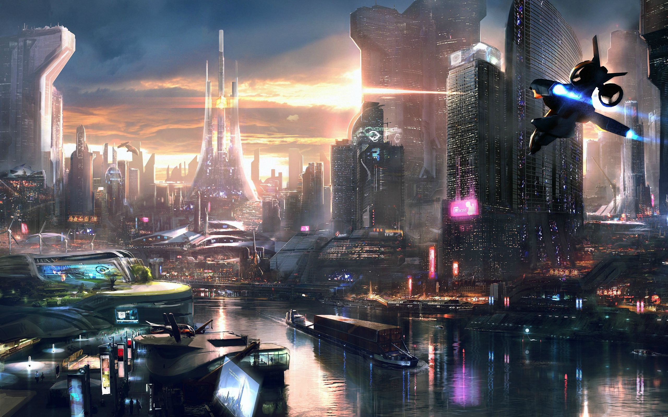
This
World
Is Not My Home
Or
Final
Destination!
This Photo by Unknown Author is licensed under CC BY-SA

