Slide 2
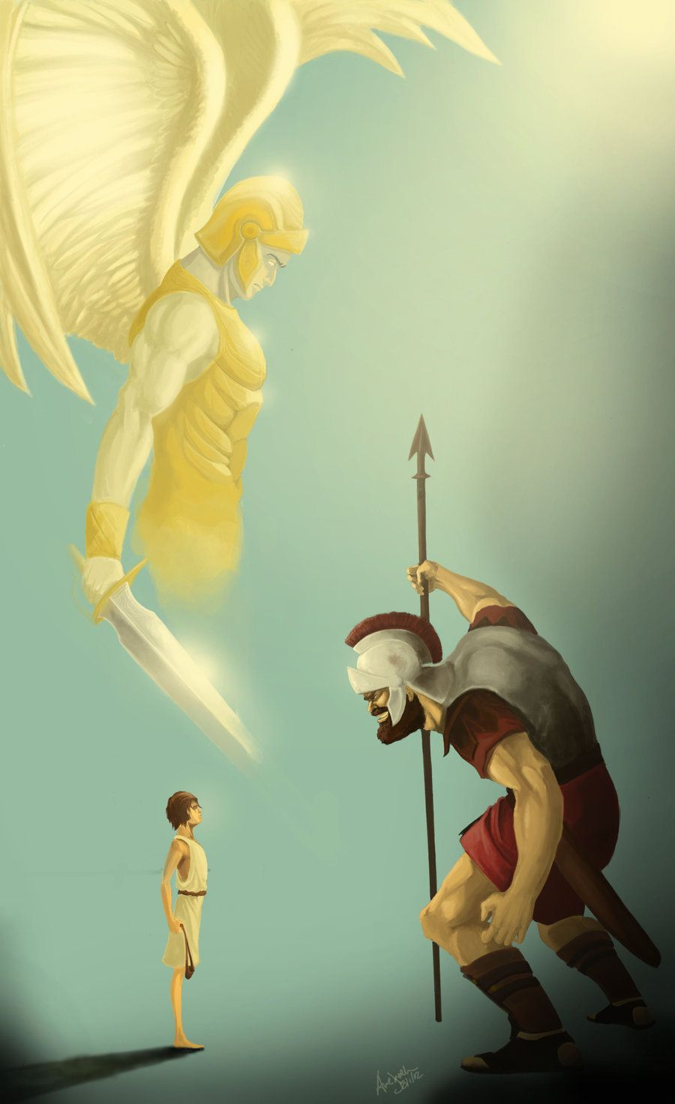
Seeking a Heart Like David’s

Slide 3
Seeking a Heart Like David’s
1. A heart that recognizes the majesty of Almighty God
2. A heart that fully trusts in God
3. A heart that loves God’s Law
4. A heart that loves God’s people
5. A heart that takes responsibility for sin
6. A heart that seeks to do all the will of God

