Slide 2
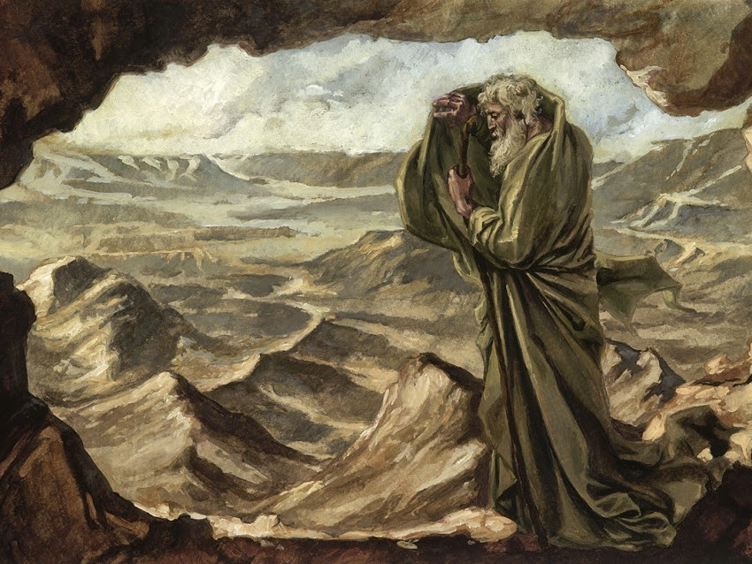
“What Are You Doing Here, Elijah?”
1 Kings 17-19

Slide 3
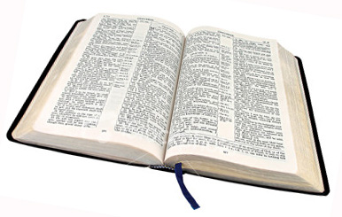
But he himself went a day’s journey into the wilderness, and came and sat down under a broom tree. And he prayed that he might die, and said, “It is enough! Now, Lord, take my life, for I am no better than my fathers!”
1 Kings 19:4

Slide 4
Hard Lessons Elijah Learned
Good Works Often Go Unnoticed By Others
Numbers Don’t Matter To God
God Doesn’t Accept Our Resignation
God Works in the Little Things
We Accomplish More Than We Realize
We Are Not Alone
First Kings 17-19

