Slide 2
The Fullness of Time
“But when the fullness of the time had come, God sent forth His Son…” (Gal. 4:4)

Slide 3
The Prophets Pointed To A Time

Slide 4
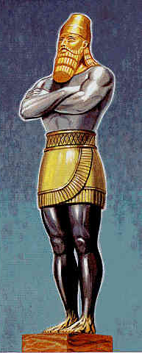
The Prophets Pointed To A Time
“And in the days of these kings the God of heaven will set up a kingdom which shall never be destroyed; and the kingdom shall not be left to other people; it shall break in pieces and consume all these kingdoms, and it shall stand forever.”
Daniel 2:44

Slide 5
The Prophets Pointed To A Time
The Messiah would have a Forerunner: John the Baptist
“The voice of one crying in the wilderness: ‘Prepare the way of the Lord; make straight in the desert a highway for our God’” (Isaiah 40:3).
Was fulfilled in Matthew 3:3.

Slide 6
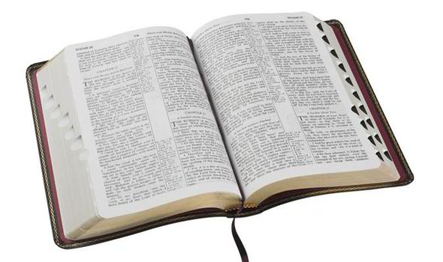
The Prophets Pointed To A Time
The New Testament speaks of the “fulfillment” of the anticipated time.
Mark 1:14-15
Ephesians 1:9-10
Titus 1:2-3

Slide 7
Favorable Conditions of the First Century
Paganism offered no hope (Acts 17:21).
Judaism was a burdensome ritual (Acts 15:10).
There had to be something better!

Slide 8
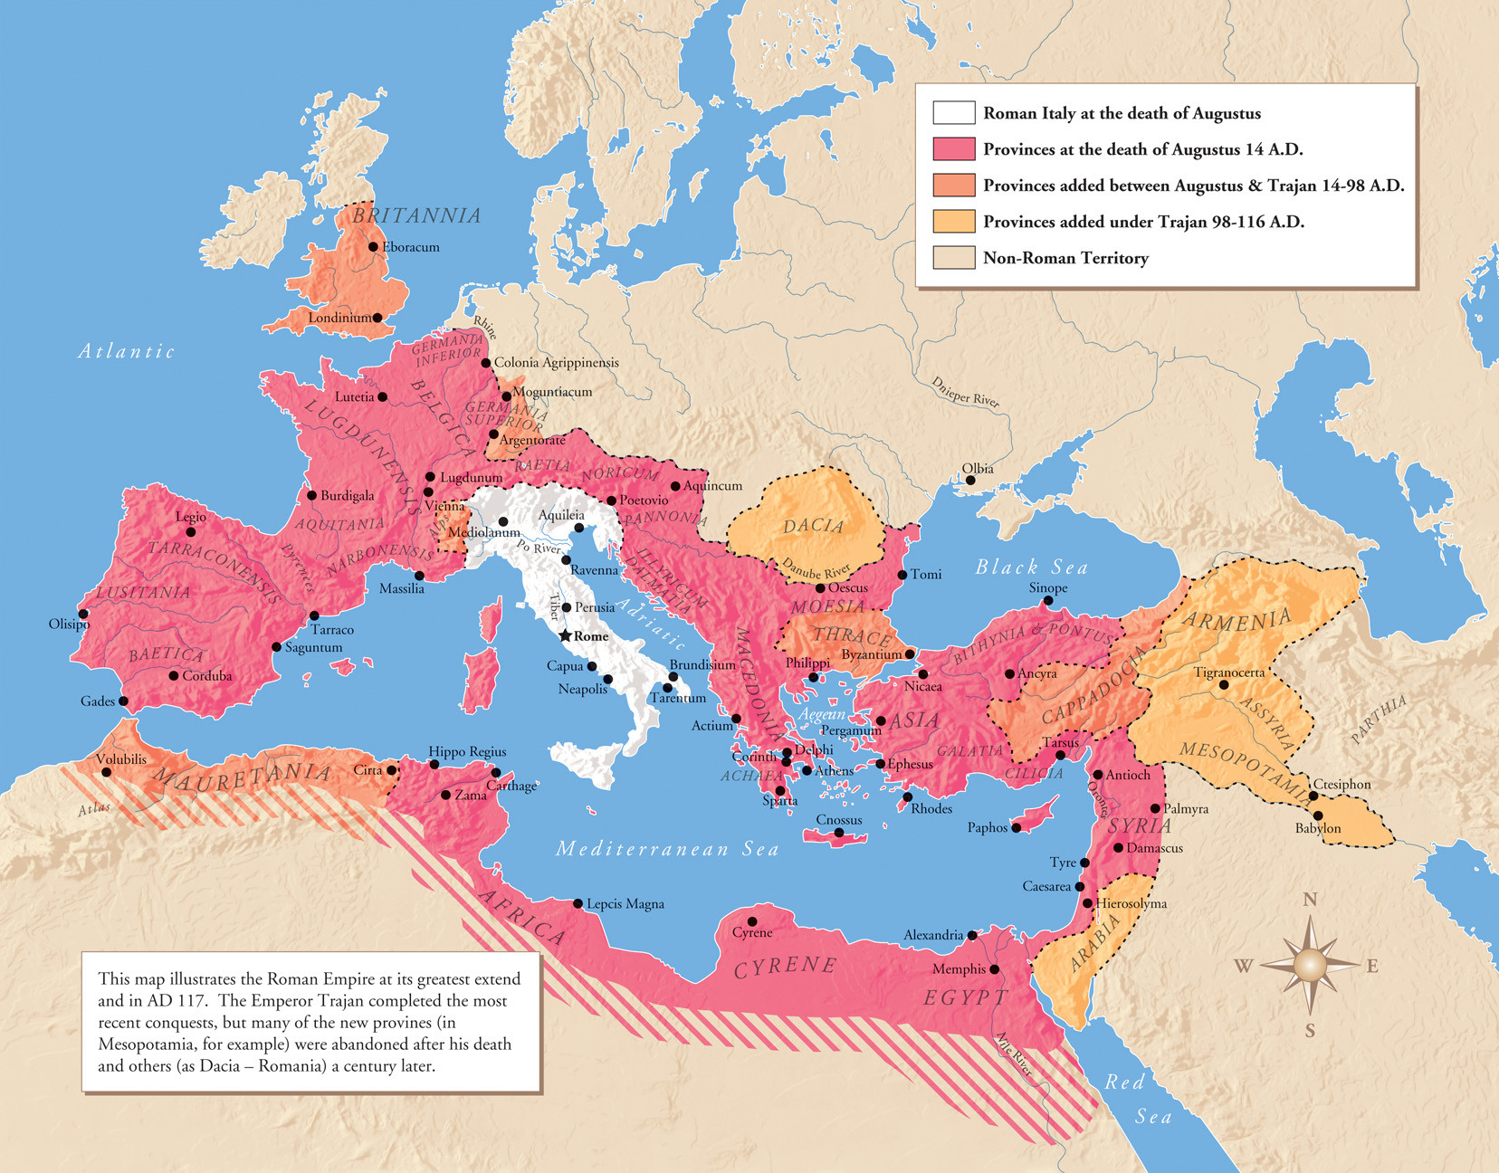
Favorable Conditions of the First Century
The vast extent of the Roman Empire.
The Pax Romana - a period of peace in the world.
One universal language.

Slide 9
Dispersion of the Jews throughout the Roman Empire
There were significant Jewish communities in Egypt, Syria, Asia Minor, Greece, Mesopotamia, and Italy in the First Century.
This dispersion had spread a knowledge of the true and living God and the expectation of a Messiah (Acts 15:21).
The existence of Jewish synagogues throughout the Empire provided ready audiences for the preaching of the gospel (Acts 17:1-2; 13:14-16).

Slide 10
The ease of travel throughout the Roman Empire

Slide 11
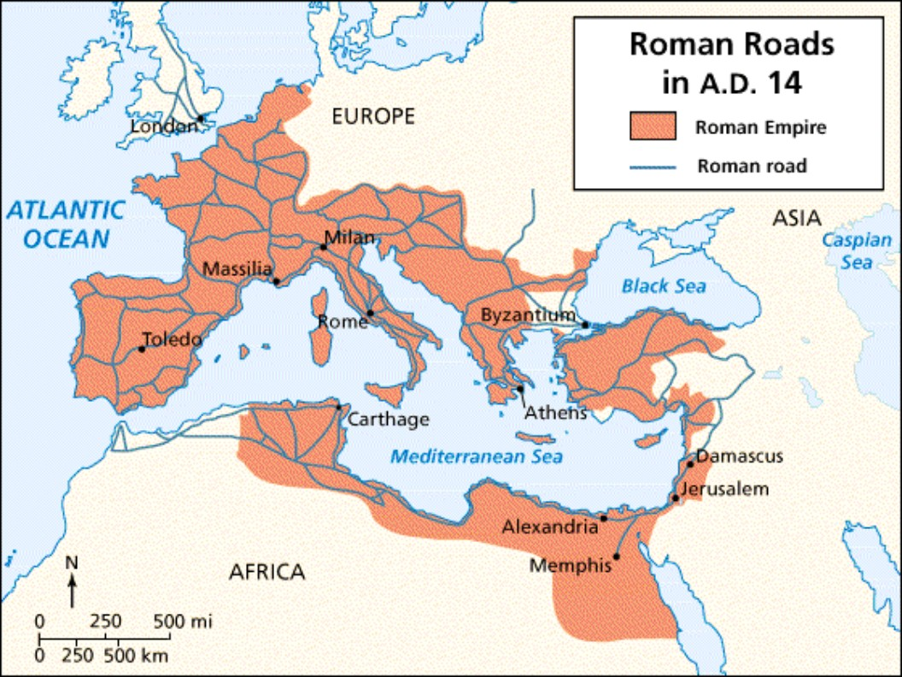

Slide 12
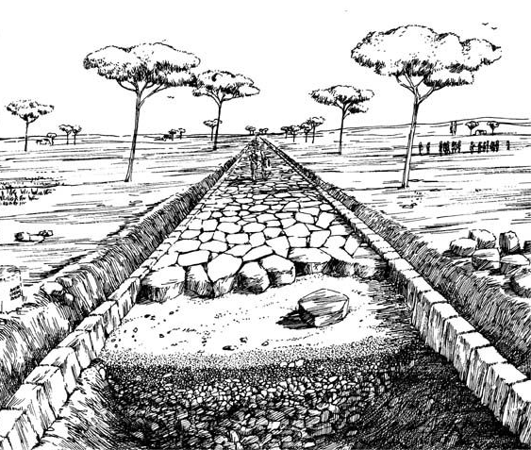
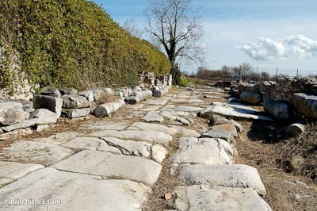
Roman Roads

Slide 13
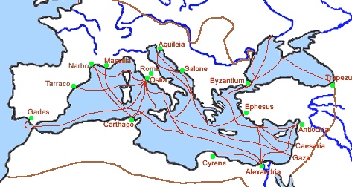
Sea travel throughout the Roman Empire
“The Romans have given the world peace and we travel without fear along the roads and across the sea wherever we will.” Irenaeus of France, 180 A.D.

Slide 14
Favorable Conditions of the First Century
The vast extent of the Roman Empire.
The Pax Romana - a period of peace in the world.
One universal language.
The dispersion of the Jews throughout the Empire.
The ease of travel throughout the Empire.
“But when the fullness of the time had come, God sent forth His Son…” (Gal. 4:4)

