Slide 1
Faces of Faith
Hebrews 12:1
A Righteous Faith
Hebrews 11:1

Slide 2
Faces of Faith
Hebrews 12:1
Righteous…
Morally Upright
Purity of Life
Virtuous Life
Right-Wiseness

Slide 3
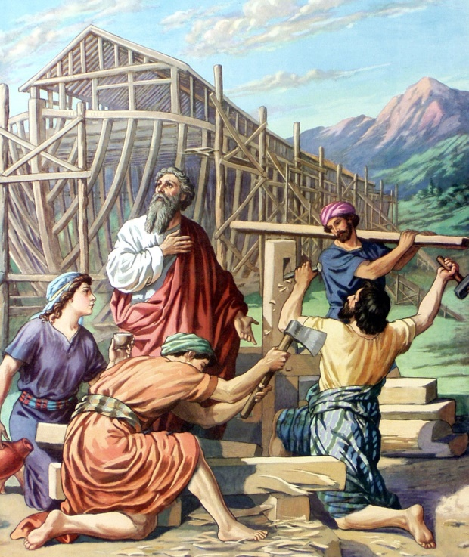
Noah’s Faith
Genesis 6:5-6
Genesis 6:9
Genesis 7:1
2 Peter 2:4-5
Genesis 6:22; 7:5
Hebrews 11:7
A Righteous Faith
Saves

Slide 4
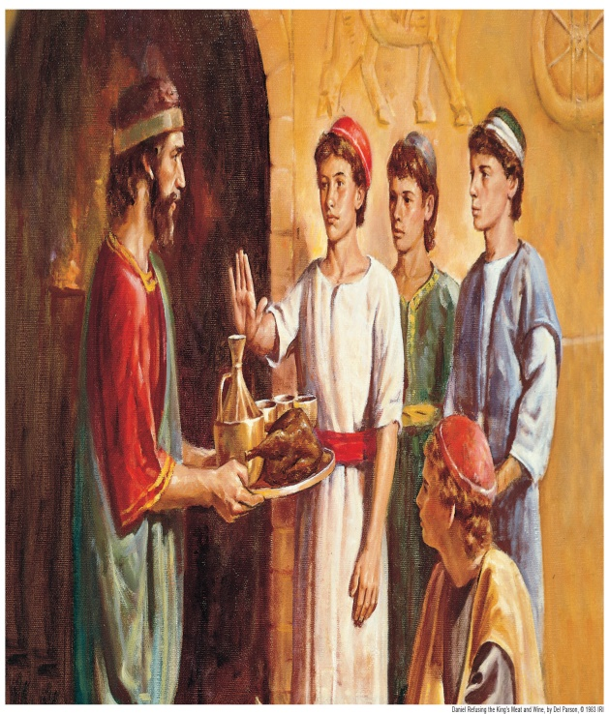
Daniel’s Faith
Daniel 1:4-15
Hebrews 11:33
A Righteous Faith
Purposes in the Heart

Slide 5
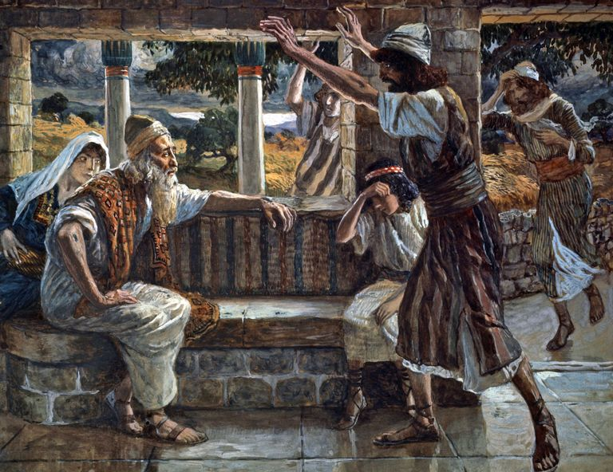
Job’s Faith
James 5:11
Job 1:1, 20-22
James 1:2-4
A Righteous Faith
Endures

Slide 6
Faces of Faith
Hebrews 12:1
A Righteous Faith
Saves
Purposes in the Heart
Endures
Hebrews 11:1

