Slide 2
The Gospel
“For I am not ashamed of the gospel of Christ, for it is the power of God to salvation for everyone who believes, for the Jew first and also for the Greek.”
Romans 1:16

Slide 3
1. The “Good News”
The gospel is good news in that it reveals the fact that salvation is now available to all of mankind.

Slide 4
2. Contains Facts, Commands and Promises
Fact to be believed - Mark 1:15
Commands to be obeyed - Rom. 10:16
Promises to be received - Eph. 3:6

Slide 5
3. The Power of God To Salvation
The gospel is God’s power, not man’s power - Titus 3:5
The gospel is complete in its ability to bring about God’s purpose - Isaiah 55:10-11
The gospel is the power to regenerate spiritual life - 1 Cor. 4:15; James 1:18

Slide 6
4. Universal in its Effectiveness
The gospel has been designed by God to bring about salvation to all mankind, without any regard to one’s gender, race, age, social status, educational background, etc.
Mark 16:15-16

Slide 7
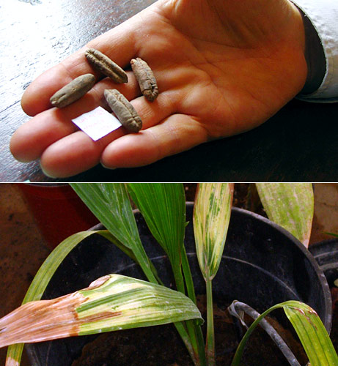
5. The Seed Principle
Luke 8:11; 1 Peter 1:23
A seed will always produce what it is genetically programmed to produce.
The gospel will produce today exactly what it produced 2,000 years ago: Christians.

Slide 8
What Must I Do To Be Saved?
Believe - John 8:24
Repent - Luke 13:3
Confess Our Faith - Matt. 10:32-33
Baptized - Mark 16:16

