Slide 1
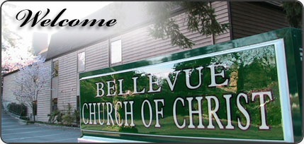
The Social Gospel

Slide 2
What Is It?
The Social Gospel brings in the modern elements of the world and merges it with the Gospel of Christ.
Meals
Food, kitchens for those meals
Recreation
Gyms, ball teams, camps, fun events
Politics
Voting booths, agendas that have nothing to do with truth
Worldly Agendas
Global warming, crisis centers, education, missions = building homes, feeding poor of the world.
Non-spiritual activities
Oil change, CPR classes, Day Care
The Social Gospel

Slide 3
Why is it NOT Biblical?
There is No Authority for it
Col. 3:17; Jn. 4:24; Matt. 21:25; 7:21-23
It is Not a Work of the Church
Eph. 4:12; Lk. 19:10; Matt. 16:18
It Keeps People Worldly
Jn. 6:26; 1 Cor. 11:22, 34; Rom. 8:5-8
The Gospel is the Drawing Power
Jn. 6:44-45; 2 Thess. 2:14; Isa. 55:8-11
The Social Gospel

Slide 4
The Social Gospel History
Wasn’t utilized till about the 1820’s by denominations.
Alleviate Poverty, improved prisons, better hospitals, world peace movement.
In 1850-70’s many denominations were caught up in the debate on slavery and state’s rights.
In the 1920-50’s when institutionalism was being discussed between brethren slowly the liberals brought in the social gospel.
The Social Gospel

Slide 5
The Social Gospel History
Even some institutional brethren fought it.
“Again, I say to you, with caution and thought, that it is not the work of the church to furnish entertainment for the members. I have never read anything in the Bible that indicates to me that such was the work of the church.” (N.B. Hardeman, Hardeman’s Tabernacle Sermons, Vol. 5, p 50)
The Social Gospel

Slide 6
The Social Gospel History
Even some institutional brethren fought it.
“It is not the mission of the church to furnish amusement for the world or even for its own members. Innocent amusement in proper proportion has its place in the life of all normal persons, but it is not the business of the church to furnish it. For the church to turn aside from its divine work to furnish amusement and recreation is to pervert its mission. If the church will discharge its duty in preaching the gospel, in edifying its members, and helping the worthy poor, it will not have the desire or the time merely to amuse and entertain.” (B.C. Goodpasture, Torch, Vol. 1, No. 2, pg 26)
The Social Gospel

Slide 7
Answering The Social Gospel
“Breaking bread” in Ax. 2:46 is a social meal.
Context agrees, but where was it done? Home.
We are to “feed the hungry” (Matt. 25:35)
Context is brethren not churches (v40).
If churches then what of v36?
The Social Gospel

Slide 8
Answering The Social Gospel
Anything the individual can do, the church can do.
1 Tim. 5:16; Matt. 18:15-17 shows that is false.
You believe the building is holy.
No, we believe in using the Lord’s money scripturally which purchased the building.
The Social Gospel

Slide 9
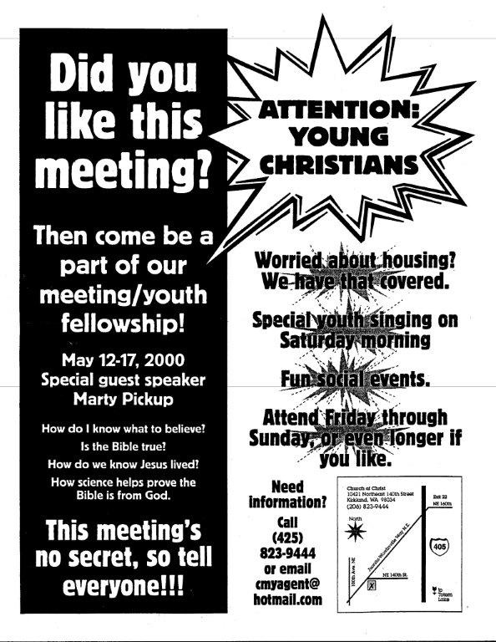
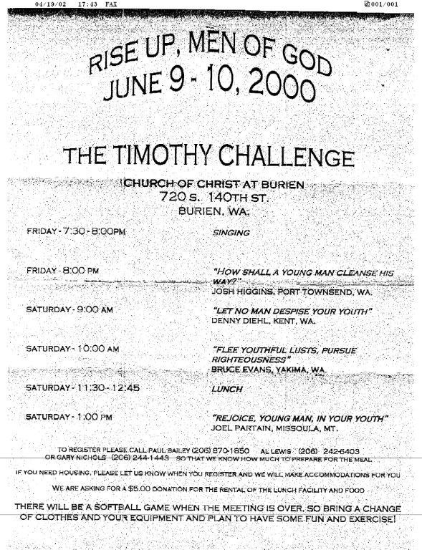
Answering The Social Gospel
Where does the Bible say “Not to”
Col. 3:17; Matt. 28:20; 1 Cor. 11:34
You have water fountains and restrooms
Difference between an aid and addition.
Songbook, collection plate, building = aids
Instrument, food plate, gym = additions
Church sponsored social activities are acceptable if not financed by the church
No, it is not a work of the church period.
The Social Gospel

Slide 10
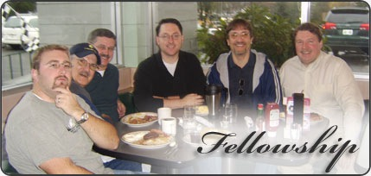
Answering The Social Gospel
You don’t believe in “fellowship”
2 Cor. 6:14-16; 1 Cor. 10:16-17; 1 Jn. 1:3, 5-7
Fellowship is not used in the bible to reference a social meal or recreation.
If so one could never eat with a non Christian – Eph. 5:11
If it is a social meal then how can one have this with God? – 1 Cor. 1:9
Bible fellowship speaks of spiritual approval and joint participation in scriptural and spiritual work.
The Social Gospel

Slide 11
The Root of the Problem
A Self-serving Religion
These things please people not God.
The Social Gospel

Slide 12
What We Learned
The Social Gospel is not authorized.
The Social Gospel came from denominations.
We must keep the church Christ’s by practicing simple New Testament Christianity.
We must support the saving gospel and not the social gospel.
The Social Gospel

Slide 13
Obey the Gospel of Jesus
Hear
“Faith comes by hearing” (Rom. 10:17)
Believe
“Believe on the Lord Jesus” (Ax. 17:31)
Repent
“Repent or perish” (Lk. 13:3)
Confess
“Confess with your mouth the Lord Jesus” (Rom. 10:9)
Baptized
“Baptism now saves us” (1 Pet. 3:21)
Remain Faithful
“He who endures to the end will be saved” (Matt. 10:22)
The Social Gospel

