Slide 1
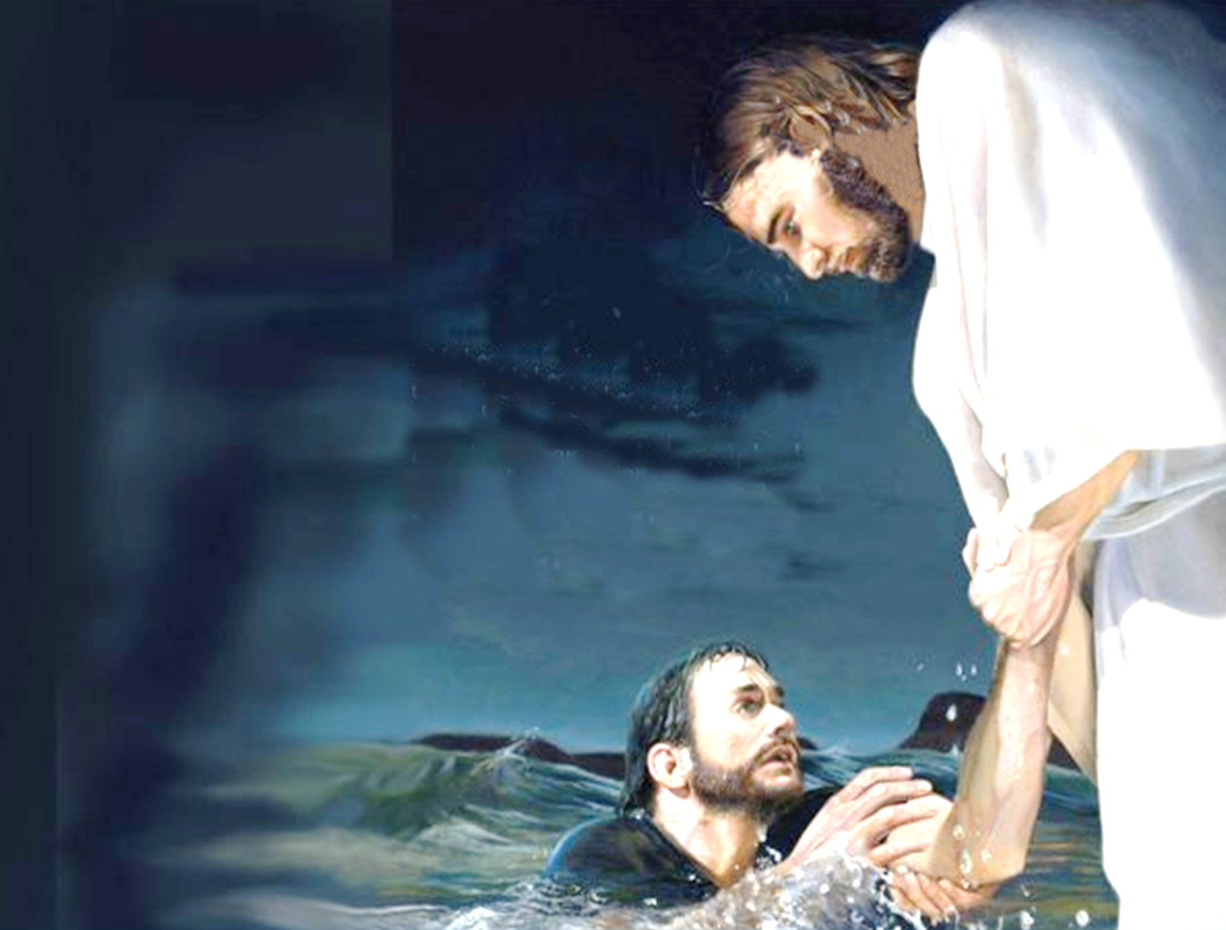
Can You Walk on Water?
Matthew 14:22-33
Notes:
Title Slide: Can You Walk on Water? (Matt.14:22-33)
PETER.
A. He was among the first disciples of Jesus.
B. He was chosen as one of the twelve, and belonged to the "inner circle" of three: Peter, James, John.
a. He is always listed first of the twelve.
b. He was (like James and John) "named" by Jesus.
C. The first....
a. To confess his faith in Jesus.
b. To see the Lord after his resurrection.
c. To preach the gospel to the gentiles.
INCIDENTS HIGHLIGHTING WEAKNESSES
1. When the Lord told him, "Get thee behind me Satan." Mk 8:33
2. His bumbling remarks at the transfiguration. Mk 9:5
3. In the garden, when he fell asleep. Mk 14:37
4. When he fled from the Lord with the others, and then denied the Lord three times.
5. When he drew back from eating with the Gentiles at Antioch. Gal 2:10ff
Peter himself said on one occasion, "Depart from me, for I am a sinful man, O Lord."
Satan went after Peter (Lk 22:31) and had some success with him.

Slide 2
Can You Walk On Water?
Matthew 14:22-24
“Immediately Jesus made His disciples get into the boat and go before Him to the other side, while He sent the multitudes away. And when He had sent the multitudes away, He went up on the mountain by Himself to pray. Now when evening came, He was alone there. But the boat was now in the middle of the sea, tossed by the waves, for the wind was contrary.”
Notes:
Text: Matt.14:22-24…
Jesus is our Mediator –
Storms come in life –
Jesus is always there!
We can overcome and walk above these trials with the Lord’s power –
The Lord is there to help us when we stumble!

Slide 3
Can You Walk On Water?
Matthew 14:25-27
“Now in the fourth watch of the night Jesus went to them, walking on the sea. And when the disciples saw Him walking on the sea, they were troubled, saying, "It is a ghost!" And they cried out for fear. But immediately Jesus spoke to them, saying, "Be of good cheer! It is I; do not be afraid.”
Notes:
Text: Matt.14:25-27…
Jesus is our Mediator –
Storms come in life –
Jesus is always there!
We can overcome and walk above these trials with the Lord’s power –
The Lord is there to help us when we stumble!

Slide 4
Can You Walk On Water?
Matthew 14:28-30
“And Peter answered Him and said, "Lord, if it is You, command me to come to You on the water.“ So He said, "Come." And when Peter had come down out of the boat, he walked on the water to go to Jesus. But when he saw that the wind was boisterous, he was afraid; and beginning to sink he cried out, saying, "Lord, save me!”
Notes:
Text: Matt.14:28-30…
Jesus is our Mediator –
Storms come in life –
Jesus is always there!
We can overcome and walk above these trials with the Lord’s power –
The Lord is there to help us when we stumble!

Slide 5
Can You Walk On Water?
Matthew 14:31-33
“And immediately Jesus stretched out His hand and caught him, and said to him, "O you of little faith, why did you doubt? And when they got into the boat, the wind ceased. Then those who were in the boat came and worshiped Him, saying, "Truly You are the Son of God.”
Notes:
Text: Matt.14:31-33…
Jesus is our Mediator –
Storms come in life –
Jesus is always there!
We can overcome and walk above these trials with the Lord’s power –
The Lord is there to help us when we stumble!

Slide 6
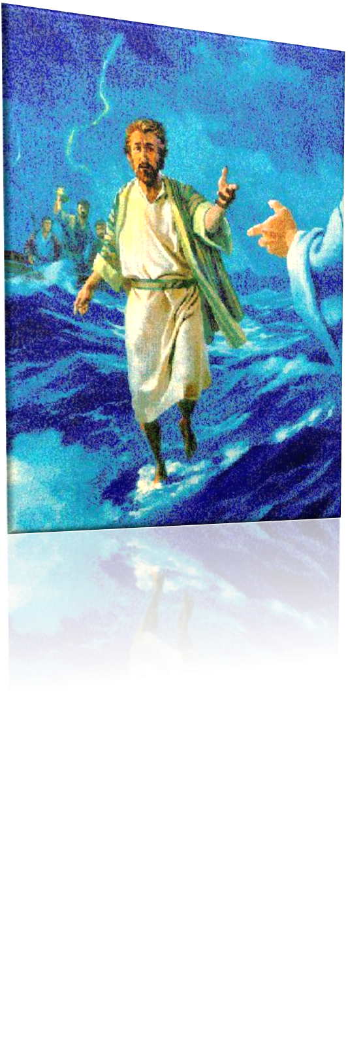
Can You Walk on Water?
“So He said, "Come." And when Peter had come down out of the boat, he walked on the water to go to Jesus.” Matthew 14:29
Notes:
Text—Matthew 14:29…Peter commanded to join the Lord on the water…

Slide 7
Can You Walk on Water?
Literally – NO – because the command was to Peter and NOT TO US!
Figuratively – YES – We can accomplish anything Jesus has Commanded us to do!
Notes:
Question is asked to each of us—does it apply? Literally?...Figuratively?...

Slide 8
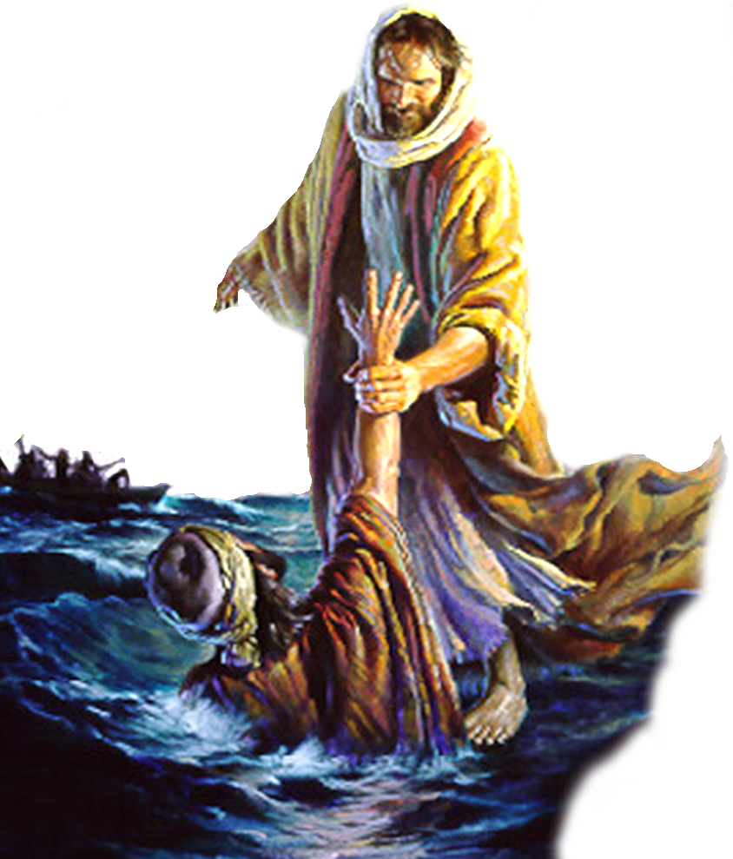
Why Did Peter Begin To Sink?
Not Because
He Lacked Faith In Jesus’ Power! – (28)
He Lacked Interest & Effort – (28)
He Acted Presumptuously – (28,29)
The Instructions Of The Lord “COULD NOT” Be Carried Out – (29)
Notes:
Not Because:
1. He Lacked Faith In Jesus’ Power! – (28) “If it be thou . . .”
He knew that Jesus could enable him to walk on the water . . .
This is an expression of faith!
2. He Lacked Interest & Effort – (28) - “Bid me to come to thee . . . “
He wanted to demonstrate his faith – (Peter was often quick to offer evidence of his devotion to Jesus)
Many fail in there service to the Lord simply because they truly do not DESIRE to serve Him – (Matthew 15:7-9; Hebrews 11:6)
3. He Acted Presumptuously – (28,29) "Lord, if it is You, command me to come to You on the water." [29] So He said, "Come." And when Peter had come down out of the boat,
He knew better to than to step out of the boat without the Lord’s permission -
Jeremiah 10:23 (KJV) O Lord, I know that the way of man is not in himself: it is not in man that walketh to direct his steps.
Psalm 17:5 (NKJV) Uphold my steps in Your paths, That my footsteps may not slip.
Psalm 37:23 (NKJV) The steps of a good man are ordered by the Lord, And He delights in his way.
Proverbs 14:12 (NKJV) There is a way that seems right to a man, But its end is the way of death.
4. The Instructions of the Lord “COULD NOT” Be Carried Out – (29) – “. . . he walked on the water to go to Jesus.”
Peter knew that if the Lord said “Do it” it could be done! “I can do all things through Christ who strengthens me.” Philip. 4:13

Slide 9
Why Did Peter Begin To Sink?
Took His Eyes off Jesus (30)
“But when he saw that the wind was boisterous.”
He was distracted by the storm–he began to notice what was going on around him instead of focusing on Jesus…
Distraction is a tool often used by Satan…
Notes:
But Rather Because:
A. He was distracted by the storm – (28) “But when he saw . . .”
1. A tactic successfully used by the devil to lure people into sin and ineffectiveness is that of “distraction!”
2. We can easily be distracted from our service to the Lord by:
a. Being anxious, or overly concerned for our material needs and desires - Matthew 6:25
b. The hardships we have been called to endure - Matthew 13:20-21
c. Allowing material things to consume our time and efforts – Matthew 13:22
d. Other People –
Parents – Matt . 10:37 He who loves father or mother more than Me is not worthy of Me. And he who loves son or daughter more than Me is not worthy of Me.
Children – Matt. 10:37
Peers – John 12:42,43 - Nevertheless even among the rulers many believed in Him, but because of the Pharisees they did not confess Him, lest they should be put out of the synagogue; [43] for they loved the praise of men more than the praise of God.
Friends – 1 Cor. 15:33 --Do not be deceived: "Evil company corrupts good habits."
No matter how bad things appear to be we MUST REMEMBER – “all things work together for good to them that love God, to them who are the called according to his purpose.” Romans 8:28
Betrayal by a close friend – Job
Persecution by enemies – Job
Lying tongues which hurt you – Job
Financial backsets – Job
Accident to yourself or loved one – Job
Loss of health – Job
A double minded man is unstable in all his ways – James 1:8
James in the context tells us that we can use these obstacles to strengthen our faith!!! (1-5, 12)

Slide 10
Why Did Peter Begin To Sink?
Take Our Eyes off Jesus!
We can easily be distracted by:
Being anxious or overly concerned for our material needs (Matthew 6:19-33)
The hardships we have been called to endure (Matthew 13:20-21)
Notes:
But Rather Because:
A. He was distracted by the storm – (28) “But when he saw . . .”
1. A tactic successfully used by the devil to lure people into sin and ineffectiveness is that of “distraction!”
2. We can easily be distracted from our service to the Lord by:
a. Being anxious, or overly concerned for our material needs and desires - Matthew 6:25
b. The hardships we have been called to endure - Matthew 13:20-21
c. Allowing material things to consume our time and efforts – Matthew 13:22
d. Other People –
Parents – Matt . 10:37 He who loves father or mother more than Me is not worthy of Me. And he who loves son or daughter more than Me is not worthy of Me.
Children – Matt. 10:37
Peers – John 12:42,43 - Nevertheless even among the rulers many believed in Him, but because of the Pharisees they did not confess Him, lest they should be put out of the synagogue; [43] for they loved the praise of men more than the praise of God.
Friends – 1 Cor. 15:33 --Do not be deceived: "Evil company corrupts good habits."
No matter how bad things appear to be we MUST REMEMBER – “all things work together for good to them that love God, to them who are the called according to his purpose.” Romans 8:28
Betrayal by a close friend – Job
Persecution by enemies – Job
Lying tongues which hurt you – Job
Financial backsets – Job
Accident to yourself or loved one – Job
Loss of health – Job
A double minded man is unstable in all his ways – James 1:8
James in the context tells us that we can use these obstacles to strengthen our faith!!! (1-5, 12)

Slide 11
Why Did Peter Begin To Sink?
Take Our Eyes off Jesus!
We can easily be distracted by:
Allowing material things to consume our time and effort (Matthew 13:22)
Temptations (Genesis 3:1-6)
Problems (Numbers 13:28-33)
Notes:
But Rather Because:
A. He was distracted by the storm – (28) “But when he saw . . .”
1. A tactic successfully used by the devil to lure people into sin and ineffectiveness is that of “distraction!”
2. We can easily be distracted from our service to the Lord by:
a. Being anxious, or overly concerned for our material needs and desires - Matthew 6:25
b. The hardships we have been called to endure - Matthew 13:20-21
c. Allowing material things to consume our time and efforts – Matthew 13:22
d. Other People –
Parents – Matt . 10:37 He who loves father or mother more than Me is not worthy of Me. And he who loves son or daughter more than Me is not worthy of Me.
Children – Matt. 10:37
Peers – John 12:42,43 - Nevertheless even among the rulers many believed in Him, but because of the Pharisees they did not confess Him, lest they should be put out of the synagogue; [43] for they loved the praise of men more than the praise of God.
Friends – 1 Cor. 15:33 --Do not be deceived: "Evil company corrupts good habits."
No matter how bad things appear to be we MUST REMEMBER – “all things work together for good to them that love God, to them who are the called according to his purpose.” Romans 8:28
Betrayal by a close friend – Job
Persecution by enemies – Job
Lying tongues which hurt you – Job
Financial backsets – Job
Accident to yourself or loved one – Job
Loss of health – Job
A double minded man is unstable in all his ways – James 1:8
James in the context tells us that we can use these obstacles to strengthen our faith!!! (1-5, 12)

Slide 12
Why Did Peter Begin To Sink?
Take Our Eyes off Jesus!
We can easily be distracted by:
Our past- (Philippians 3:13,14)
Our work- (Ephesians 4:28)
Our Burdens- (Hebrews 10:35-39)
Notes:
But Rather Because:
A. He was distracted by the storm – (28) “But when he saw . . .”
1. A tactic successfully used by the devil to lure people into sin and ineffectiveness is that of “distraction!”
2. We can easily be distracted from our service to the Lord by:
a. Being anxious, or overly concerned for our material needs and desires - Matthew 6:25
b. The hardships we have been called to endure - Matthew 13:20-21
c. Allowing material things to consume our time and efforts – Matthew 13:22
d. Other People –
Parents – Matt . 10:37 He who loves father or mother more than Me is not worthy of Me. And he who loves son or daughter more than Me is not worthy of Me.
Children – Matt. 10:37
Peers – John 12:42,43 - Nevertheless even among the rulers many believed in Him, but because of the Pharisees they did not confess Him, lest they should be put out of the synagogue; [43] for they loved the praise of men more than the praise of God.
Friends – 1 Cor. 15:33 --Do not be deceived: "Evil company corrupts good habits."
No matter how bad things appear to be we MUST REMEMBER – “all things work together for good to them that love God, to them who are the called according to his purpose.” Romans 8:28
Betrayal by a close friend – Job
Persecution by enemies – Job
Lying tongues which hurt you – Job
Financial backsets – Job
Accident to yourself or loved one – Job
Loss of health – Job
A double minded man is unstable in all his ways – James 1:8
James in the context tells us that we can use these obstacles to strengthen our faith!!! (1-5, 12)

Slide 13
Why Did Peter Begin To Sink?
Take Our Eyes off Jesus!
We can easily be distracted by:
Relationships- (1 Corinthians 15:33)
False teachers- (Ephesians 4:14)
Notes:
But Rather Because:
A. He was distracted by the storm – (28) “But when he saw . . .”
1. A tactic successfully used by the devil to lure people into sin and ineffectiveness is that of “distraction!”
2. We can easily be distracted from our service to the Lord by:
a. Being anxious, or overly concerned for our material needs and desires - Matthew 6:25
b. The hardships we have been called to endure - Matthew 13:20-21
c. Allowing material things to consume our time and efforts – Matthew 13:22
d. Other People –
Parents – Matt . 10:37 He who loves father or mother more than Me is not worthy of Me. And he who loves son or daughter more than Me is not worthy of Me.
Children – Matt. 10:37
Peers – John 12:42,43 - Nevertheless even among the rulers many believed in Him, but because of the Pharisees they did not confess Him, lest they should be put out of the synagogue; [43] for they loved the praise of men more than the praise of God.
Friends – 1 Cor. 15:33 --Do not be deceived: "Evil company corrupts good habits."
No matter how bad things appear to be we MUST REMEMBER – “all things work together for good to them that love God, to them who are the called according to his purpose.” Romans 8:28
Betrayal by a close friend – Job
Persecution by enemies – Job
Lying tongues which hurt you – Job
Financial backsets – Job
Accident to yourself or loved one – Job
Loss of health – Job
A double minded man is unstable in all his ways – James 1:8
James in the context tells us that we can use these obstacles to strengthen our faith!!! (1-5, 12)

Slide 14
We Do Not Have To Sink!
Hebrews 12:2,3
We Need to Keep Our
Mind on Jesus!!
“Looking unto Jesus, the author and finisher of our faith, who for the joy that was set before Him endured the cross, despising the shame, and has sat down at the right hand of the throne of God. For consider Him who endured such hostility from sinners against Himself, lest you become weary and discouraged in your souls.”
Notes:
But Rather Because:
A. He was distracted by the storm – (28) “But when he saw . . .”
1. A tactic successfully used by the devil to lure people into sin and ineffectiveness is that of “distraction!”
2. We can easily be distracted from our service to the Lord by:
a. Being anxious, or overly concerned for our material needs and desires - Matthew 6:25
b. The hardships we have been called to endure - Matthew 13:20-21
c. Allowing material things to consume our time and efforts – Matthew 13:22
d. Other People –
Parents – Matt . 10:37 He who loves father or mother more than Me is not worthy of Me. And he who loves son or daughter more than Me is not worthy of Me.
Children – Matt. 10:37
Peers – John 12:42,43 - Nevertheless even among the rulers many believed in Him, but because of the Pharisees they did not confess Him, lest they should be put out of the synagogue; [43] for they loved the praise of men more than the praise of God.
Friends – 1 Cor. 15:33 --Do not be deceived: "Evil company corrupts good habits."
No matter how bad things appear to be we MUST REMEMBER – “all things work together for good to them that love God, to them who are the called according to his purpose.” Romans 8:28
Betrayal by a close friend – Job
Persecution by enemies – Job
Lying tongues which hurt you – Job
Financial backsets – Job
Accident to yourself or loved one – Job
Loss of health – Job
A double minded man is unstable in all his ways – James 1:8
James in the context tells us that we can use these obstacles to strengthen our faith!!! (1-5, 12)

Slide 15
We Do Not Need To Sink
We Need to Keep Our
Mind On Jesus!
Upon our Lord Jesus Christ- (1 Peter 2:21; Hebrews 2:9-18; 12:1-3)
Upon the words of Christ- (Luke 21:33; Matthew 28:18,19; James 1:25; John 12:48)
Notes:
We Need to Keep Our Mind On Jesus!
(1) Upon our Lord Jesus Christ- (1 Peter 2:21; Hebrews 2:9-18; 12:1-3)
(2) Upon the words of Christ- (Luke 21:33; Matthew 28:18,19; James 1:25; John 12:48)

Slide 16
We Do Not Need To Sink
We Need to Keep Our
Mind On Jesus!
Upon Our Blessings (Ephesians 1:3; Philippians 4:4-13)
Upon God’s Promises (Acts 2:38; 1 John 1:9; 2 Corinthians 4:16-18)
Notes:
We Need to Keep Our Mind On Jesus!
(1) Upon Our Blessings- (Ephesians 1:3; Philippians 4:4-13)
(2) Upon God’s Promises (Acts 2:38; 1 John 1:9; 2 Corinthians 4:16-18)
(2)

Slide 17
Why Did Peter Begin To Sink?
Fear Overpowered Peter’s Faith (30)
“But when he saw that the wind was boisterous.”
What seemed so sure to Peter “INSIDE” the boat became a frightening experience “OUTSIDE” the boat!
Notes:
But Rather Because:
A. He was distracted by the storm – (28) “But when he saw . . .”
1. A tactic successfully used by the devil to lure people into sin and ineffectiveness is that of “distraction!”
2. We can easily be distracted from our service to the Lord by:
a. Being anxious, or overly concerned for our material needs and desires - Matthew 6:25
b. The hardships we have been called to endure - Matthew 13:20-21
c. Allowing material things to consume our time and efforts – Matthew 13:22
d. Other People –
Parents – Matt . 10:37 He who loves father or mother more than Me is not worthy of Me. And he who loves son or daughter more than Me is not worthy of Me.
Children – Matt. 10:37
Peers – John 12:42,43 - Nevertheless even among the rulers many believed in Him, but because of the Pharisees they did not confess Him, lest they should be put out of the synagogue; [43] for they loved the praise of men more than the praise of God.
Friends – 1 Cor. 15:33 --Do not be deceived: "Evil company corrupts good habits."
No matter how bad things appear to be we MUST REMEMBER – “all things work together for good to them that love God, to them who are the called according to his purpose.” Romans 8:28
Betrayal by a close friend – Job
Persecution by enemies – Job
Lying tongues which hurt you – Job
Financial backsets – Job
Accident to yourself or loved one – Job
Loss of health – Job
A double minded man is unstable in all his ways – James 1:8
James in the context tells us that we can use these obstacles to strengthen our faith!!! (1-5, 12)

Slide 18
Why Did Peter Begin To Sink?
Fear Overpowered Peter’s Faith (30)
“But when he saw that the wind was boisterous.”
When buffeted by the gale he began to doubt and then panicked-
Fear gripped Peter again-- Matthew 26:33, 69-75; Galatians 2:11,12
Notes:
Fear Overpowered Peter’s Faith (30):
(1) When buffeted by the gale he began to doubt and then panicked-
(2) Fear would gripped Peter again--Matthew 26:33, 69-75 (denial of the Lord) ; Galatians 2:11,12(eating w/Gentiles)

Slide 19
Why Do We Begin To Sink?
Our Faith Can be Overpowered by Fear
Faith is easier professed than practiced- (James 2:14-20)
Fear is the direct result of doubt- (Matthew 14:31; James 1:6-8)
Notes:
Our Faith Can Be Overpowered by Fear!
(1) Faith is easier professed than practiced-(James 2:14-20)
(2) Fear is the direct result of doubt- (Matthew 14:31;James 1:6-8)

Slide 20
Why Do We Begin To Sink?
Our Faith Can be Overpowered by Fear
Do Not Let Fear Destroy Your Faith – Revelation 2:10; 21:8
Faith needs to be strengthened – Luke 17:5; Hebrews 12:12; 13:5,6; Romans 10:17
Notes:
Our Faith Can Be Overpowered by Fear!
(1) Do Not Let Fear Destroy Your Faith – Rev. 2:10; 21:8
(2) Faith needs strengthened – Luke 17:5; Heb. 12:12; 13:5,6; Rom. 10:17
Fear is a manifestation of a weak faith -
Matthew 10:28,31 (NKJV) And do not fear those who kill the body but cannot kill the soul. But rather fear Him who is able to destroy both soul and body in hell. . . .[31] Do not fear therefore; you are of more value than many sparrows.
Hebrews 13:5-6 (NKJV) Let your conduct be without covetousness; be content with such things as you have. For He Himself has said, "I will never leave you nor forsake you." [6] So we may boldly say: "The Lord is my helper; I will not fear. What can man do to me?"
We should desire that the Lord strengthen our faith
Luke 17:5 And the apostles said to the Lord, "Increase our faith."
Our love for God and His children “Casts out fear!”
1 John 4:18 (NKJV) There is no fear in love; but perfect love casts out fear, because fear involves torment. But he who fears has not been made perfect in love.
Context:
3:24 Now he who keeps His commandments abides in Him, and He in him. And by this we know that He abides in us, by the Spirit whom He has given us.
4:4 You are of God, little children, and have overcome them, because He who is in you is greater than he who is in the world.
4:7 Beloved, let us love one another, for love is of God; and everyone who loves is born of God and knows God.
4:17-18 Love has been perfected among us in this: that we may have boldness in the day of judgment; because as He is, so are we in this world. [18] There is no fear in love; but perfect love casts out fear, because fear involves torment. But he who fears has not been made perfect in love.
Do NOT let fear destroy your faith!!
Rev. 2:10 (NKJV) Do not fear any of those things which you are about to suffer. Indeed, the devil is about to throw some of you into prison, that you may be tested, and you will have tribulation ten days. Be faithful until death, and I will give you the crown of life.
Rev. 21:8 (NKJV) But the cowardly, unbelieving, abominable, murderers, sexually immoral, sorcerers, idolaters, and all liars shall have their part in the lake which burns with fire and brimstone, which is the second death."
(2) Fear is the direct result of doubt- (Matthew 14:31;James 1:6-8)

Slide 21
Why Did Peter Begin To Sink?
BECAUSE…
He Was Distracted By The Storm And Took His Eyes Off Jesus – (30)
He Doubted What He Could Do With The Lord and Feared – (30)
When His Faith Sank, He sank -(30)
Notes:
Because…Review of facts…

Slide 22
Can You Walk on Water?
Peter…
Had the faith to get out of the boat (29)
Walked on Water (29)
Began to Sink (30)
Cried out “Lord save me!” (30)
Jesus SAVED HIM! (32)
Notes:
Peter…Review of facts…

Slide 23
Can You Walk on Water?
Signs That You May Be Beginning to Sink
A loosening of morals
A creeping disinterest in worship and associating w/ other Christians
Backsliding into practices you confessed were wrong
Good news: If we are slipping there is a way to fix it
Notes:
Concluding Thoughts and Admonitions

Slide 24
Can You Walk on Water?
Unsinkable faith requires a single mind! Matthew 6:22,23
It is a challenge to serve the Lord! – Mathew 7:13,14
Notes:
Doubt – distazo – lit. “to be divided” –
Faith requires a single mind!
Peter allowed his attention to be diverted –
To the storm –
Away from Jesus
Producing fear –
Weakening – or mixing his faith with doubt!
Causing him to sink!
It is a challenge to serve the Lord! –
Mat. 7:13,14 “Strait is the gate and narrow is the way . . .”
It takes courage to serve Him!!
Ephesians 6:10 ¶ Finally, my brethren, be strong in the Lord and in the power of His might.
Serving the Lord CAN be done! –
No mountain can stand before our faith IF it is what it ought to be! –
Matthew 21:21 (KJV) Jesus answered and said unto them, Verily I say unto you, If ye have faith, and doubt not, ye shall not only do this which is done to the fig tree, but also if ye shall say unto this mountain, Be thou removed, and be thou cast into the sea; it shall be done.
Mark 9:23 (KJV) Jesus said unto him, If thou canst believe, all things are possible to him that believeth.
But . . . If we find ourselves sinking . . . WHY DROWN?????
Maybe you are in the ocean of sin because you’ve never obeyed the gospel – know this – you don’t have to drown!!
Cry out to the Lord - Whosever shall call . . . Acts 2:21; Rom 10:13;
The Bible tells us HOW TO CALL – Whosever doesn’t mean in just ANY MANNER! - Matthew 7:21-23
Told how in Acts 2:38 – Also see Acts 22:16
Maybe you are in the ocean of sin because you’ve fallen overboard – fallen out of the ark of safety . . .You don’t have to drown! Cry out to the Lord in repentance and prayer – Acts 8:22; 1 John 1:9

Slide 25
Can You Walk on Water?
We can do anything and everything the Lord commands us to do! – Philippians 4:13; 1 Corinthians 10:13
But . . . we can easily find ourselves sinking . . . If we do - WHY DROWN?????
Notes:
Doubt – distazo – lit. “to be divided” –
Faith requires a single mind!
Peter allowed his attention to be diverted –
To the storm –
Away from Jesus
Producing fear –
Weakening – or mixing his faith with doubt!
Causing him to sink!
It is a challenge to serve the Lord! –
Mat. 7:13,14 “Strait is the gate and narrow is the way . . .”
It takes courage to serve Him!!
Ephesians 6:10 ¶ Finally, my brethren, be strong in the Lord and in the power of His might.
Serving the Lord CAN be done! –
No mountain can stand before our faith IF it is what it ought to be! –
Matthew 21:21 (KJV) Jesus answered and said unto them, Verily I say unto you, If ye have faith, and doubt not, ye shall not only do this which is done to the fig tree, but also if ye shall say unto this mountain, Be thou removed, and be thou cast into the sea; it shall be done.
Mark 9:23 (KJV) Jesus said unto him, If thou canst believe, all things are possible to him that believeth.
But . . . If we find ourselves sinking . . . WHY DROWN?????
Maybe you are in the ocean of sin because you’ve never obeyed the gospel – know this – you don’t have to drown!!
Cry out to the Lord - Whosever shall call . . . Acts 2:21; Rom 10:13;
The Bible tells us HOW TO CALL – Whosever doesn’t mean in just ANY MANNER! - Matthew 7:21-23
Told how in Acts 2:38 – Also see Acts 22:16
Maybe you are in the ocean of sin because you’ve fallen overboard – fallen out of the ark of safety . . .You don’t have to drown! Cry out to the Lord in repentance and prayer – Acts 8:22; 1 John 1:9

