Slide 1
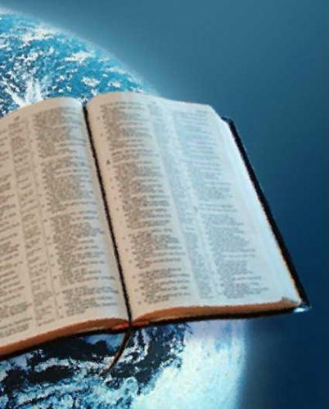
God’s Two Bodies of Revelation
A Study of Psalm 19

Slide 2
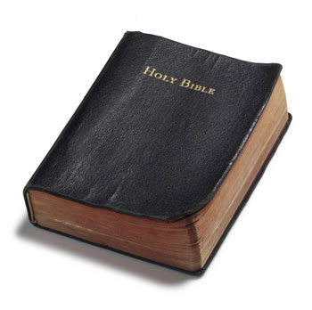
Psalm 19
God’s power and wisdom shown in His creation (vs. 1-6)
God’s character shown in His word (vs. 7-11)
Man’s appropriate response to God’s revelation (vs. 12-14)

Slide 3

God’s Creation vs. 1-6
declares God’s glory
shows God’s handiwork
utters speech and shows knowledge
this “voice” is present everywhere on earth

Slide 4
What God’s Creation Says About God
God has great wisdom
God has an eye for beauty and variety
God appreciates law and order
God possesses great power

Slide 5


Slide 6
The existence of a creation implies the existence of a Creator
Romans 1:18-20
Psalm 14:1

Slide 7
God’s Law vs. 7-11

Slide 8
God’s Law vs. 7-11
“The law of the Lord is perfect, converting the soul”
  1 Peter 1:23

Slide 9
God’s Law vs. 7-11
“The testimony of the Lord is sure, making wise the simple”
  Psalm 119:89, 152
  Psalm 119:97-100, 130

Slide 10
God’s Law vs. 7-11
“The statutes of the Lord are right, rejoicing the heart”
  Romans 3:4

Slide 11
God’s Law vs. 7-11
“The commandment of the Lord is pure, enlightening the eyes”
  2 Timothy 3:15
  Psalm 119:105

Slide 12
God’s Law vs. 7-11
“The fear of the Lord is clean, enduring forever”
  Proverbs 1:7
  Matthew 24:35
  John 12:49-50

Slide 13
God’s Law vs. 7-11
“The judgments of the Lord are true and righteous altogether”

Slide 14
What God’s Word Reveals About God
He is…
Perfect
Sure
Right
Pure
Clean
True
Righteous

Slide 15
Progression of Benefits Received From God’s Law vs. 7-11
converts the soul
makes one wise
rejoices the heart
enlightens the eyes
endures forever

Slide 16
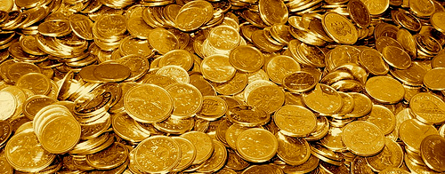
God’s Word is to be desired above great riches and pleasure
“More to be desired are they than gold, yea, than much fine gold: sweeter also than honey and the honeycomb” (v. 10).

Slide 17

Man’s Response vs. 12-14
“Cleanse thou me from secret faults”
“Keep back thy servant also from presumptuous sins”
Let the words of my mouth, and the meditation of my heart, be acceptable in thy sight”

