Slide 1
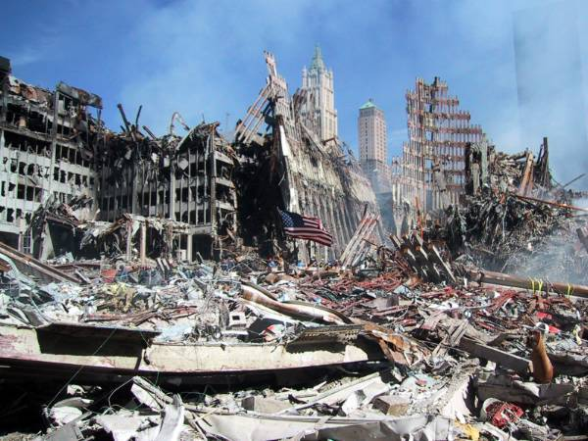
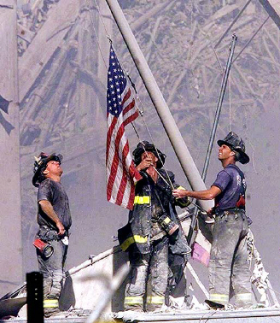
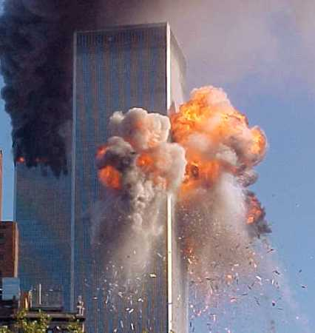

Slide 2
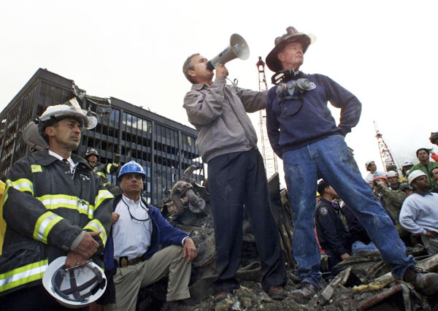
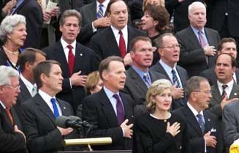

Slide 3
How To Be A Good Citizen

Slide 4
1. Honor Our Laws and Leaders
Romans 13:1-7
Government exists by the authority of God.
Protect citizens by punishing lawbreakers.
We are to live in subjection to governing authorities.
Obey the law - 1 Pet. 2:13
Pay our taxes
Honor our leaders - 1 Pet. 2:17

Slide 5
2. Pray
Leaders - 1 Timothy 2:1-2
Nation - Psalm 122:6

Slide 6
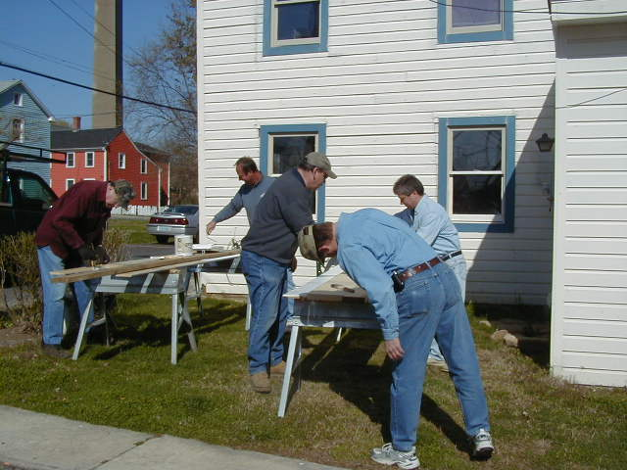
3. Be A Good Neighbor
Luke 10:25-37

Slide 7
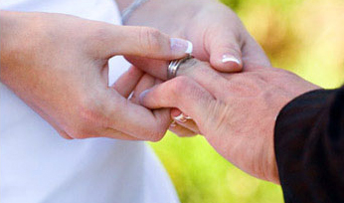
4. Maintain Strong Marriages
Colossians 3:18-21

Slide 8
5. Stand Up For Righteousness
Proverbs 14:34
Isaiah 1:17

Slide 9
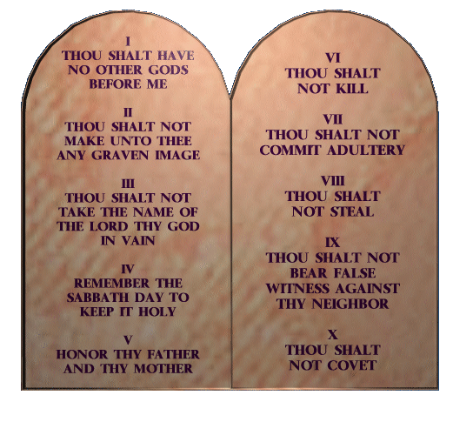
5. Stand Up For Righteousness
Exodus 20:13-19
The Ten Commandments preserved the rights of the Israelites.

Slide 10
How To Be A Good Citizen
Honor Our Laws and Leaders
Pray
Be A Good Neighbor
Maintain Strong Marriage
Stand Up For Righteousness

