Slide 1

The Rights of a Virtuous Wife
Proverbs 31:10-31

Slide 2
1. To Be Trusted

Slide 3
1. To Be Trusted
“The heart of her husband safely trusts her; so he will have no lack of gain. She does him good and not evil all the days of her life.”
Prov. 31:11-12

Slide 4
1. To Be Trusted
Home - v. 27

Slide 5
1. To Be Trusted
Home - v. 27
Children - v. 21

Slide 6
1. To Be Trusted
Home - v. 27
Children - v. 21
Finances - vs. 13-16

Slide 7
2. To Be Honored

Slide 8
2. To Be Honored
“Who can find a virtuous wife? For her worth is far above rubies.”
Proverbs 31:10

Slide 9
2. To Be Honored
“Strength and honor are her clothing; she shall rejoice in time to come.”
Proverbs 31:25

Slide 10
2. To Be Honored
“Her children rise up and call her blessed; her husband also, and he praises her:
‘Many daughters have done well, but you excel them all.’”
Proverbs 31:28-29

Slide 11
2. To Be Honored
“Charm is deceitful and beauty is passing, but a woman who fears the Lord, she shall be praised. Give her of the fruit of her hands, and let her own works praise her in the gates.”
Proverbs 31:30-31

Slide 12
3. To Be Respected

Slide 13
3. To Be Respected
“She makes tapestry for herself; her clothing is fine linen and purple.
Her husband is known in the gates, when he sits among the elders of the land.”
Proverbs 31:22-23

Slide 14
4. To Rejoice

Slide 15
4. To Rejoice
“Strength and honor are her clothing; she shall rejoice in time to come.”
Proverbs 31:25

Slide 16
5. Security

Slide 17
5. Security
“She is not afraid of snow for her household, for all her household is clothed with scarlet.”
Proverbs 31:21

Slide 18
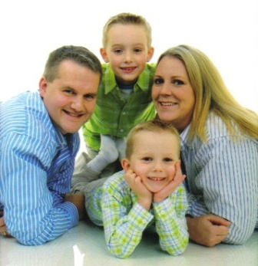

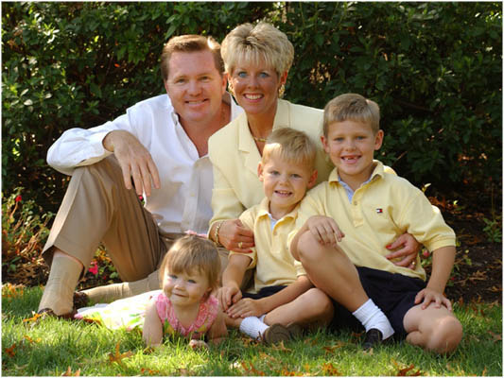
The Rights of a Virtuous Wife
Trust
Honor
Respect
Joy
Security

