Slide 1
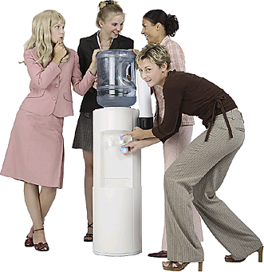
“Be Careful Little Mouth What You Say…”
Matthew 12:33-37
Notes:
O Be Careful, Little Eyes (Title Slide)
Listen to sample & buy CD »
O be careful little eyes what you see
O be careful little eyes what you see
There's a Father up above
And He's looking down in love
So, be careful little eyes what you see
O be careful little ears what you hear
O be careful little ears what you hear
There's a Father up above
And He's looking down in love
So, be careful little ears what you hear
O be careful little hands what you do
O be careful little hands what you do
There's a Father up above
And He's looking down in love
So, be careful little hands what you do
O be careful little feet where you go
O be careful little feet where you go
There's a Father up above
And He's looking down in love
So, be careful little feet where you go
O be careful little mouth what you say
O be careful little mouth what you say
There's a Father up above
And He's looking down in love
So, be careful little mouth what you say

Slide 2
Be Careful Little Mouth What You Say…
#@%^** “>”@## @!@%## *
Matthew 12:33,34
“Either make the tree good and its fruit good, or else make the tree bad and its fruit bad; for a tree is known by its fruit. Brood of vipers! How can you, being evil, speak good things? For out of the abundance of the heart the mouth speaks.”
Notes:
Our text…Matt.12:33,34

Slide 3
Be Careful Little Mouth What You Say…
#@%^** “>”@## @!@%## *
Matthew 12:35,36
“A good man out of the good treasure of his heart brings forth good things, and an evil man out of the evil treasure brings forth evil things. But I say to you that for every idle word men may speak, they will give account of it in the day of judgment.”
Notes:
Our text…Matt.12:35,36

Slide 4
Be Careful Little Mouth What You Say…
#@%^** “>”@## @!@%## *
Matthew 12:37
“For by your words you will be justified, and by your words you will be condemned.”
Notes:
Our text…Matt.12:37. Let us see what we can learn from these words uttered by our Lord concerning the need for rightful and edifying speech…

Slide 5
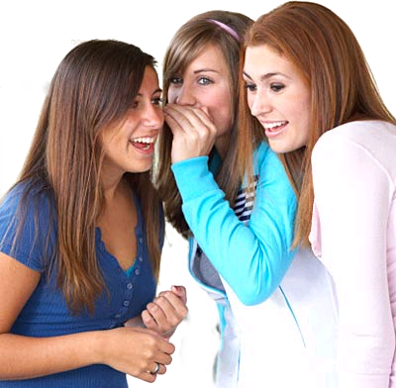
The Christian Is Concerned About What He /She Says…
Psalm 39:1
“I said, ‘I will guard my ways, lest I sin with my tongue; I will restrain my mouth with a muzzle, while the wicked are before me.”
Notes:
The Christian Is Concerned About What He /She Says… (Psa.39:1) Each of us must guard his tongue lest we use it to commit sin. To guard the tongue, we MUST guard our hearts. This is especially true when we are around others who use their speech in a wicked way. We do not want to follow their conduct and add our voices to the situation!

Slide 6
The Christian Is Concerned About What He /She Says…
James 1:26
“If anyone among you thinks he is religious, and does not bridle his tongue but deceives his own heart, this one's religion is useless.”
Notes:
The Christian Is Concerned About What He /She Says… (Jam.1:26)
God’s people must be people who have mastered the ability to bridle their tongues. Defined, the word means, “to curb or check; to control or restrain.” {Illus. horse bridle} Our religion is useless (unprofitable and vain} if we don’t control our tongues! This can only be accomplished if we understand that our words have meaning and power—either good or evil!

Slide 7
Be Careful Little Mouth What You Say…
The Tongue Is Dangerous
Some Sins of the Tongue
Effects the Tongue Can Have
How to Prevent Misuse of the Tongue
Notes:
Overview of our study…

Slide 8
The Tongue Is Dangerous
Tremendous power for good and evil
(But most often is the cause of big problems) —James 3:1-6
Is never fully tamed— James 3:7,8
Reflects what is in the heart—James 3:9-12
Notes:
The Tongue Is Dangerous.
Tremendous power for both good and evil. (But most often is the cause of big problems) Jam.3:1-6.
Is never fully tamed—Jam.3:7,8.
Reflects what is in the heart—Jam.3:9-12. People sometimes say, “I’m sorry I said that.” What they mean is they are sorry what they were thinking slipped out!

Slide 9
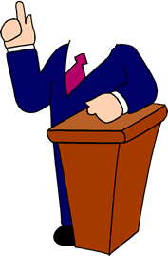
Some Sins of the Tongue
Acts 20:30
“Also from among yourselves men will rise up, speaking perverse things, to draw away the disciples after themselves.”
Notes:
Some Sins of the Tongue… (Acts 20:30)
God’s people must listen carefully to the words of teachers and preachers giving instructions. Be certain they are teaching from God’s word—not their personal opinions. (Acts 17:11)

Slide 10
Some Sins of the Tongue
Titus 1:11
“Whose mouths must be stopped, who subvert whole households, teaching things which they ought not, for the sake of dishonest gain.”
Notes:
Some Sins of the Tongue… (Titus 1:11)
The false teacher’s false teaching must be opposed and stopped! It can lead souls away from God and toward destruction. This opposition must be done with love (Eph.4:15), but it MUST be done!

Slide 11
Some Sins of the Tongue
2 Corinthians 12:20
“For I fear lest, when I come, I shall not find you such as I wish, and that I shall be found by you such as you do not wish; lest there be contentions, jealousies, outbursts of wrath, selfish ambitions, backbitings, whisperings, conceits, tumults.”
Notes:
Some Sins of the Tongue… (2 Cor.12:20)
Paul warned about problems that could arise among brethren because of failure to properly guard their tongues. All of these sinful emotions are stirred by words from an evil tongue. Such conduct can be avoided by practicing self-control (Gal.5:22,23).

Slide 12
Some Sins of the Tongue
1 Timothy 5:13
“And besides they learn to be idle, wandering about from house to house, and not only idle but also gossips and busybodies, saying things which they ought not.”
Notes:
Some Sins of the Tongue… (1 Tim. 5:13)
People who are idle will fill their time with something. Before we repeat a matter, we need to ask one question: why are we are telling this person? Have we talked to the other person? (Prov.26:20)

Slide 13
Some Sins of the Tongue
Ephesians 4:29
“Let no corrupt word proceed out of your mouth, but what is good for necessary edification, that it may impart grace to the hearers.”
Notes:
Some Sins of the Tongue… (Eph.4:29)
Edification should be the aim of a person’s speech. Imparting grace may mean giving others what they don’t deserve—but what is proper! (Col.4:6) We must be careful about saying unnecessary things that serve no good purpose.

Slide 14
Some Sins of the Tongue
Ephesians 5:4
“Neither filthiness, nor foolish talking, nor coarse jesting, which are not fitting, but rather giving of thanks.”
Notes:
Some Sins of the Tongue… (Eph.5:4)
Some language and speech is just not compatible with Christianity. We must be careful about the kinds of conversations in which we involve ourselves.

Slide 15
Some Sins of the Tongue
The lying tongue
The flattering tongue
The proud tongue
The overused tongue
The swift tongue
The backbiting tongue
The tale-bearing (gossiping) tongue
The cursing tongue
The filthy-talking tongue
The complaining tongue
The silent tongue
Notes:
Some Sins of the Tongue…
Following is a list of tongue dangers that God’s people need to avoid. They are all sinful uses of the tongue. (Briefly comment on each one)

Slide 16
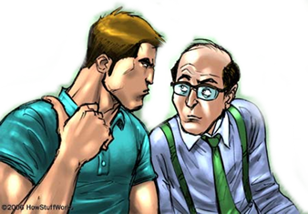
Effects the Tongue Can Have
Like poison (James 3:8)
A destructive fire (James 3:6)
Destroys a neighbor (Proverbs 11:9)
Reveals secrets (Proverbs 11:13; 20:19)
Sows strife (Proverbs 16:28)
Separates friends (Proverbs 16:28; 17:9)
Destroys a church (Galatians 5:15)
Notes:
Effects the Tongue Can Have…
Like poison (Jam.3:8); can kill relationships.
A destructive fire (Jam.3:6); can destroy in a minute things that took years to build.
Destroys a neighbor (Prov.11:9).
Reveals secrets (Prov.11:13; 20:19); destroys one credability.
Sows strife (Prov.16:28).
Separates friends (Prov.16:28; 17:9); many friendships have been ruined by uncontrolled tongued.
Destroys a church (Gal.5:15); the worst case and something God hates (Prov.6:19).

Slide 17
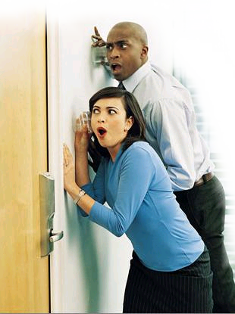
How to Prevent Misuse of the Tongue
Restraint - (Proverbs 10:19; 29:11)
Being careful what we say to and about others (James 1:19; Proverbs 11:13)
Give the benefit of the doubt (1 Corinthians 13:4-8)
Purify your mind (Matthew 23:25-26; 12:33
Notes:
How to Prevent Misuse of the Tongue…
Restraint (Prov.10:19;29:11); choose your words carefully and soberly.
Be careful what you say to and about others (Jam.1:19; Prov.11:13); think before you speak. Measure your words and consider the effect they might have on others.
Give the benefit of the doubt (1 Cor.13:4-8); don’t be so quick to think the worse instead of the better.
Purify your mind (Matthew 23:25,26; 12:33; Rom.12:1,2); be careful that you don’t make your life one that is full of hypocrisy.

Slide 18
Be Careful Little Mouth What You Say…
The Tongue Is Dangerous
Some Sins of the Tongue
Effects the Tongue Can Have
How to Prevent Misuse of the Tongue
Notes:
Review of our study…

Slide 19
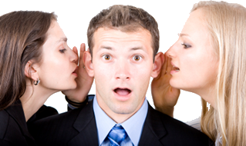
Every one of us can work harder at being careful about:
What we say; how we say it; to whom we say it!
Notes:
Summary—Invitation…

