Slide 2
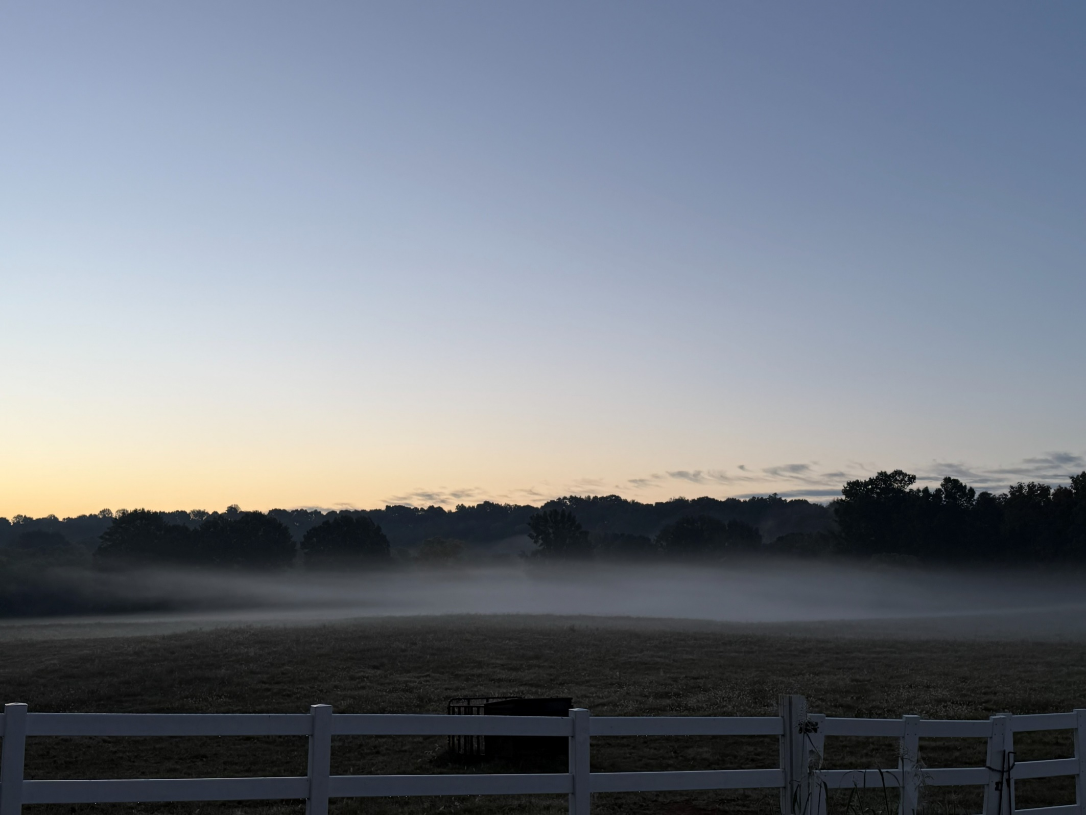
Daily Disciplines for Disciples

Slide 3
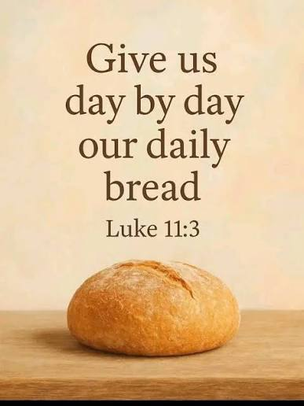
We live “day by day”
God fed the Israelites with manna every day - Exodus 16:4-5
The early church provided daily distribution of food for their needy widows - Acts 6:1

Slide 4
1. Active Discipleship
“Then He said to them all, ‘If anyone desires to come after Me, let him deny himself, and take up his cross daily, and follow Me.’”
Luke 9:23

Slide 5
2. Studying God’s Word
“These were more fair-minded than those in Thessalonica, in that they received the word with all readiness, and searched the Scriptures daily to find out whether these things were so.”
Acts 17:11

Slide 6
2. Studying God’s Word
“Therefore we do not lose heart. Even though our outward man is perishing, yet the inward man is being renewed day by day.”
2 Corinthians 4:16

Slide 7
2. Studying God’s Word
“But his delight is in the law of the Lord, and in His law he meditates day and night” (Ps. 1:2).
“Oh, how I love Your law! It is my meditation
all the day” (Ps. 119:97).

Slide 8
3. Teaching God’s Word
“And daily in the temple, and in every house, they did not cease teaching and preaching Jesus as the Christ” (Acts 5:42).
“Therefore he reasoned in the synagogue with the Jews and with the Gentile worshipers, and in the marketplace daily with those who happened to be there” (Acts 17:17).
“But when some were hardened and did not believe, but spoke evil of the Way before the multitude, he departed from them and withdrew the disciples, reasoning daily in the school of Tyrannus” (Acts 19:9).

Slide 9
4. Exhorting Our Brethren
“Beware, brethren, lest there be in any of you an evil heart of unbelief in departing from the living God;
but exhort one another daily, while it is called ‘Today,’ lest any of you be hardened through the deceitfulness of sin.”
Hebrews 3:12-13

Slide 10
4. Exhorting Our Brethren
“So continuing daily with one accord in the temple, and breaking bread from house to house, they ate their food with gladness and simplicity of heart.”
Acts 2:46

Slide 11
5. Saving the Lost
“Praising God and having favor with all the people. And the Lord added to the church daily those who were being saved” (Acts 2:47).
“So the churches were strengthened in the faith, and increased in number daily” (Acts 16:5).

Slide 12
5. Saving the Lost
“For He says: ‘In an acceptable time I have heard you, and in the day of salvation I have helped you.’
Behold, now is the accepted time; behold, now is the day of salvation.”
2 Corinthians 6:2

Slide 13
Daily Disciplines for Disciples
Be on Active Duty (take up our cross)
Study God’s Word
Teach/Share God’s Word
Exhort Our Brethren
Save the Lost

