Slide 1
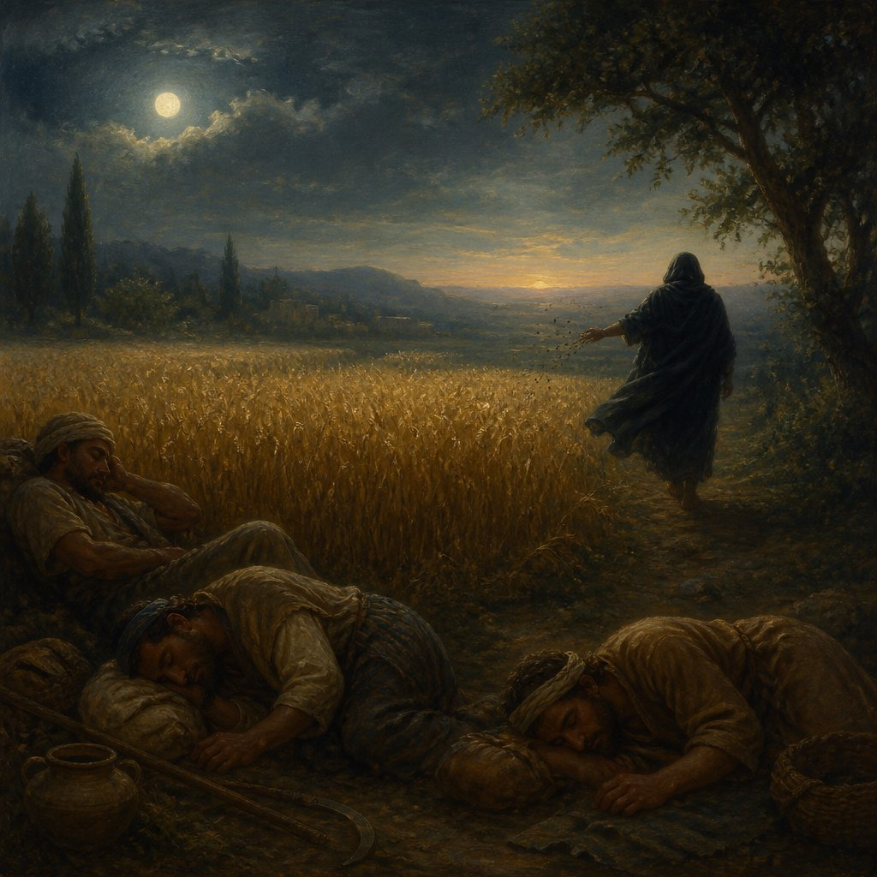
“While Men Slept”
Matthew 13:25

Slide 2
While we sleep, the enemy sows his tares in…
Our Churches
Our Homes
Our Lives

Slide 3
While we sleep, the enemy sows his tares in…
Our Churches
Our Homes
Our Lives
“Therefore let us not sleep,
as others do, but let us
watch and be sober.”
1 Thessalonians 5:6

