Slide 1
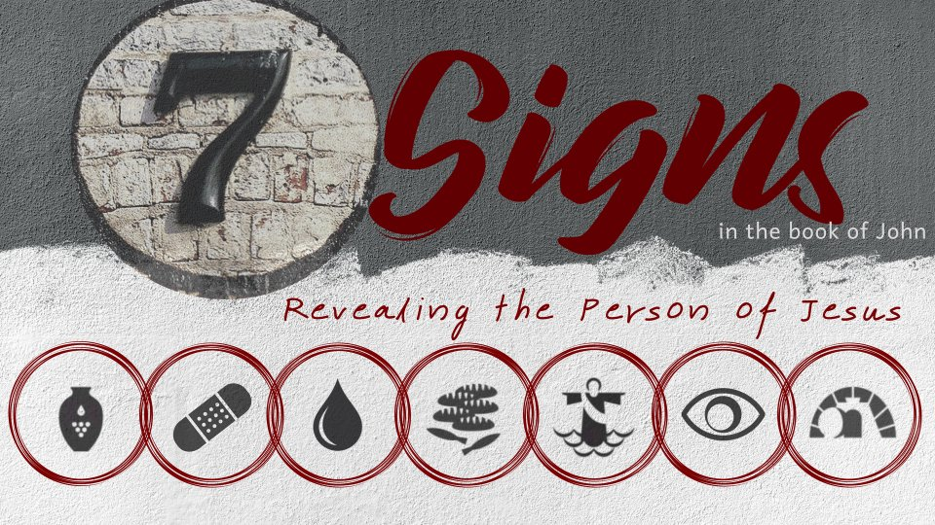
Raising Lazarus from the Dead
John 11:38-44

Slide 2
John 11
Jesus receives word that Lazarus is sick. He purposely waits two days to leave - vs. 1-6
Jesus announces He is going to Judea to raise Lazarus from the dead - vs. 7-16
Martha meets Jesus outside of Bethany - vs. 17-27
Mary and the rest of the Jews join Jesus - vs. 28-37

Slide 3
The Sign
Then Jesus, again groaning in Himself, came to the tomb. It was a cave, and a stone lay against it.
Jesus said, “Take away the stone.” Martha, the sister of him who was dead, said to Him, “Lord, by this time there is a stench, for he has been dead four days.”
Jesus said to her, “Did I not say to you that if you would believe you would see the glory of God?”
John 11:38-40

Slide 4
The Sign
Then they took away the stone from the place where the dead man was lying. And Jesus lifted up His eyes and said, “Father, I thank You that You have heard Me.
And I know that You always hear Me, but because of the people who are standing by I said this, that they may believe that You sent Me.”
John 11:41-42

Slide 5
The Sign
Now when He had said these things, He cried with a loud voice, “Lazarus, come forth!”
And he who had died came out bound hand and foot with graveclothes, and his face was wrapped with a cloth. Jesus said to them, “Loose him, and let him go.”
John 11:43-44

Slide 6
The Impact of the Sign
“This sickness is not unto death, but for the glory of God, that the Son of God may be glorified through it” (v. 4).
“And I am glad for your sakes that I was not there, that you may believe. Nevertheless let us go to him” (v. 15).
“…but because of the people who are standing by I said this, that they may believe that You sent Me” (v. 42)

Slide 7
The Impact of the Sign
Many of the Jews who were there and saw the sign believed - v. 45
The Pharisees acknowledged that Jesus worked many signs - v. 47
Many Jews were seeking Jesus - vs. 55-56
Many Jews believed in Jesus - 12:9-11
A great multitude met Jesus - 12:12-13

