Slide 2
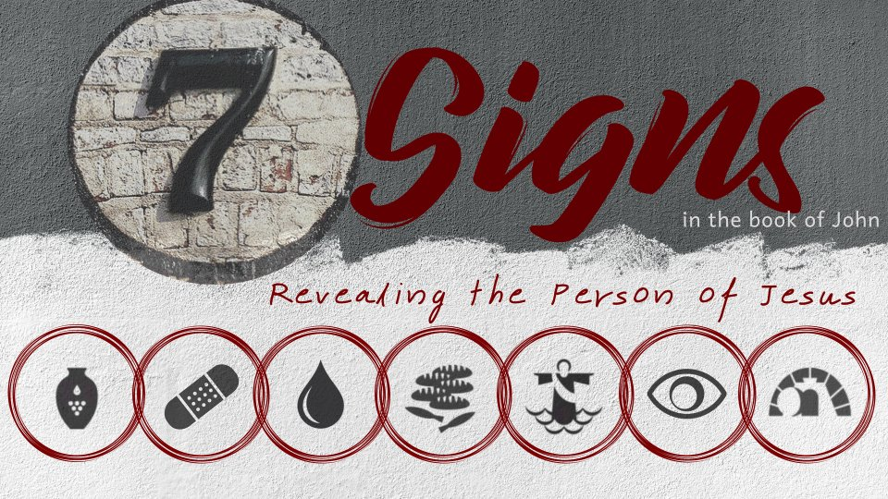
Raising Lazarus from the Dead
John 11

Slide 3
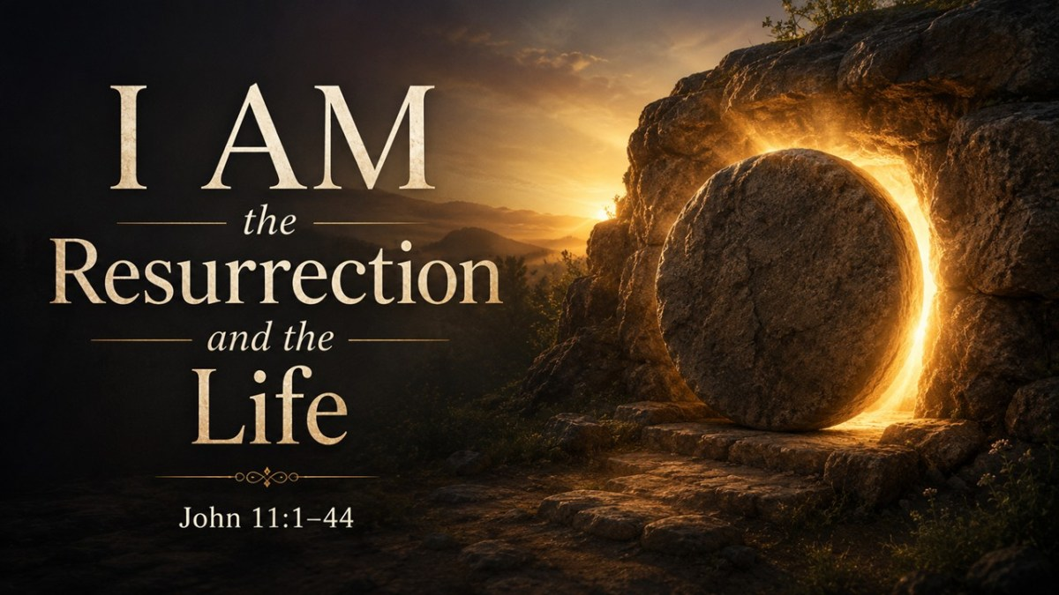

Slide 4
Jesus’ “I AM” Statements
The Bread of Life - 6:35
The Light of the World - 8:12
The Door of the Sheep - 10:7
The Good Shepherd - 10:11, 14
The Resurrection and the Life - 11:25
The Way, Truth, Life - 14:6
The True Vine - 15:1

Slide 5
What the Signs Tell Us About Jesus’ Power and Authority
Water into wine – quality.
Healing nobleman’s son – distance.
Healing lame man – time.
Feeding the 5,000 – quantity.
Walking on water – nature.
Healing blind man – darkness.
Raising Lazarus – death.

Slide 6
Martha’s Faith
Believes Jesus has power to heal and to prevent death - v. 21
Believes in the resurrection - v. 24
Believes Jesus is the Christ and the Son of God - v. 27

Slide 7
Martha’s Faith
Now Martha said to Jesus, “Lord, if You had been here, my brother would not have died.
But even now I know that whatever You ask of God, God will give You.”

Slide 8
Martha’s Faith
Now Martha said to Jesus, “Lord, if You had been here, my brother would not have died.
But even now I know that whatever You ask of God, God will give You.”
Powerful statement of her continued faith in Jesus.
She is not giving up her belief and confidence in Jesus even though her brother died.

Slide 9
“I am the Resurrection”
Jesus is the source of the resurrection.
Jesus has the keys of Hades and Death - Rev. 1:18
Jesus, by the authority of His voice, has power over death - John 5:24-29

Slide 10
Understanding John 11:25-26
I am the resurrection and the life.
He who believes in Me, though he may die, he shall live.
And whoever lives and believes in Me shall never die.

Slide 11
Understanding John 11:25-26
I am the resurrection and the life.
He who believes in Me, though he may die, he shall live.
And whoever lives and believes in Me shall never die.

Slide 12
Jesus Has Power Over Our Death
He became flesh and died to conquer death on our behalf - Heb. 2:9, 14
He “has abolished death and brought life and immortality to light” - 2 Tim. 1:10
He has given us victory over our greatest enemy -
1 Cor. 15:54-57

Slide 13
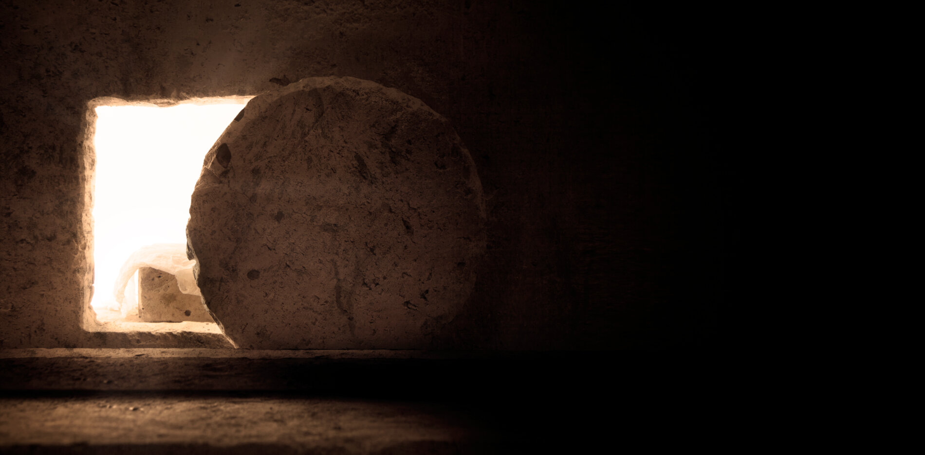
“Unbind him, and let him go”

Slide 14
Jesus said to her, “I am the resurrection and the life. He who believes in Me, though he may die, he shall live.
And whoever lives and believes in Me shall never die. Do you believe this?”

