Slide 2
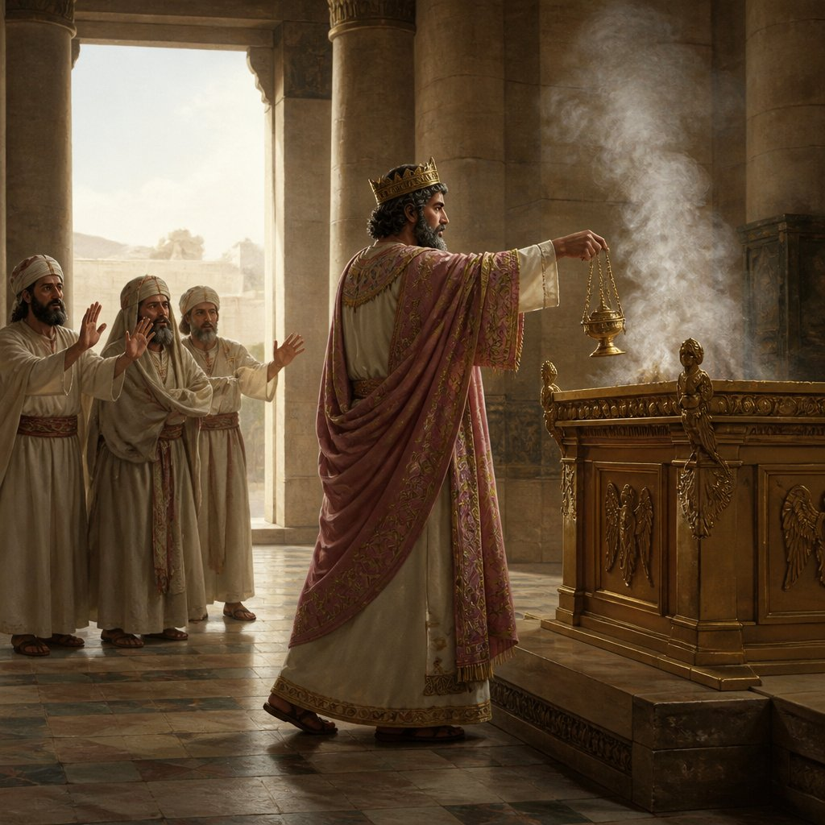
Uzziah’s Arrogance
2 Chronicles 26

Slide 3
Uzziah’s Accomplishments
A Successful Soldier - v. 2, 6-8, 11-14
A Successful Builder - v. 2, 6, 9, 15
A Successful Farmer - v. 10

Slide 4
Uzziah’s Arrogant Transgression
2 Chronicles 26:16-21
His strength and success led to his sinful pride.
“Pride goes before destruction, and a haughty spirit before a fall” (Prov. 16:18).
He took on the role of the High Priest.
He entered an area that was off limits.

Slide 5
Uzziah’s Failure to Repent
He responded in anger, refused to repent, and raged at the priests for their interference.
He was struck with leprosy and was cut off from the house of God for the rest of his life.

Slide 6
How to Overcome Pride
Remember who we are before God.
  1 Pet. 5:5-6; Gen. 18:27
Remain grateful to God.
  Rom. 1:21; 1 Cor. 15:10
Respond appropriately to correction.
  2 Sam. 12:13; Prov. 27:6

