Slide 2
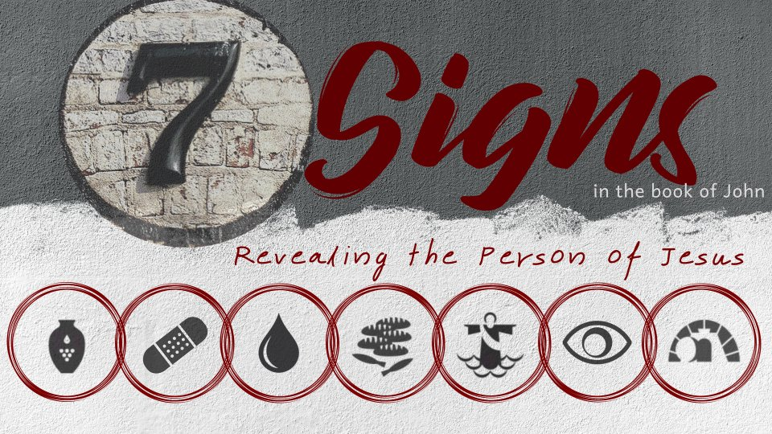
Walking on Water
John 6:15-21

Slide 3
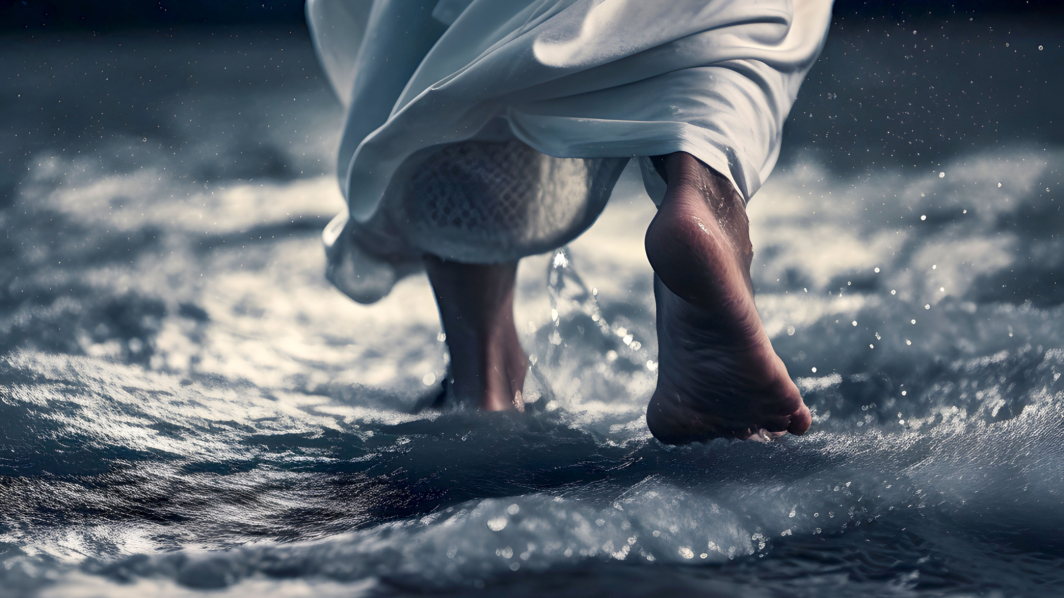
This miracle is recorded in three gospel accounts.
Matthew 14:22-33
Mark 6:45-52
John 6:15-21

Slide 4
The Sign
Then those men, when they had seen the sign that Jesus did, said, “This is truly the Prophet who is to come into the world.”
Therefore when Jesus perceived that they were about to come and take Him by force to make Him king, He departed again to the mountain by Himself alone.
John 6:14-15

Slide 5
The Sign
“Immediately He made His disciples get into the boat and go before Him to the other side…” (Mark 6:45).
“made” (anankazo) - to drive or compel; signifying strong action, either by force or persuasion.

Slide 6
The Sign
“And when He had sent them away, He departed to the mountain to pray”
(Mark 6:46).

Slide 7
The Sign
“Then He saw them straining at rowing, for the wind was against them…” (Mark 6:48).
“But the boat was now in the middle of the sea, tossed by the waves, for the wind was contrary” (Matt. 14:24).
“Then the sea arose because a great wind was blowing. So when they had rowed about three or four miles…” (John 6:18-19).

Slide 8
The Sign
Now in the fourth watch of the night Jesus went to them, walking on the sea.
And when the disciples saw Him walking on the sea, they were troubled, saying, “It is a ghost!” And they cried out for fear.
But immediately Jesus spoke to them, saying, “Be of good cheer! It is I; do not be afraid.”
Matthew 14:25-27

Slide 9
The Sign
“the wind ceased” (Mark 6:51).
“immediately the boat was at the land where they were going” (John 6:21).

Slide 10
The Impact of the Sign
“And they were greatly amazed in themselves beyond measure, and marveled. For they had not understood about the loaves, because their heart was hardened” (Mark 6:51-52).
“Then those who were in the boat came and worshiped Him, saying, ‘Truly You are the Son of God’” (Matt. 14:33).

Slide 11
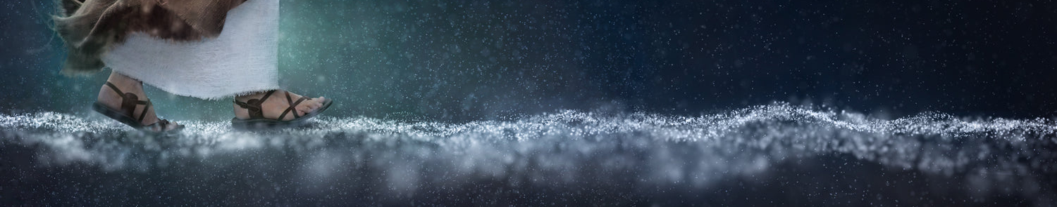
What This Sign Tells Us About Jesus
Water into wine – power over quality.
Healing nobleman’s son – power over distance.
Healing lame man – power over time.
Feeding the 5,000 – power over quantity.
Walking on water – power over nature.

