Slide 1
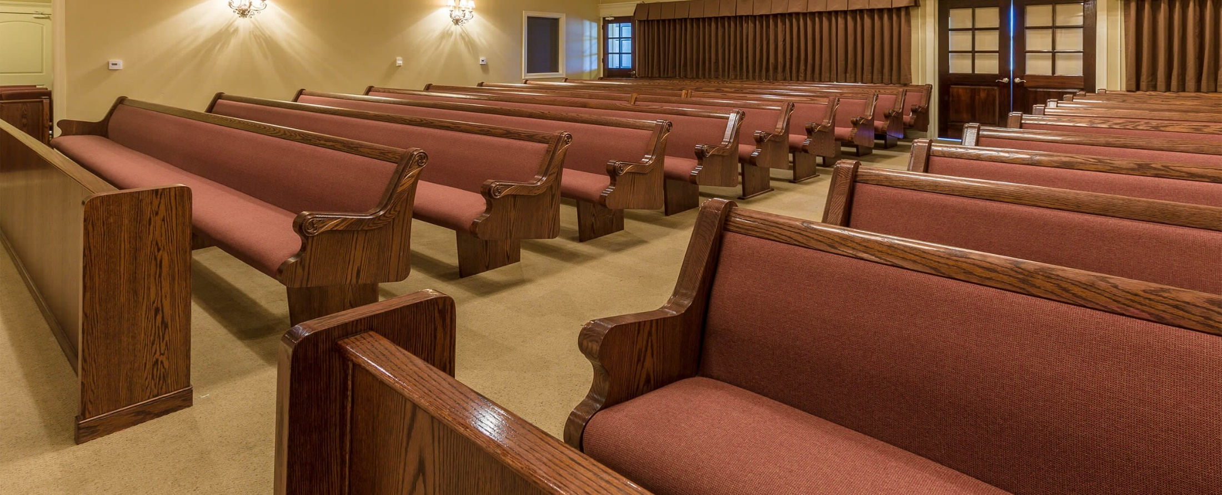
Honoring God in Our Worship
God is greatly to be feared in the assembly of the saints, and to be held in reverence by all those around Him.
Psalm 89:7

Slide 2
“Therefore, since we are receiving a kingdom which cannot be shaken, let us have grace, by which we may serve God acceptably with reverence and godly fear. For our God is a consuming fire.”
Hebrews 12:28-29

Slide 3
1. Remember
What We Are Doing Here
Who God Is - Rev. 4:8-11
Why God is Worthy of Our Worship

Slide 4
1. Remember
What We Are Doing Here
Who God Is - Rev. 4:8-11
Why God is Worthy of Our Worship
Give unto the Lord, O you mighty ones, give unto the Lord glory and strength.
Give unto the Lord the glory due to His name; worship the Lord in the beauty of holiness.
Psalm 29:1-2

Slide 5
1. Remember
What We Are Doing Here
Who God Is - Rev. 4:8-11
Why God is Worthy of Our Worship
Oh come, let us worship and bow down; let us kneel before the Lord our Maker.
For He is our God, and we are the people of His pasture, And the sheep of His hand…
Psalm 95:6-7

Slide 6
2. Our Attitude
Our Heart Must Be Prepared - 2 Chron. 30:19
Humility - Luke 18:10-14
Respect

Slide 7
2. Our Attitude
Our Heart Must Be Prepared - 2 Chron. 30:19
Humility - Luke 18:10-14
Respect
“For all those things My hand has made, and all those things exist,” says the Lord. “But on this one will I look: on him who is poor and of a contrite spirit, and who trembles at My word.”
Isaiah 66:2

Slide 8
2. Our Attitude
Our Heart Must Be Prepared - 2 Chron. 30:19
Humility - Luke 18:10-14
Respect
And Ezra opened the book in the sight of all the people, for he was standing above all the people; and when he opened it, all the people stood up.
Nehemiah 8:5

Slide 9
3. Our Dress
1 Peter 3:3-4
The way we dress for an occasion reflects on that occasion.
God sees our heart – but the way we dress reveals to others what is in our heart.

Slide 10
4. Our Conduct
Different occasions and situations call for different kinds of behavior.
The worship of the Lord’s church must be “done decently and in order” - 1 Cor. 14:40
Worship in spirit may evoke emotions, but we must always honor God and edify others with our behavior.

Slide 11
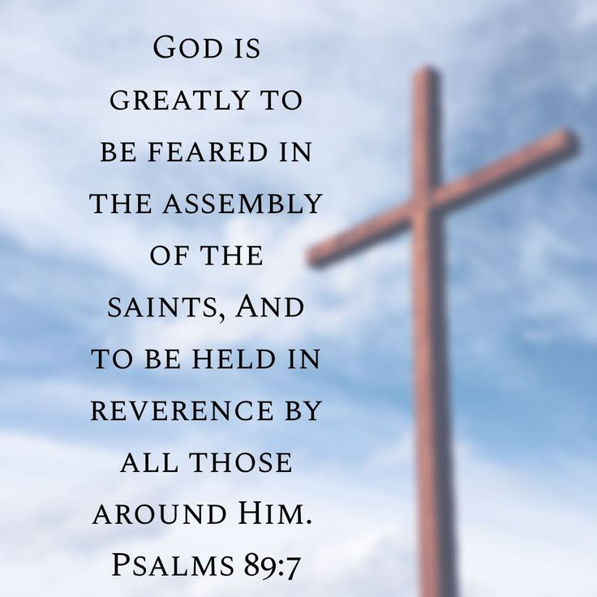
Honoring God in Our Worship
We Need to Remember
Our Attitude
Our Dress
Our Conduct

