Slide 2
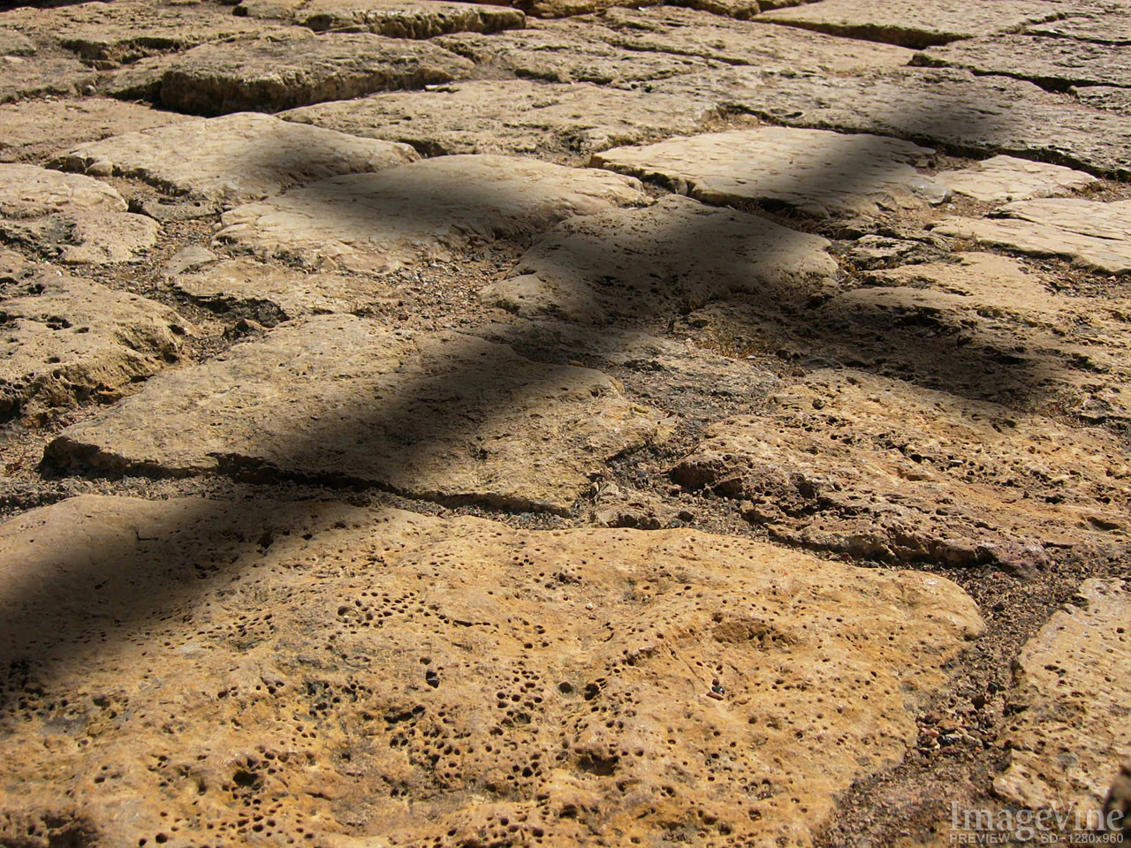
Old Testament Shadows of Christ

Slide 3
Introduction
Noah: Gavin Thomas
Moses: Kaz Willis
David: Micah Blackaby
Conclusion
Prayer: Blaine Thomas

Slide 5
Moses

Slide 7
Introduction
Noah: Gavin Thomas
Moses: Kaz Willis
David: Micah Blackaby
Conclusion
Prayer: Blaine Thomas

