Slide 2
Why Our Words Matter

Slide 3
1. Our Words Matter to Ourselves
James 3:2-8 AMP
[2] For we all stumble and sin in many ways. If anyone does not stumble in what he says, he is a perfect man, able to bridle his whole body and rein in his entire nature. [3] Now if we put bits into the horses' mouths to make them obey us, we guide their whole body as well. [4] And look at the ships. Even though they are so large and driven by strong winds, they are still directed by a very small rudder wherever the impulse of the helmsman determines.

Slide 4
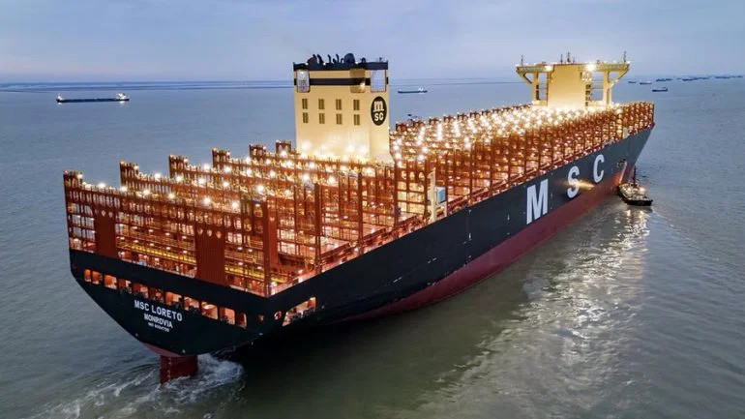

Slide 5
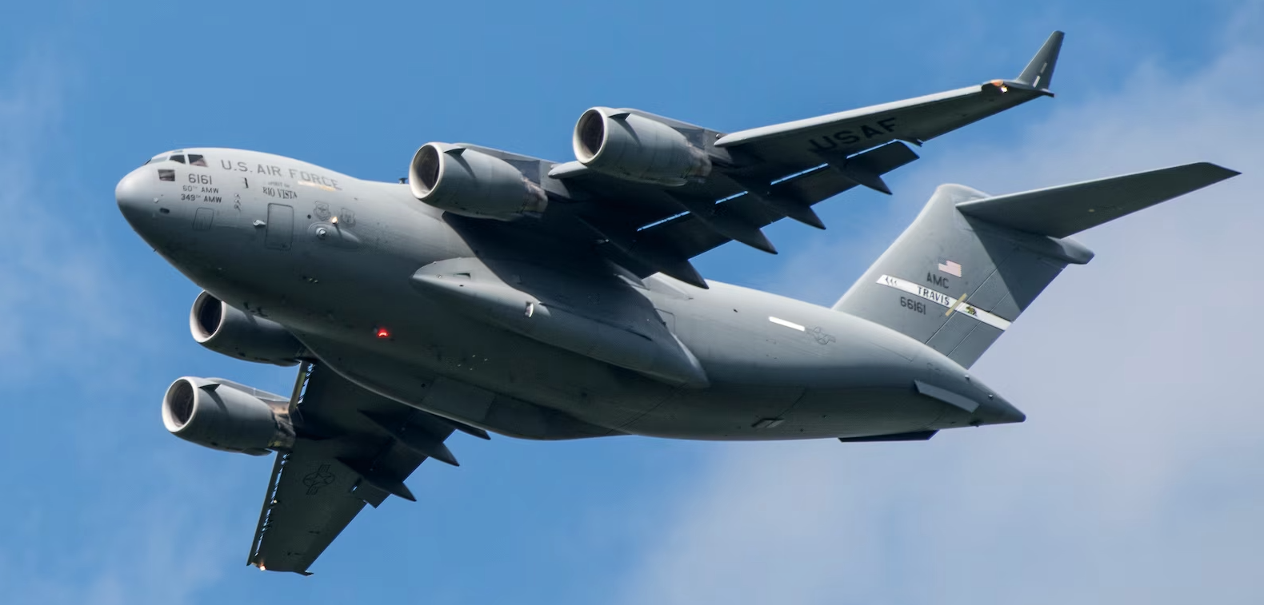

Slide 6
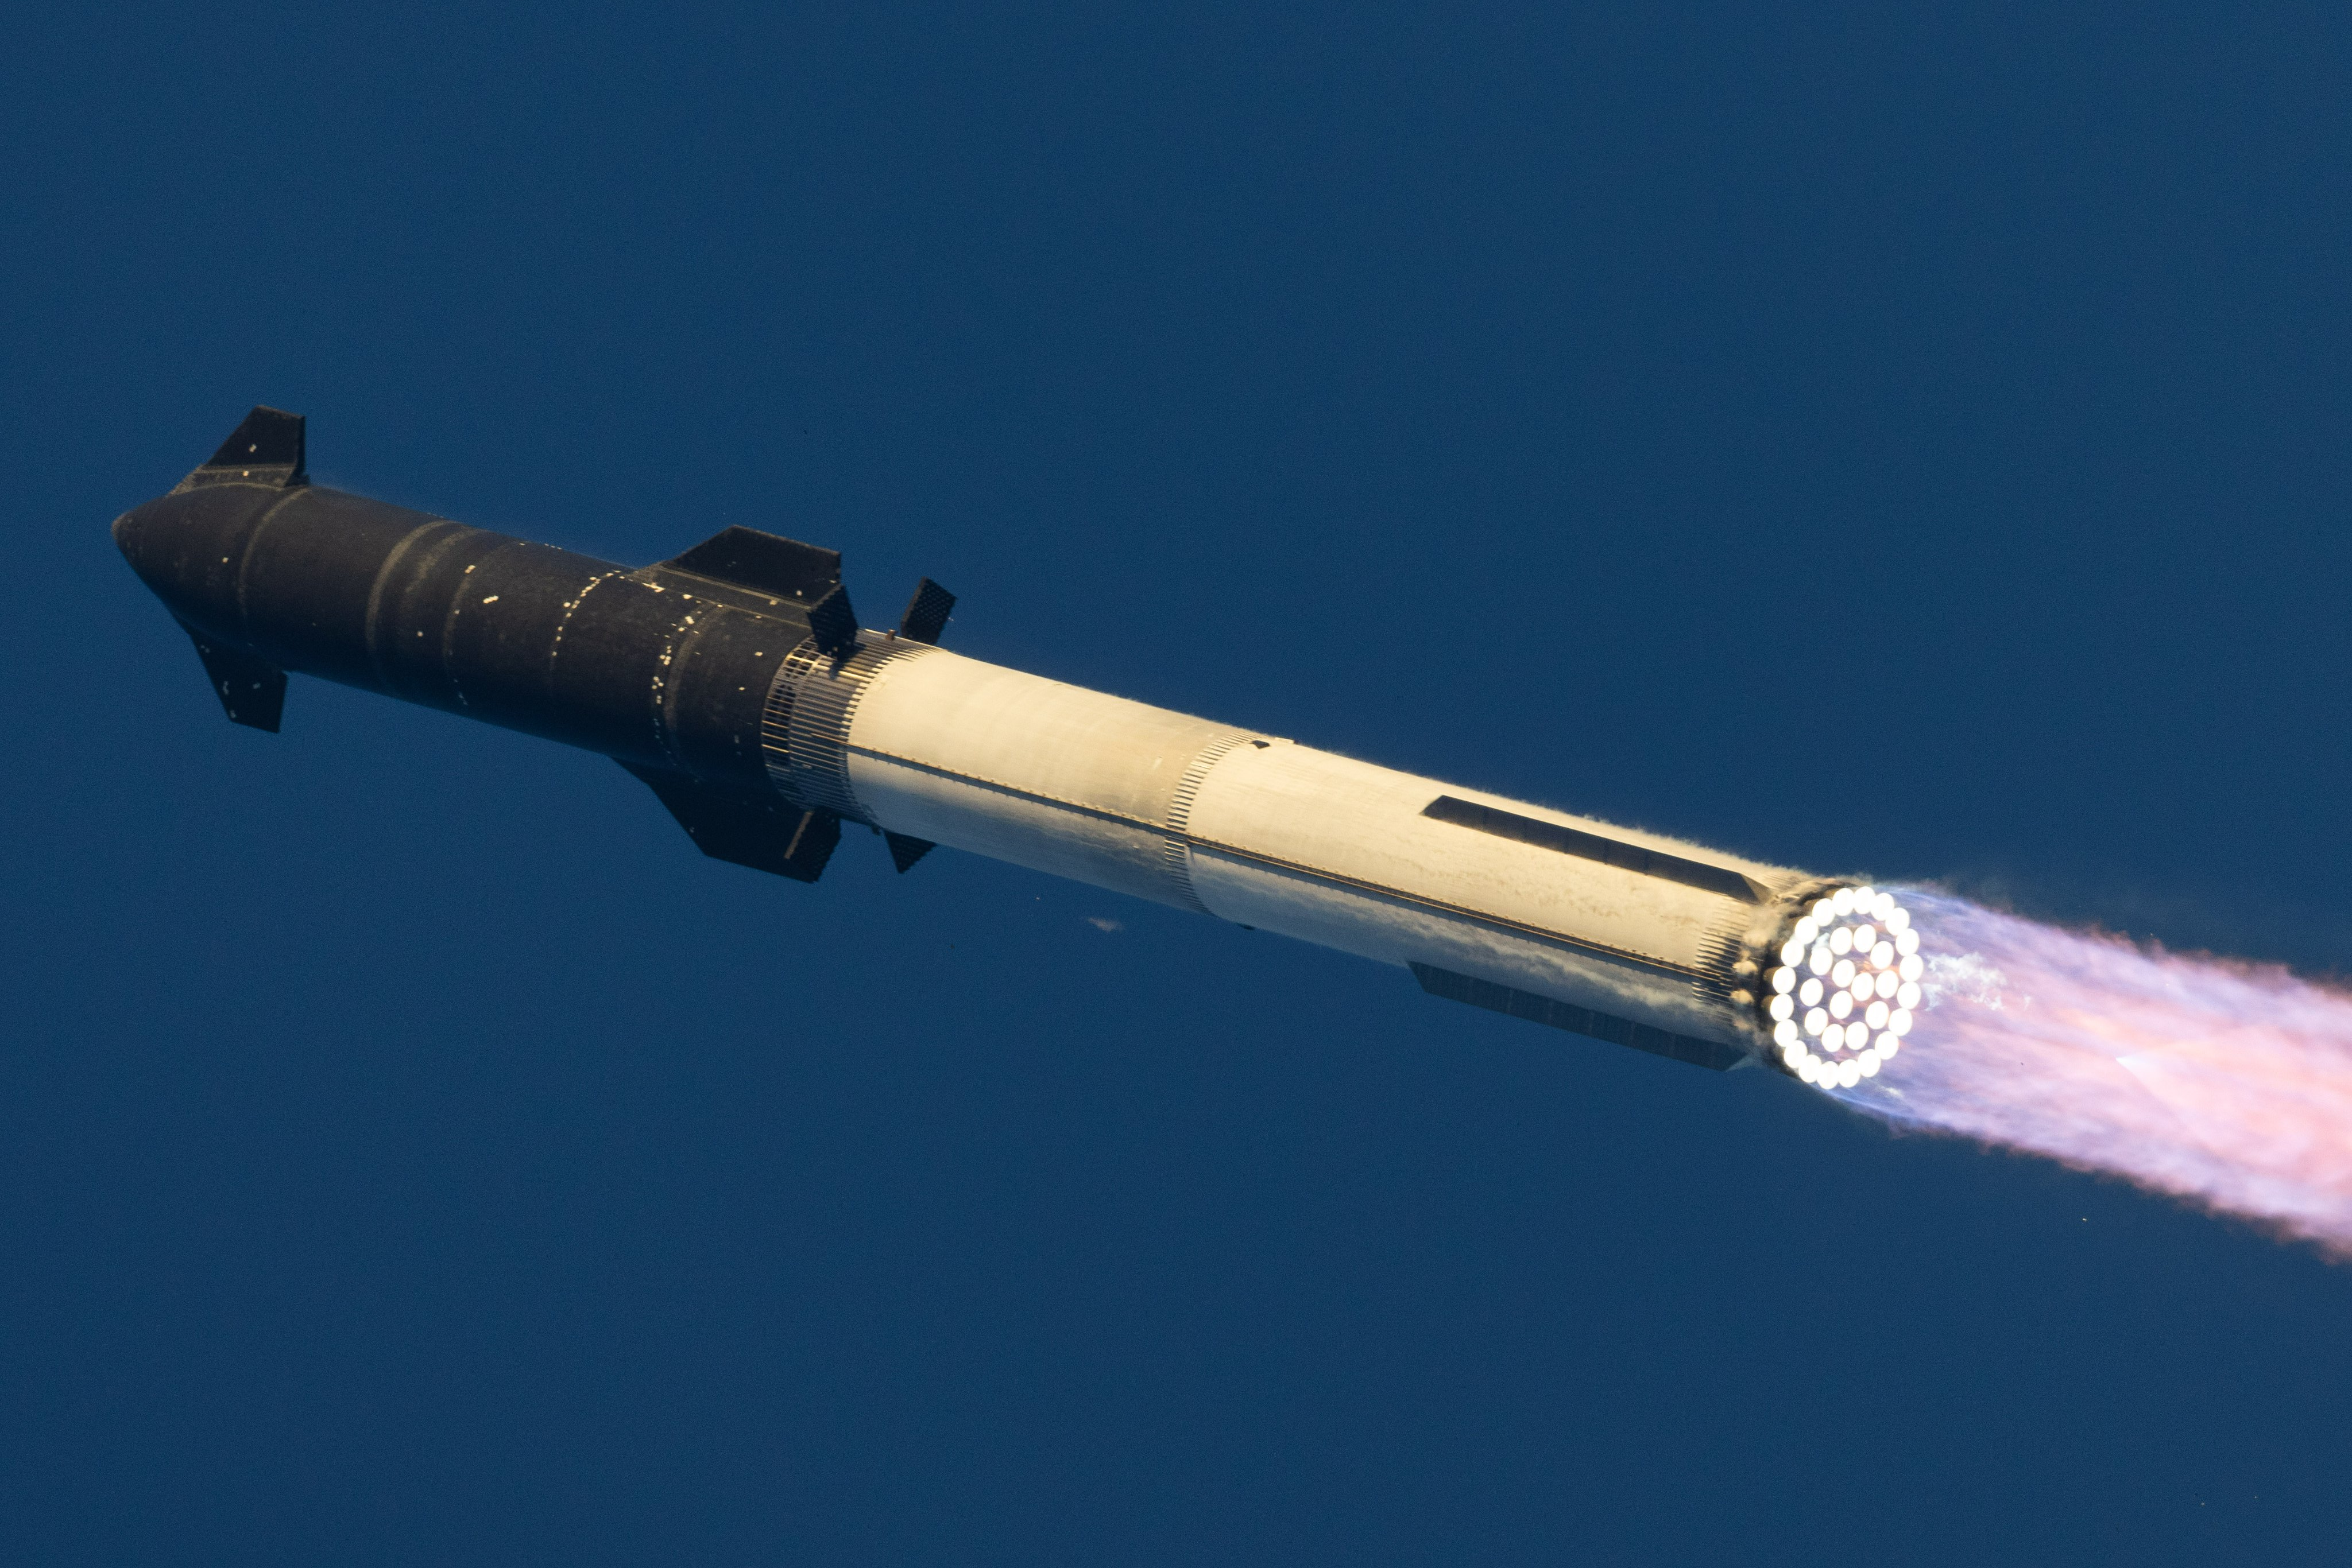

Slide 7
1. Our Words Matter to Ourselves
James 3:2-8 AMP (continued)
[5] In the same sense, the tongue is a small part of the body, and yet it boasts of great things. See how great a forest is set on fire by a small spark! [6] And the tongue is a fire, the very world of injustice and unrighteousness; the tongue is set among our members as that which contaminates the entire body, and sets on fire the course of our life, and is itself set on fire by hell. [7] For every species of beasts and birds, of reptiles and sea creatures, is tamed and has been tamed by the human race. [8] But no one can tame the human tongue; it is a restless evil, full of deadly poison.

Slide 8
1. Our Words Matter to Ourselves
Matthew 15:7-11 AMP
[7] You hypocrites (play-actors, pretenders), rightly did Isaiah prophesy of you when he said,
[8] This people honors Me with their lips,
but their heart is far away from Me.
[9] But in vain do they worship Me,
for they teach as doctrines the precepts of men.
[10] After Jesus called the crowd to Him, He said, "Listen and understand this: [11] It is not what goes into the mouth of a man that defiles and dishonors him, but what comes out of the mouth, this defiles and dishonors him"

Slide 9
2. Our Words Matter to God
Matthew 12:33-37 AMP
[33] “Either make the tree good and its fruit good, or make the tree bad and its fruit bad; for the tree is recognized and judged by its fruit. [34] You brood of vipers, how can you speak good things when you are evil? For the mouth speaks out of that which fills the heart. [35] The good man, from his good treasure, brings out good things; and the evil man, from his evil treasure, brings out evil things.

Slide 10
2. Our Words Matter to God
Matthew 12:33-37 AMP (continued)
[36] But I tell you, on the day of judgment people will have to give an accounting for every careless or useless word they speak. [37] For by your words you will be justified and acquitted of the guilt of sin; and by your words you will be condemned and sentenced.”

Slide 11
2. Our Words Matter to God
Proverbs 18:21 AMP
Death and life are in the power of the tongue,
And those who love it and indulge it will eat its fruit and bear the consequences of their words.

Slide 12
3. Our Words Matter to Others
Proverbs 12:6 AMP
The words of the wicked lie in wait for blood,
But the mouth of the upright will rescue and protect them.

Slide 13
3. Our Words Matter to Others
James 3:10-12 AMP
[10] Out of the same mouth come both blessing and cursing. These things, my brothers, should not be this way. [11] Does a spring send out from the same opening both fresh and bitter water? [12] Can a fig tree, my brothers, produce olives, or a grapevine produce figs? Nor can salt water produce fresh.

Slide 14
3. Our Words Matter to Others
Ephesians 4:29 AMP
Do not let any unwholesome words ever come out of your mouth, but only such speech is as good for building up others, according to the need and the occasion, so that it will be a blessing to those who hear.

Slide 15
3. Our Words Matter to Others
2 Timothy 2:23 AMP
But have nothing to do with foolish and ignorant speculations, since you know that they produce strife and give birth to quarrels.

Slide 16
4. Our Words Matter to the Gospel
Acts 2...
[14] But Peter, standing with the eleven, raised his voice and addressed them: "Men of Judea and all you who live in Jerusalem, let this be explained to you; listen closely and pay attention to what I have to say."
[37] Now when they heard this, they were cut to the heart, and they said to Peter and the rest of the apostles, "Brothers, what are we to do?"

Slide 17
4. Our Words Matter to the Gospel
Romans 10:12-17 AMP
[12] For there is no distinction between Jew and Gentile; for the same Lord is Lord over all, and abounding in riches for all who call on Him. [13] For "whoever calls on the name of the Lord will be saved."

Slide 18
4. Our Words Matter to the Gospel
Romans 10:12-17 AMP (continued)
[14] But how will people call on Him in whom they have not believed? And how will they believe in Him of whom they have not heard? And how will they hear without a preacher? [15] And how will they preach unless they are commissioned and sent? Just as it is written and forever remains written, "How beautiful are the feet of those who bring good news of good things."
[16] But they did not all pay attention to the good news; for Isaiah says, "Lord, who has believed our report?" [17] So faith comes from hearing, and what is heard comes by the message concerning Christ."

Slide 19
4. Our Words Matter to the Gospel
Colossians 4:5-6 AMP
[5] Conduct yourselves with wisdom in your interactions with outsiders (non-believers), making the most of each opportunity. [6] Let your speech at all times be gracious and pleasant, seasoned with salt, so that you will know how to answer each one.

Slide 20
4. Our Words Matter to the Gospel
1 Peter 3:15 AMP
But in your hearts set Christ apart as Lord. Always be ready to give a defense to anyone who asks you to account for the hope and confident assurance that is within you, yet with gentleness and respect.

Slide 21
4. Our Words Matter to the Gospel
Ephesians 6:19-20 AMP
[19] And pray for me, that words may be given to me when I open my mouth, to proclaim boldly the mystery of the good news, [20] for which I am an ambassador in chains. And pray that in proclaiming it I may speak boldly and courageously, as I should.

Slide 22
4. Our Words Matter to the Gospel
2 Corinthians 3:12 AMP
Since we have such a hope and confident expectation, we speak with great courage

Slide 23
4. Our Words Matter to the Gospel
Proverbs 24:11-12 AMP
[11] Rescue those who are being taken away to death, And those who stagger to the slaughter, Oh hold them back! [12] If you say, “See, we did not know this,” Does He not consider it who weighs and examines the hearts and their motives? And does He not know it who guards your life and keeps your soul? And will He not repay every man according to his works?

Slide 24
Why Our Words Matter
Our Words Matter to Ourselves
Our Words Matter to God
Our Words Matter to Others
Our Words Matter to the Gospel

