Slide 3
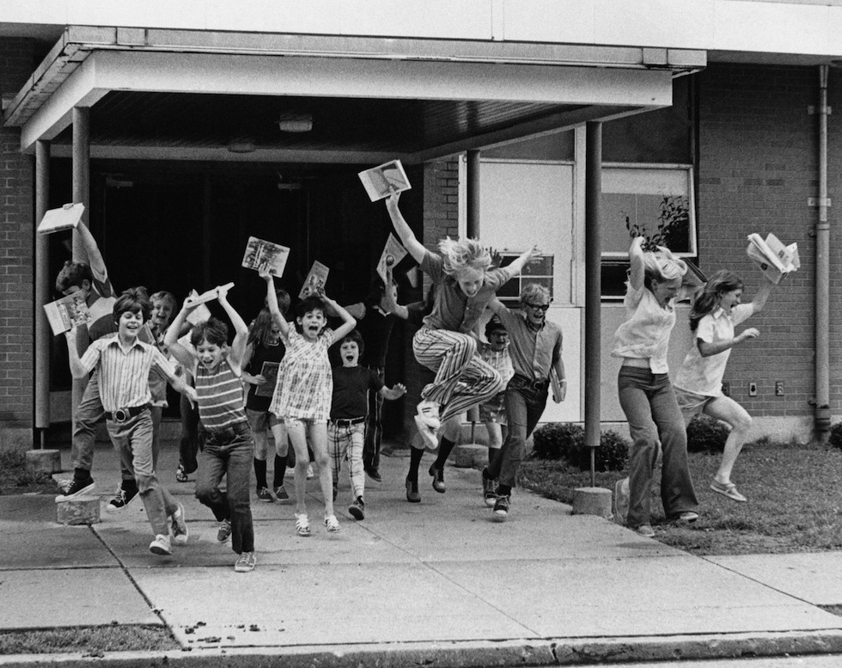

Slide 4
1. Be Self-Disciplined

Slide 5
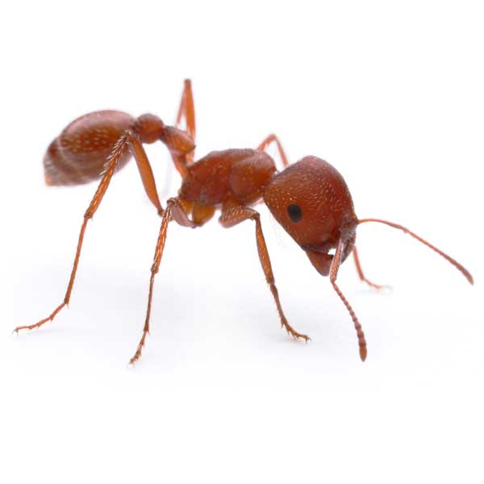
1. Be Self-Disciplined
Go to the ant, you sluggard! Consider her ways and be wise,
Which, having no captain, overseer or ruler,
Provides her supplies in the summer, and gathers her food in the harvest.
Proverbs 6:6-8

Slide 6
1. Be Self-Disciplined
Read your Bible.
Participate in VBS, camps.
Get a summer job.
Work on a new hobby.
Serve your brethren: visiting, yardwork, etc.

Slide 7
2. Vacation

Slide 8
2. Vacation

Slide 10
2. Vacation
“not forsaking the assembling of ourselves together…” (Hebrews 10:25)
wheresaintsmeet.com
bible.ca link “Find A Church Near You”

Slide 11
3. Immodest Dress
in like manner also, that the women adorn themselves in modest apparel, with propriety and moderation, not with braided hair or gold or pearls or costly clothing,
but, which is proper for women professing godliness, with good works.
1 Timothy 2:9-10

Slide 12
3. Immodest Dress
in like manner also, that the women adorn themselves in modest apparel, with propriety and moderation, not with braided hair or gold or pearls or costly clothing,
but, which is proper for women professing godliness, with good works.
1 Timothy 2:9-10

Slide 13
3. Immodest Dress
in like manner also, that the women adorn themselves in modest apparel, with propriety and moderation, not with braided hair or gold or pearls or costly clothing,
but, which is proper for women professing godliness, with good works.
1 Timothy 2:9-10

Slide 14
3. Immodest Dress
in like manner also, that the women adorn themselves in modest apparel, with propriety and moderation, not with braided hair or gold or pearls or costly clothing,
but, which is proper for women professing godliness, with good works.
1 Timothy 2:9-10

Slide 15
3. Immodest Dress
in like manner also, that the women adorn themselves in modest apparel, with propriety and moderation, not with braided hair or gold or pearls or costly clothing,
but, which is proper for women professing godliness, with good works.
1 Timothy 2:9-10

Slide 16
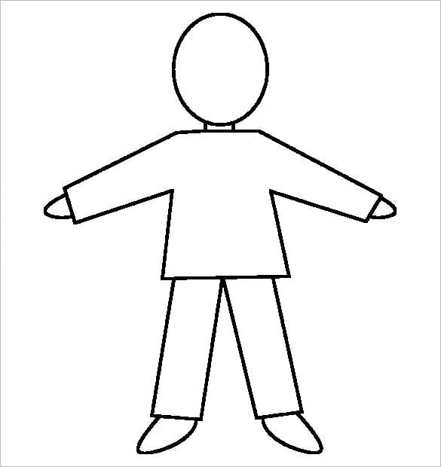
3. Immodest Dress
The Bible reveals what constitutes nakedness.
Thigh - Ex. 28:42
Buttocks - Is. 20:4
Breasts - Ezek. 16:7

Slide 17
3. Immodest Dress
“Also for Adam and his wife the Lord God made tunics of skin, and clothed them” (Gen. 3:21).
Kethoneth - “the basic outer garment worn next to the skin, was a long shirt reaching the knees or ankles” (Wenham).

Slide 18
4. Mixed Swimming

Slide 19
4. Mixed Swimming
Falls under the sinful category of lewdness or lasciviousness.
Aselgeia - “excess, licentiousness, absence of restraint, indecency, wantonness” (Vine).
Ephesians 4:17-20
Galatians 5:19-21

Slide 20
SCHOOL’S OUT!
Self Discipline
Vacation
Immodest Dress
Mixed Swimming

