Slide 2
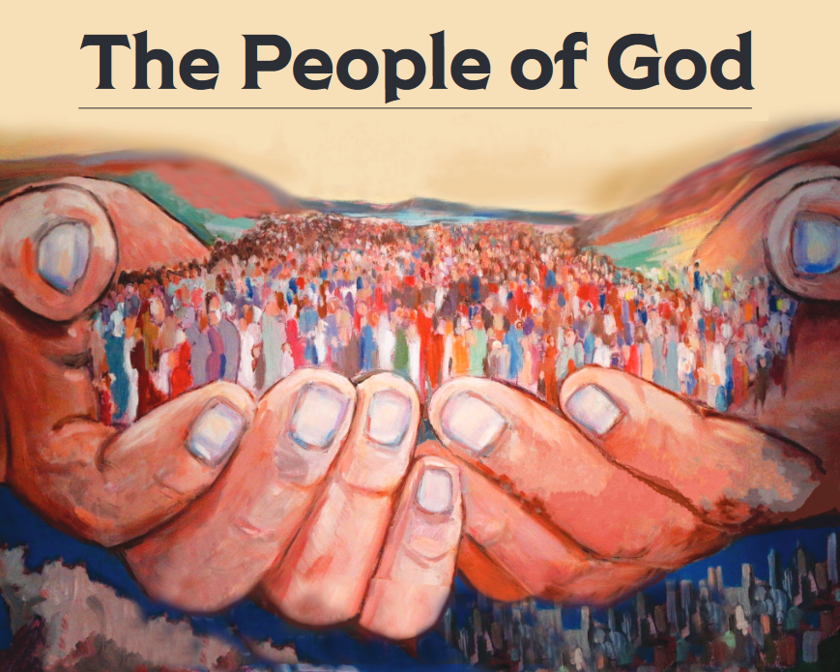
“But you are a chosen race, a royal priesthood, a holy nation, a people for God’s own possession, so that you may proclaim the excellencies of Him who has called you out of darkness into His marvelous light; for you once were not a people, but now you are the people of God.” (1 Peter 2:9-10)

Slide 3
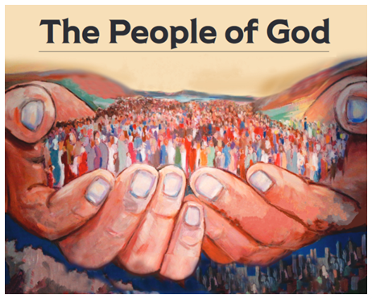
A People In Waiting
Acts 1:10-11

Slide 4
Jesus is not coming...
(I Thes. 5:1-3)
(Jn. 5:28-29)
(Mk. 9:1; Col. 1:13-14)
At a date/time that any man can determine
To ‘‘rapture’’ anyone
To establish an earthly kingdom

Slide 5
Jesus is coming...
To keep his word
To condemn the wicked
To save the righteous for all eternity
To bring an end to this world
(Jn. 14:1-3)
(II Thes. 1:7-9)
(Heb. 9:28)
(II Pet. 3:8-10)

Slide 6
Jesus is REALLY coming!
Jesus is coming...
To keep his word
To condemn the wicked
To save the righteous eternally
To bring an end to this world
(II Pet. 3:11-13)
(Heb. 10:26-31)
(I Thes. 4:13-18)
(II Thes. 1:10)
(Rev. 6:15-17)
(I Cor. 16:22)

Slide 7
Maranatha
O Lord, come!

