Slide 2
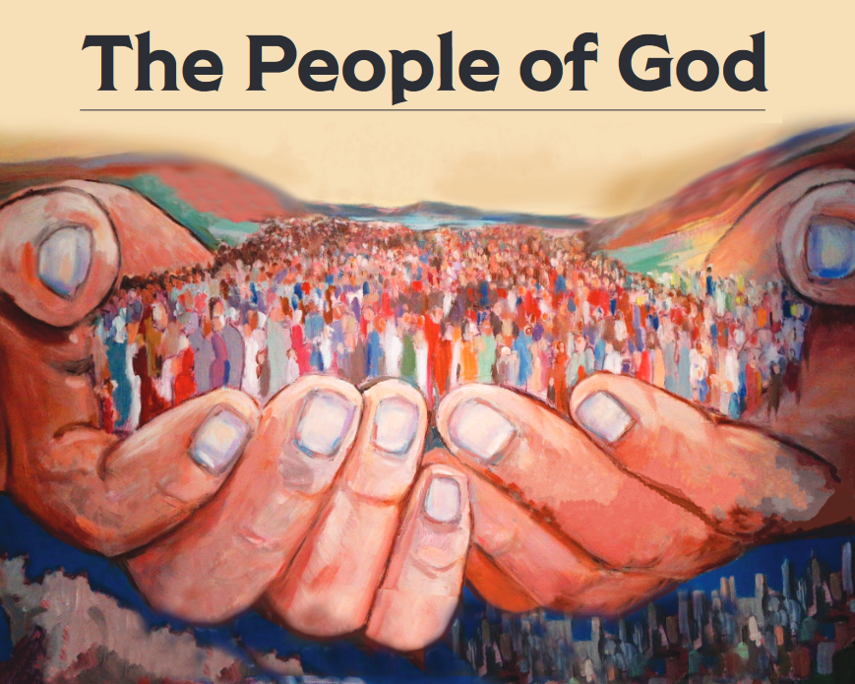
“But you are a chosen race, a royal priesthood, a holy nation, a people for God’s own possession, so that you may proclaim the excellencies of Him who has called you out of darkness into His marvelous light; for you once were not a people, but now you are the people of God.” (1 Peter 2:9-10)

Slide 3
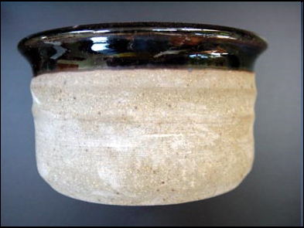
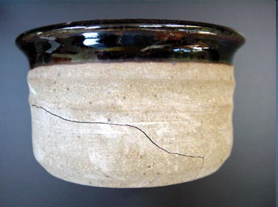
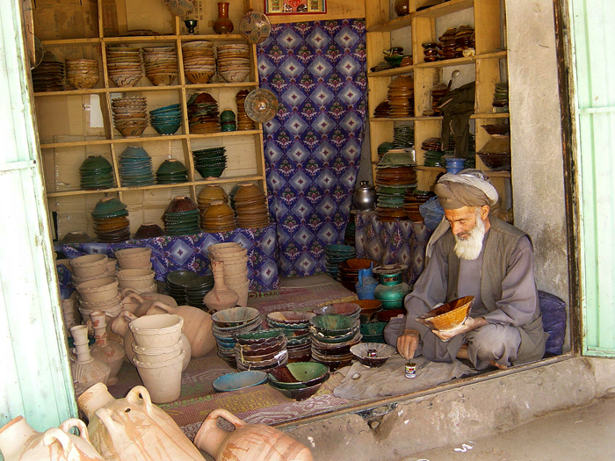
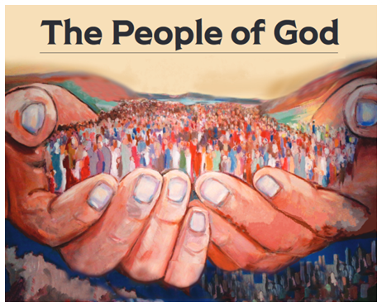
A Sincere People
Sine Cera
≈ Without Wax
Genesis 20:1-14

Slide 4
“Sincerity” In Scripture…
“Integrity”
“Pure” or “Without Guile”
“Incorruptible”
“Genuine”
Living a life consistent with one’s beliefs, and then having those beliefs permeate every facet of one’s life.

Slide 5
3 Truths About Sincerity…
Sincerity will not turn wrong into right.
Sincerity gets you the opportunity to do right.
Sincerity demands that you start doing right.

