Slide 2
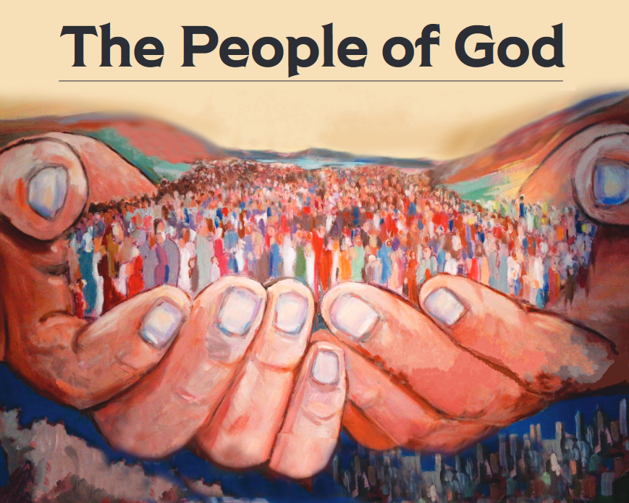
“But you are a chosen race, a royal priesthood, a holy nation, a people for God’s own possession, so that you may proclaim the excellencies of Him who has called you out of darkness into His marvelous light; for you once were not a people, but now you are the people of God.” (1 Peter 2:9-10)

Slide 3
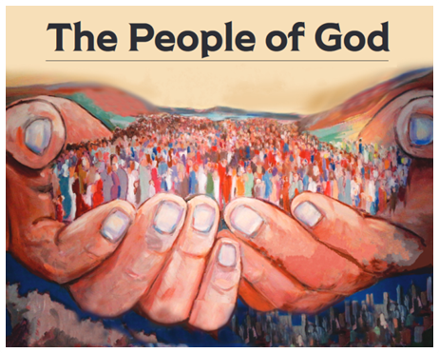
Matthew 6:9
A Reverent People

Slide 4
Learning From Exodus 20:7
“You shall not take the name of the LORD your God in vain, for the LORD will not hold him guiltless who takes his name in vain.”
God’s name represents all that He is, His character
God takes a risk by revealing His name (ie. misused, abused)
God gives His name because He wants us to know Him

Slide 5
Learning From Exodus 20:7
“You shall not take the name of the LORD your God in vain, for the LORD will not hold him guiltless who takes his name in vain.”
Disrespect for God, demonstrated by the thoughtless, or pointless, or misleading, or false use of His name

Slide 6
Learning From Exodus 20:7
“You shall not take the name of the LORD your God in vain, for the LORD will not hold him guiltless who takes his name in vain.”
God takes the misuse of His name as a direct attack on Him
God expects to be taken seriously

Slide 7
How We Can Fail To Reverence God’s Name
Using God’s name as an exclamation point (“OMG!”)
Attaching God’s name to profanity
Connecting God’s name to evil deeds
Associating God’s name with things He has not said
Invoking God’s name in worship, while “going through the motions”

