Slide 2
Jesus Washes the Disciples’ Feet
John 13:1-17

Slide 3
Prelude John 13:2-3
Just instituted the Lord’s Supper.
Judas was looking to betray Jesus.
Jesus was aware of the position He held.
The disciples were once again arguing about greatness (Luke 22:24-27).

Slide 4
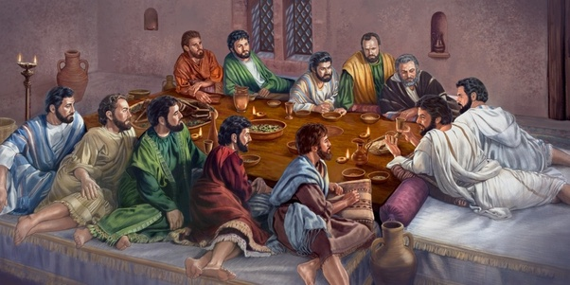
Washing verses 4-5

Slide 5
An Objection verses 6-11
Peter objected to this being done to him.
Peter continued to object.
“You shall never wash my feet!”
“You will not never wash my feet!”
Jesus made this washing essential to ongoing fellowship.
Peter requested a full washing.

Slide 6
An Objection verses 6-11
“He who is bathed needs only to wash his feet, but is completely clean…”
bathed (louo) “to wash, as a rule, the whole body.”
wash (nipto) “used frequently to indicate the washing of extremities – hands and feet”

Slide 7
The Lesson verses 12-17
“For I have given you an example, that you should do as I have done to you” (v. 15).
Jesus did not institute ceremonial foot washing.
He answered their controversy regarding the greatest in the kingdom with an extreme example of humility and service.
“If you know these things, blessed are you if you do them” (v. 17).

Slide 8
Illustration of Philippians 2:6-8
who, being in the form of God, did not consider it robbery to be equal with God,
but made Himself of no reputation, taking the form of a bondservant, and coming in the likeness of men.
And being found in appearance as a man, He humbled Himself and became obedient to the point of death, even the death of the cross.

