Slide 2
Social Media Evangelism

Slide 3
We are to be Salt and Light Matthew 5:13-16
79% of Americans have a social media account.
Facebook is the largest social media platform, with over 2.9 billion accounts worldwide.
People with a large social media following are called “influencers.”
Have you thought about trying to be a social media “influencer” for the gospel?

Slide 4
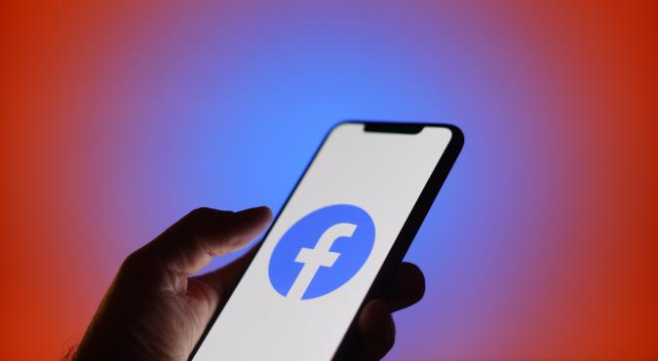
How you can use social media in personal evangelism.

Slide 5
How you can use social media in personal evangelism.
Share social media posts from Knollwood.

Slide 6
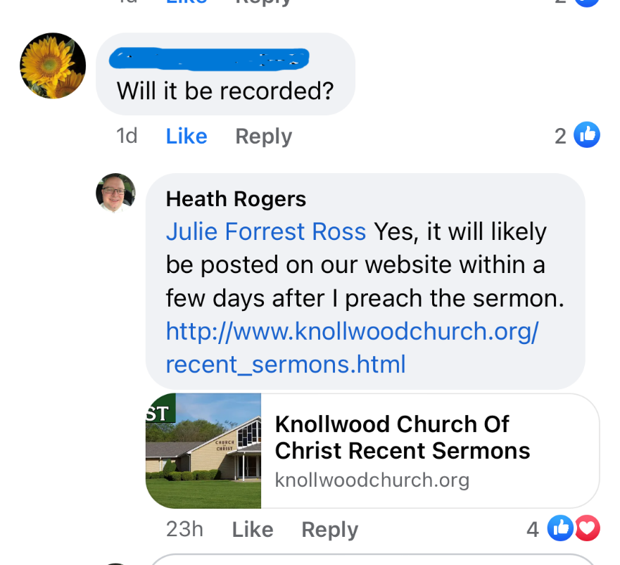
How you can use social media in personal evangelism.
Share social media posts from Knollwood.
Direct people to our website.

Slide 7
How you can use social media in personal evangelism.
Share social media posts from Knollwood.
Direct people to our website.
Post something positive about Knollwood.

Slide 8
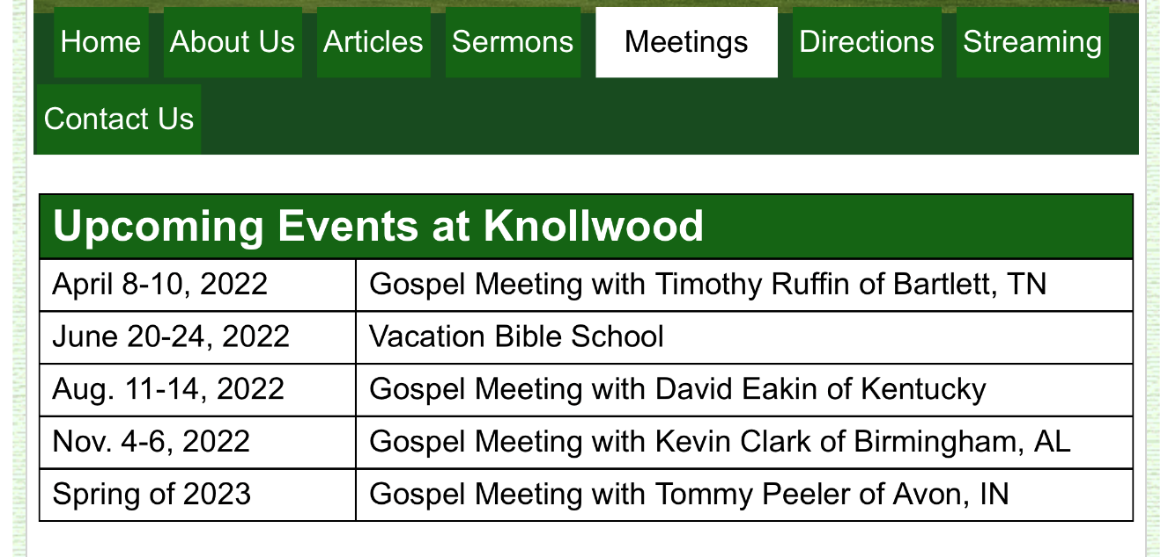
How you can use social media in personal evangelism.
Share social media posts from Knollwood.
Direct people to our website.
Post something positive about Knollwood.
Announce upcoming church events.

Slide 9
How you can use social media in personal evangelism.
Share social media posts from Knollwood.
Direct people to our website.
Post something positive about Knollwood.
Announce upcoming church events.
Post something about your daily Bible reading.

Slide 10
Rules for using social media for personal evangelism.
Be real.
Don’t be a hypocrite.
Don’t be offensive - 1 Cor. 9:19-23.
Don’t be argumentative or judgmental.
Colossians 4:5-6
Be brief.
Use pictures.

Slide 11
Social Media Evangelism

