Slide 2
Daniel, A.D. 70 & The Second Coming
Daniel 7.9-14

Slide 3
Trending ideas in the religious world
Premillennialists identifying signs / AD 70 doctrine – not happening
Recent post / meme – “ The New Testament doesn’t say one word about the second coming taking place after AD 70
Recent article proposes Christ returned in AD 70
Refers to belief of coming return as Futurism
Combines prophecies from Dan & NT to prove this point
Take a look at …
Statements made, texts cited
Then compare that to what the New Testament has to say
Compare the scriptural evidence to the statements made

Slide 4
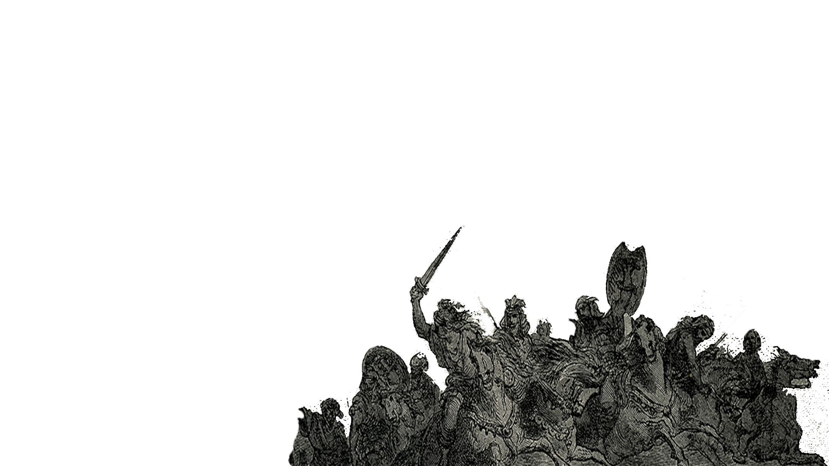
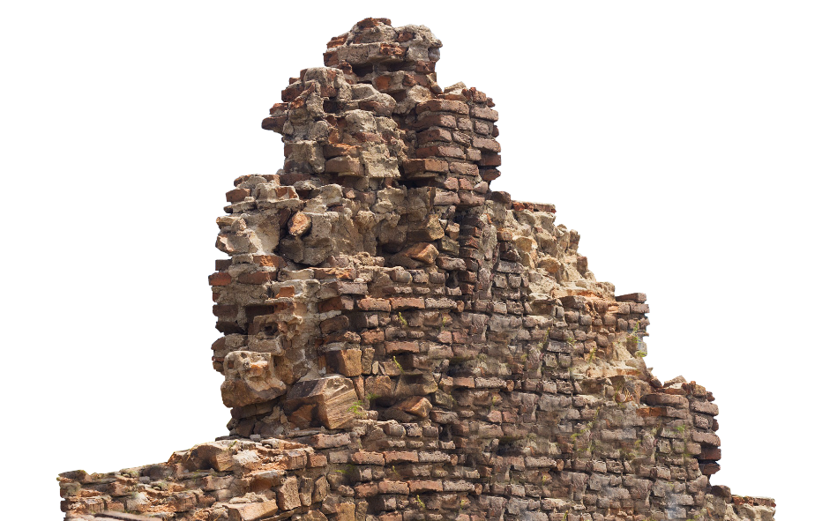
Statements about Christ’s return & references
Dan 7.13 – Son of man coming in clouds with angels for the opening of the books of judgment
Dan 12.2,11 / Matt 24.15 - Resurrection of just / unjust correlated to the time of the appearance of the abomination of desolation
Matt 24.34 – All to fulfilled during the generation alive at that time

Slide 5
Statements about Christ’s return & references
“…since there is only one prophecy of the son of man coming in the clouds of heaven with the holy angels for the opening of the books of judgment then all references in the New Testament must agree with the time frame posited by Jesus for that event and must also include the eschatological elements of the resurrection of the just and the unjust and the opening of the books of judgment because there was only one 2nd coming of the Lord foretold”

Slide 6
Questions & Considerations
1. Is Daniel talking about the second coming of Christ in Daniel chapter 7 and chapter 12 ?
2. Is Daniel talking about Christ judging the world in these chapters ??
Some things to consider
1. At face value it is easy to mistake the passages in Daniel for the second coming.
2. In order to understand what Daniel is referring to we’ll
a. Summarize what the New Testament says about the 2nd coming
b. Briefly review Daniel to establish the context of the prophecies
c. Take a close look at Daniel chapter 12 / chapter 7
d. Draw conclusions based on the scriptures

Slide 7
What the New Testament says about the 2nd coming
a. No sign given - Matt 24.42
b. As a thief in the night - 2 Pet 3.10
c. As in the days of Noah - Matt 24.37-39
d. Only God knows when - Matt 24.36
e. As the lightning from East to West - Matt 24.27
f. Trump of the Lord to sound - 1 Cor 15.52
g. Christ revealed with his angels - Matt 24.30-31, 2 Thess 1.7-9
h. Dead to rise first - 1 Cor 15.52
i. With Christ in the air - 1 Thess 4.16-17
j. Judgment takes place - Rom 14.11-12
k. Physical universe destroyed - 2 Pet 3.11
l. Kingdom delivered up to God - 1 Cor 15.24

Slide 8
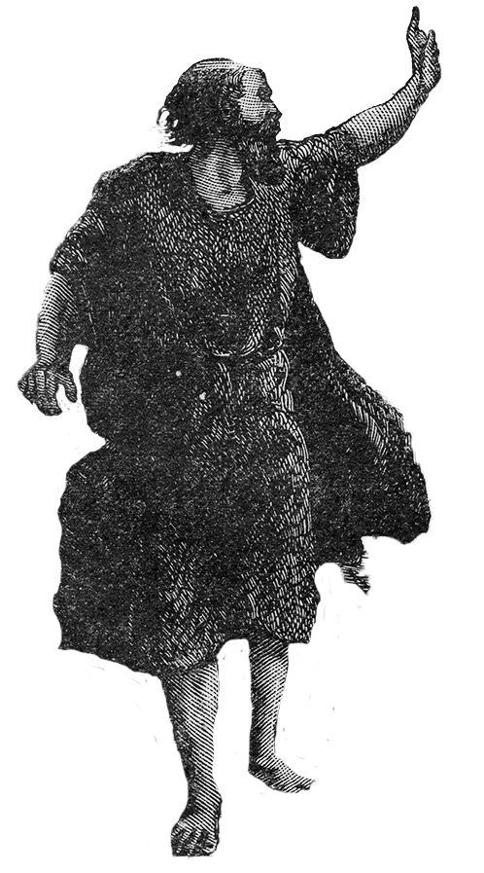
Overview of Daniel
a. Daniel one of the first captives taken in 606 B.C.
b. Lived until the end of the 70 years
c. Saw …
1. The end of the Chaldean dynasty in Babylon,
2. The end of the Babylonian dynasty,
3. Beginning of the Medo-Persians
d. Prophecy given spans the kingdoms from the Babylonians to the Romans (Chaldeans / Babylonians, Medes / Persians, Greeks, Romans)
e. Speaks of God’s judgment against each of these powers
f. Represents the last chronological prophecy in the Old Testament - which is about AD 70

Slide 9
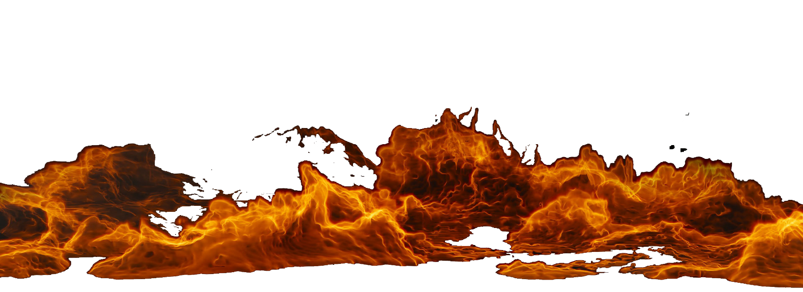
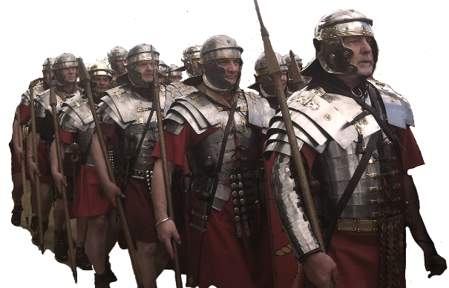
The prophecy of Daniel 12
Dan 12.1 – A time of trouble such as never was since there was a nation
Matt 24.15-21 – For then shall be great tribulation
Dan 12.2 – And many of them the sleep … shall awake
1 Cor 15.52 – At the last trump … dead shall be raised
Rom 14.11 – Every knee shall bow to me / confess to God
Dan 12. 11 – Abomination that maketh desolate setup
Matt 24.15 – Abomination of desolation spoken of by Daniel … flee (?)
Rev 1.7 – Behold he cometh with clouds – every eye shall see him – all kindreds of the earth

Slide 10
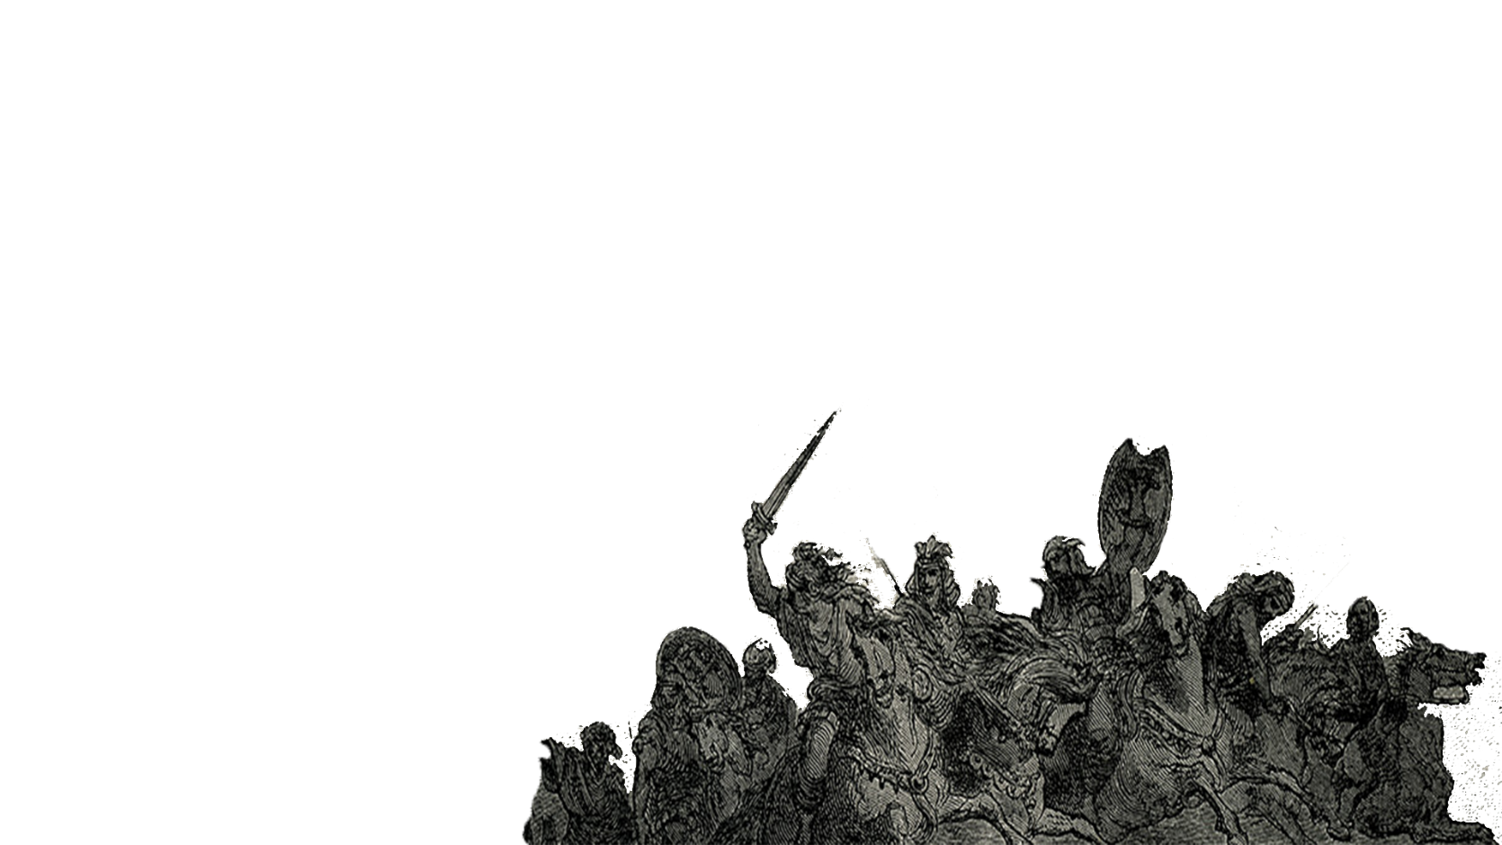
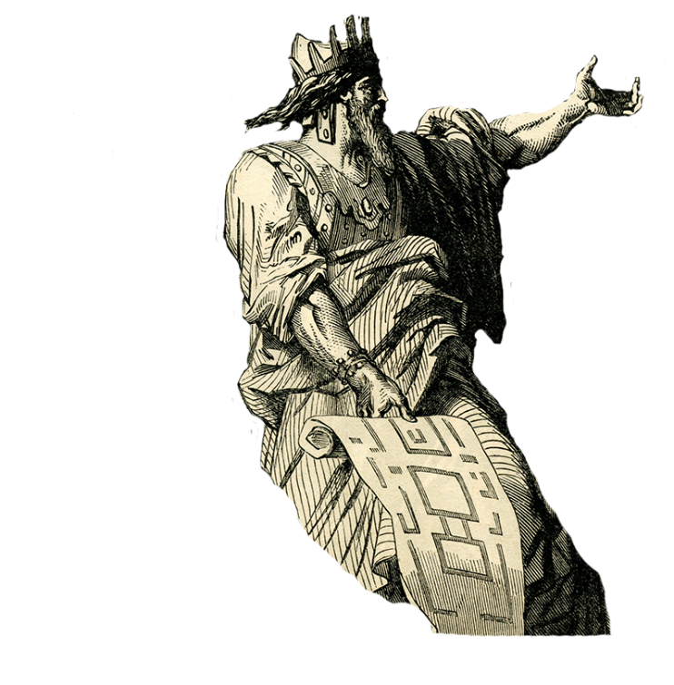
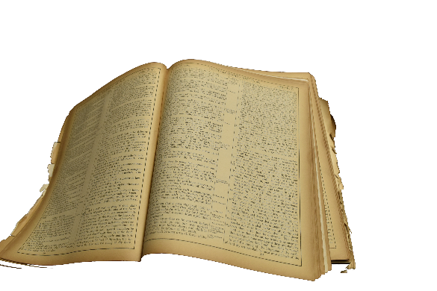
The prophecy of Daniel 7
Dan 7.9-10 – Thrones cast down, Ancient of days … judgment was set… books open
Dan 7.12 – Beasts dominion taken away … lives prolonged for a season –
problems with this being the second coming of Christ or the final judgment
Ancient of days has rendered judgment
Acts 17.31 – God to judge through “that man” delegated through Christ
Dan 7.12 – lives of the beasts have been prolonged –
Not the final judgment – second coming – that ends with destruction

Slide 11
The prophecy of Daniel 7
Dan 7.13 – I saw in the night visions, and, behold, one like the Son of man came with the clouds of heaven, and came to the Ancient of days, and they brought him near before him
Not accompanied by angels
Not going to the Earth – goes to Ancient of days (God the Father)
Not rendering judgment – Already done by Ancient of days

Slide 12
The prophecy of Daniel 7
Dan 7.14 – And there was given him dominion, and glory, and a kingdom, that all people, nations, and languages, should serve him: his dominion is an everlasting dominion, which shall not pass away, and his kingdom that which shall not be destroyed
Given dominion, glory, kingdom for all people, nations, languages
Kingdom is everlasting
Same kingdom as in Nebuchadnezzar’s dream – Daniel 2
Matt 16.18 - ... thou art Peter, and upon this rock I will build my church; and the gates of hell shall not prevail against it. (Pentecost – Acts 2)

Slide 13
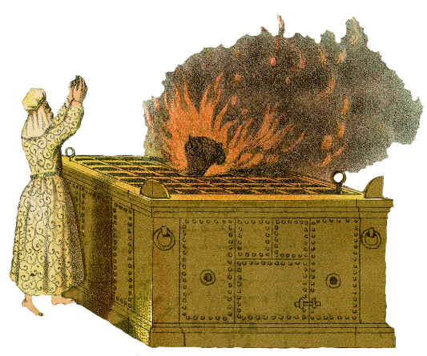
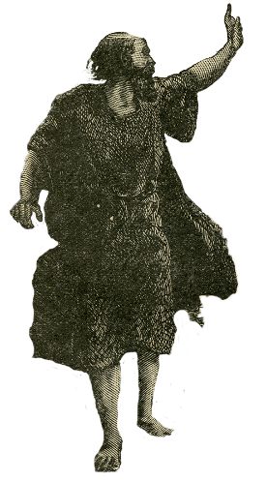
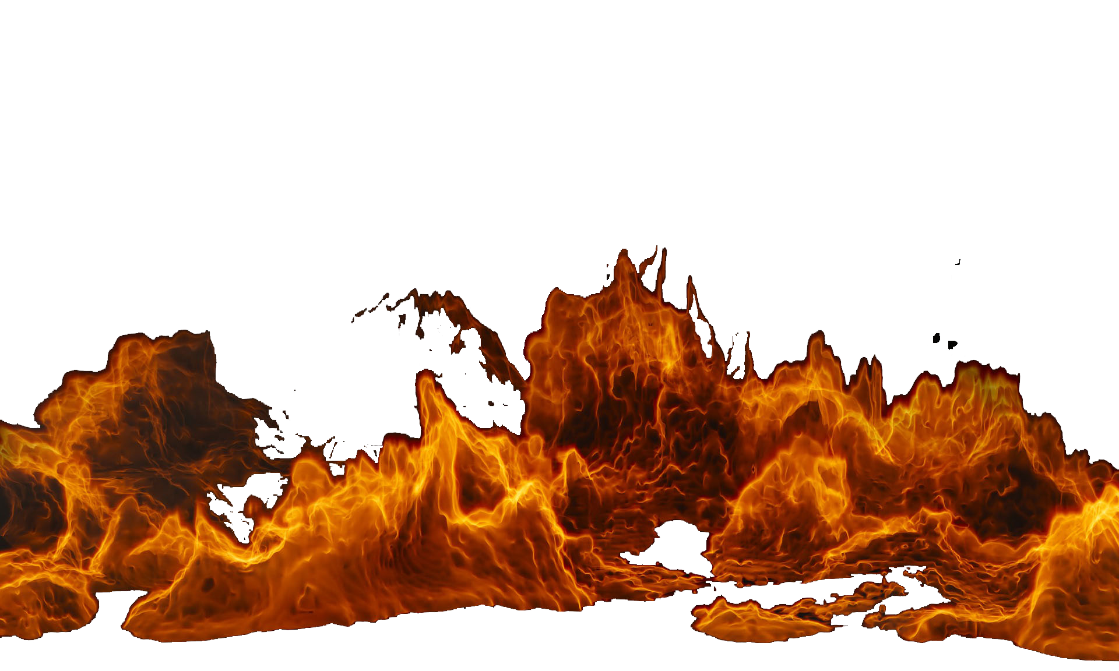
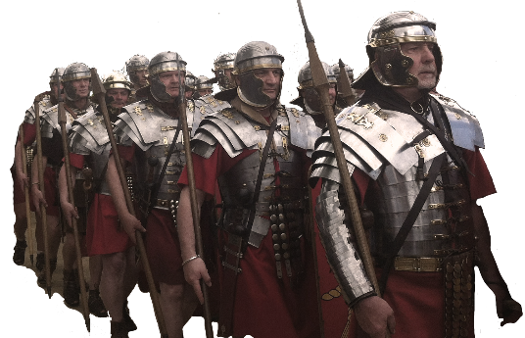
Conclusions / Summary
a. Daniels’s prophecies speak of kingdoms - Babylon, Persia, Greece, Rome
b. Daniel’s prophecy of a great tribulation cover dest of Jerusalem in AD 70 - Christ
c. Daniel’s prophecies are the last chronologically in the O.T. / end with AD 70
d. Second coming and description are covered only in the New Testament
e. Christ’s statements in Matt 24 deal with three events - church, Jerusalem, 2nd coming

Slide 14
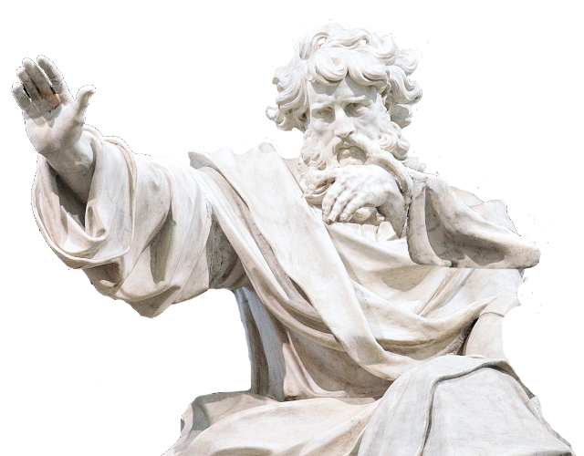
Conclusions / Summary
f. Characteristics of the second coming
1. Only God knows when
2. No sign
3. All will be raised / judged
4. Christ will be the judge
5. Judge according to word he spoke (John 12.48)
6. Physical universe destroyed
7. Kingdom presented to God
8. Hasn’t taken place yet
9. Everyone will know when it happens

Slide 15
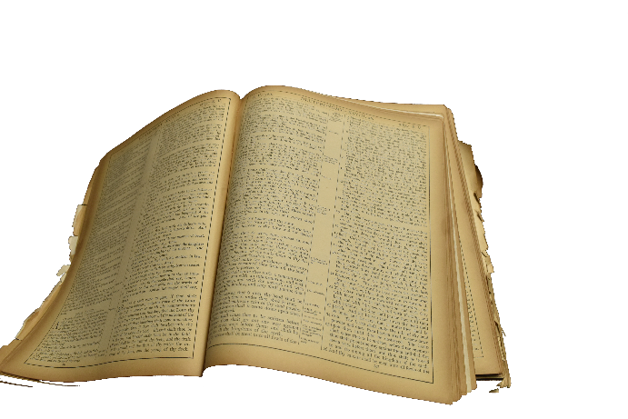
Some Final Thoughts
For those who look for signs of the end – Matt 24.42 no sign given
For those who think the 2nd coming is past – 2 Pet 3.10 – like thief
For those who are wishing for Christ to return to solve all the problems:
Woe unto you that desire the day of the Lord! to what end is it for you? the day of the Lord is darkness, and not light. – Amos 5.8
Be careful what you wish for!

Slide 16
Are you ready???

