Slide 2
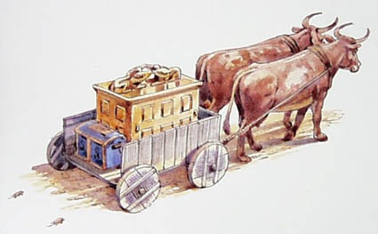
Uzza and the Ark
1 Chronicles 13

Slide 3
Lessons from Uzza and the Ark
The Seriousness of God’s Authority
The Danger of Neglect
Sincerity Alone is Not Enough
Ignorance is No Excuse
God Honors Obedience

