Slide 2
How Shall The Young Secure Their Hearts?
Psalm 119:9-16

Slide 3
Decisions
determine
your

Slide 4
Making Godly Decisions
How many of you plan on getting drunk?

Slide 5
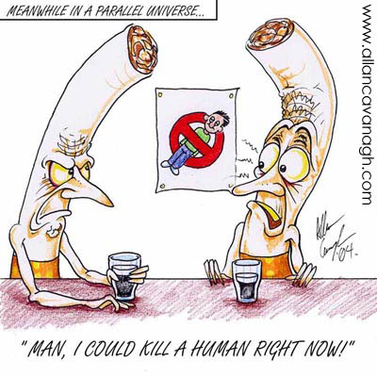
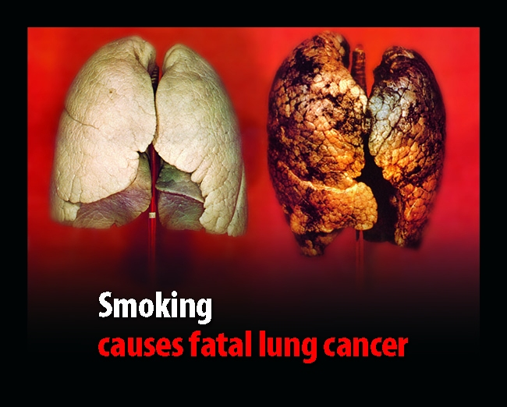
Making Godly Decisions
How many of you plan on starting to smoke, get lung cancer, and die a painful death?

Slide 6
Making Godly Decisions
How many of you plan on becoming addicted to porn and ruin your most precious relationships?

Slide 7
Making Godly Decisions
How many of you plan on getting hooked on drugs and spend time in jail and recovery?

Slide 8
Making Godly Decisions
How many of you plan on marrying someone who will not help you get to heaven?

Slide 9
Short term decisions should be based on long term goals/decisions.

Slide 10
Review Reverse Brainstorming
How can we make sure and not listen to God?
What can we do to make sure that we do not get to Heaven?

Slide 11
Decision Guidelines
God and His Word!
Godly Wisdom
Avoid Panic Decisions

Slide 12
How Shall The Young Secure Their Hearts?
Psalm 119:9-16

