Slide 2
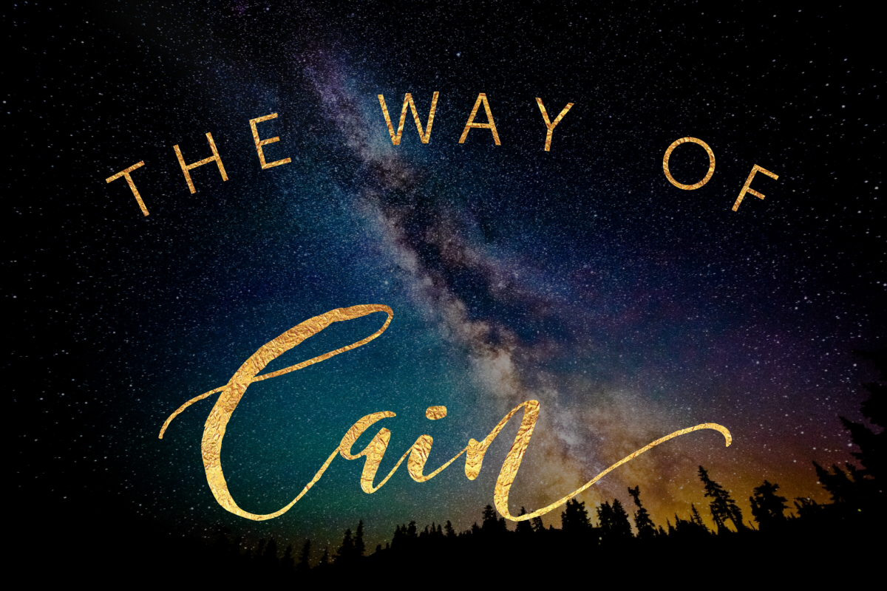
Genesis 4:1-13

Slide 3
1. Cain Was Religious
One’s religious service may be in error.
Heb. 11:4; Rom. 10:17
One’s religious service may be in vain.
Matthew 15:8-9

Slide 4
2. Cain Was Self-Willed
Cain offered what he wanted to offer, with no true respect for God or His authority.
Therefore, God had no respect for Cain or his offering.

Slide 5
2. Cain Was Self-Willed
King Saul
“So Samuel said: ‘Has the Lord as great delight in burnt offerings and sacrifices, as in obeying the voice of the Lord? Behold, to obey is better than sacrifice, and to heed than the fat of rams.
For rebellion is as the sin of witchcraft, and stubbornness is as iniquity and idolatry. Because you have rejected the word of the Lord, He also has rejected you from being king.’”
1 Samuel 15:22-23

Slide 6
2. Cain Was Self-Willed
The Nation of Israel
“And testified against them, that You might bring them back to Your law. Yet they acted proudly, and did not heed Your commandments, but sinned against Your judgments, ‘Which if a man does, he shall live by them.’ And they shrugged their shoulders, stiffened their necks, and would not hear.
Yet for many years You had patience with them, and testified against them by Your Spirit in Your prophets. Yet they would not listen; therefore You gave them into the hand of the peoples of the lands.”
Nehemiah 9:29-30

Slide 7
2. Cain Was Self-Willed
The Nation of Israel
“And testified against them, that You might bring them back to Your law. Yet they acted proudly, and did not heed Your commandments, but sinned against Your judgments, ‘Which if a man does, he shall live by them.’ And they shrugged their shoulders, stiffened their necks, and would not hear.
Yet for many years You had patience with them, and testified against them by Your Spirit in Your prophets. Yet they would not listen; therefore You gave them into the hand of the peoples of the lands.”
Nehemiah 9:29-30

Slide 8
2. Cain Was Self-Willed
The Nation of Israel
“And testified against them, that You might bring them back to Your law. Yet they acted proudly, and did not heed Your commandments, but sinned against Your judgments, ‘Which if a man does, he shall live by them.’ And they shrugged their shoulders, stiffened their necks, and would not hear.
Yet for many years You had patience with them, and testified against them by Your Spirit in Your prophets. Yet they would not listen; therefore You gave them into the hand of the peoples of the lands.”
Nehemiah 9:29-30

Slide 9
2. Cain Was Self-Willed
The Nation of Israel
“And testified against them, that You might bring them back to Your law. Yet they acted proudly, and did not heed Your commandments, but sinned against Your judgments, ‘Which if a man does, he shall live by them.’ And they shrugged their shoulders, stiffened their necks, and would not hear.
Yet for many years You had patience with them, and testified against them by Your Spirit in Your prophets. Yet they would not listen; therefore You gave them into the hand of the peoples of the lands.”
Nehemiah 9:29-30

Slide 10
3. Cain Was Envious
Envy is a source for “every evil thing” - James 3:16
Joseph’s brothers sold him into slavery because of envy - Gen. 37:11
Saul tried to kill David because of envy - 1 Sam. 18
Jesus was delivered up by the elders and chief priests because of envy - Matt. 27:18
Envy is a work of the flesh - Gal. 5:19-21

Slide 11
4. Cain Ignored God’s Warning
God took the time to warn Cain - Gen. 4:7
Cain’s parents ignored God’s warning - Gen. 2:17
God warns us through His word - Psalm 19:11

Slide 12
5. Cain Would Not Master Sin
“If you do well, will not your countenance be lifted up? And if you do not do well, sin is crouching at the door; and its desire is for you, but you must master it.”
Genesis 4:7, NASU

Slide 13
6. Cain Refused To Accept Responsibility
Cain refused to accept responsibility for his brother’s well-being - Gen. 4:9
Cain did not want to accept the punishment for his sin - Gen. 4:13
God holds us responsible and accountable for our choices and actions - Gal. 6:7; Rom. 14:10-12

Slide 14
The Way of Cain
Cain Was Religious
Cain Was Self-Willed
Cain Was Envious
Cain Ignored God’s Warning
Cain Would Not Master Sin
Cain Refused To Accept Responsibility
Are we walking in the way of Cain?

