Slide 2
Why Did Joshua Choose to Serve the Lord?
Joshua 24:15
“And if it seems evil to you to serve the Lord, choose for yourselves this day whom you will serve, whether the gods which your fathers served that were on the other side of the River, or the gods of the Amorites, in whose land you dwell. But as for me and my house, we will serve the Lord.”

Slide 3
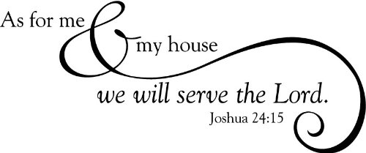
1. He Saw the Power of the Lord
God showed His power over the gods of Egypt in the plagues (Ex. 32:11).
God showed His power in dividing the Red Sea.
God’s power and presence were seen by Israel daily in the pillar of cloud and pillar of fire.

Slide 4
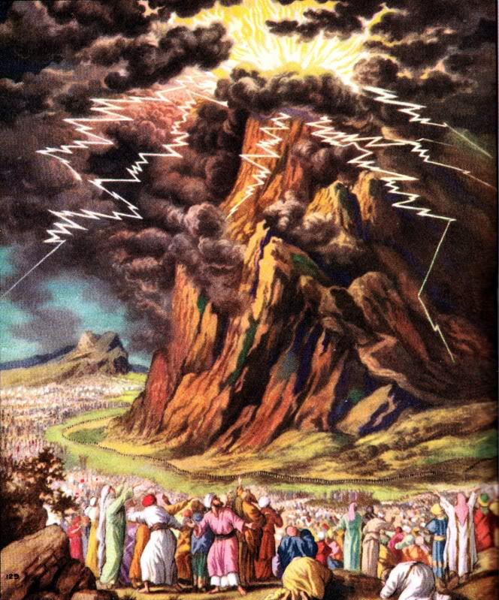
1. He Saw the Power of the Lord
Exodus 19:10-11, 16-19, 20:18-20
Lightning, thunder, fire, loud trumpet, smoke, earthquake
The people trembled and feared they would die

Slide 5
2. He Saw the Salvation of the Lord
The people of Israel were trapped against the Red Sea (Ex. 14:5-9).
They cried out in fear (vs. 10-14).
“Do not be afraid. Stand still, and see the salvation of the Lord…” (v. 13).

Slide 6
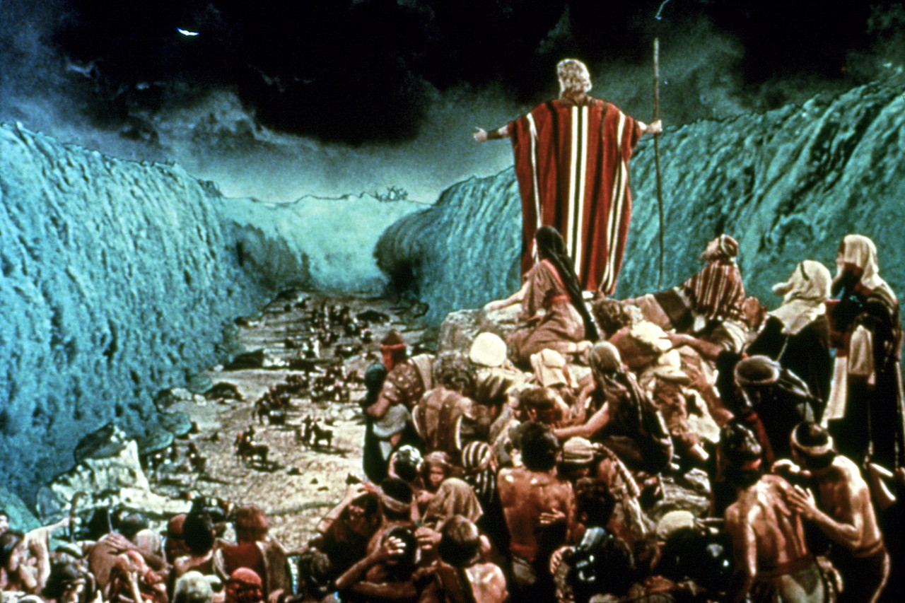
2. He Saw the Salvation of the Lord

Slide 7
3. He Saw the Judgment of the Lord
The Plagues Against Egypt
God’s judgment against Egypt (Ex. 7:3-5)
Manifestations of God’s power over the gods of Egypt
They increased in severity, eventually impacting the nation’s livelihood, strength and morale

Slide 8
3. He Saw the Judgment of the Lord
God’s Judgments Against Israel
“their bodies were scattered in the wilderness” (1 Cor. 10:5-11)
Korah’s rebellion (Num. 16:31-35)
Moses cannot enter Canaan (Num. 20:12)
Defeat at Ai (Josh. 7:1-9)

Slide 9
4. He Saw the Faithfulness of the Lord

Slide 10
4. He Saw the Faithfulness of the Lord
“So the Lord gave to Israel all the land of which He had sworn to give to their fathers…
The Lord gave them rest all around, according to all that He had sworn to their fathers…
Not a word failed of any good thing which the Lord had spoken to the house of Israel. All came to pass.”
Joshua 21:43-45

Slide 11
4. He Saw the Faithfulness of the Lord
“God is not a man, that He should lie, nor a son of man, that He should repent. Has He said, and will He not do? Or has He spoken, and will He not make it good?”
Numbers 23:19

Slide 12
4. He Saw the Faithfulness of the Lord
“He who calls you is faithful, who also will do it.”
1 Thess. 5:24
“In hope of eternal life which God, who cannot lie, promised before time began.”
Titus 1:2

Slide 13
Why Joshua Chose to Serve the Lord
He saw the POWER of the Lord
He saw the SALVATION of the Lord
He saw the JUDGMENT of the Lord
He saw the FAITHFULNESS of the Lord
Romans 15:4
Romans 10:17

Slide 14
Why We Must Chose to Serve the Lord
God is still the powerful God that Joshua saw on Mt. Sinai.
God has provided an even greater salvation than the Red Sea (the death and resurrection of His Son).
God will judge the world in righteousness.
God is faithful and will keep His promises to us.

