Slide 1
Notes:
Intro
Good afternoon everyone! It’s so wonderful to be here among the Saints, and to have this opportunity to worship our Lord and our God together with all of you! I want to thank the Elders for giving me this opportunity to speak this afternoon, and I pray that what is said here is in all accordance with The Word of God, and that as I strive to speak where the Bible Speaks and be silent where the Bible is silent, we all strive together to learn more about God’s Word.
I also want to thank Brother Randy Reeder for his great song selection and his work to lead us in Worship this afternoon, it is always a pleasure to hear all the Saints lift praises to God and I greatly appreciate that.
I won’t lie to you this afternoon, there are times when I experience some anxiety and nervousness, especially when I’m about to talk about something that I’ve never taught on before. So I’ve found that the best way to deprive Satan of his temptation to be anxious is just to talk about it for a minute. Each one of us will experience anxiety at different times in our lives, and we know it can be distracting. But as we gather together to learn more of God’s Word this afternoon, we can draw strength from knowing that God is giving us the blessing of being here and we can put the cares and concerns of this world out of our mind for a short time while we focus more on Him. So let’s do that now, and go to the Lord’s Word.
As I was thinking about was going to talk about this afternoon, and I spent some time thinking about things that I have not heard a lesson on in a little while. Now that is not meant as a negative commentary on Brother Heath, I have taken great pleasure in learning at his feet for the last few years and I have learned a great many things. While preparing for this lesson, I asked for his advice on this topic and he gave me a wealth of resources to draw from, so I am very grateful to him for that. But as I was thinking about Focusing on God, especially in those times when I can become anxious in my life, I remembered examples of people in distress or when sincerely seeking The Lord, they would Fast.

Slide 2
Faithfully fasting
Matthew 6:16-18
Notes:
So I’d like to take a few moments this afternoon to look at Fasting, and specifically Faithfully Fasting.
We’ll read again the scripture that was read by brother ______, if you would turn to Matthew 6 and we’ll look at 16-18.

Slide 3
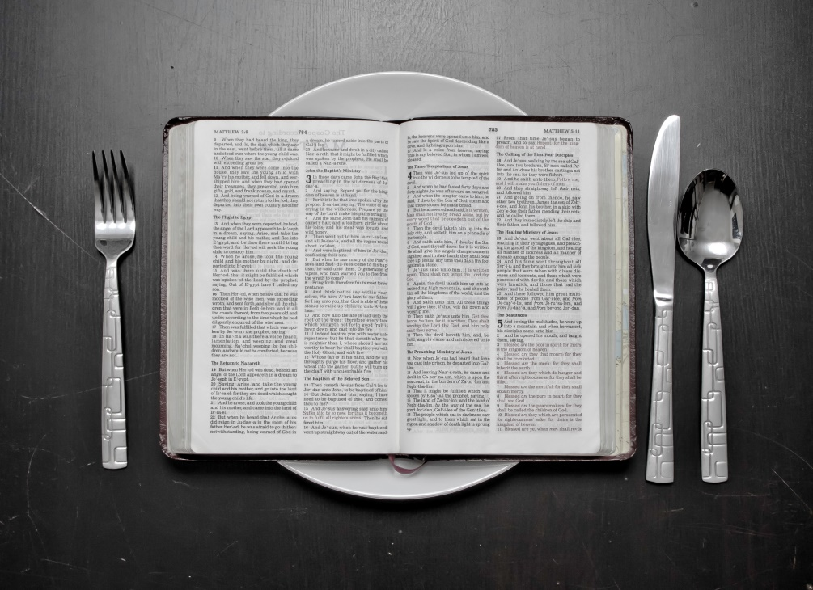
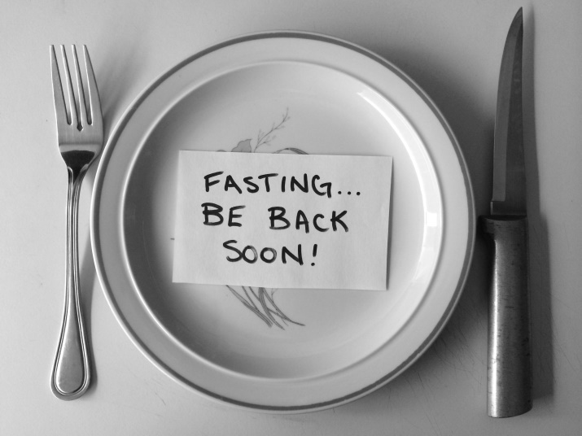
What is fasting?
Dictionary.com -
“Abstain from all or some kinds of food or drink, especially as a religious observance.”
Synonyms: eat nothing, abstain from food, refrain from eating, go without food, go hungry, starve oneself; go on a hunger strike; crash-diet
Notes:
Define what fasting is
From Dictionary.com: Abstain from all or some kinds of food or drink, especially as a religious observance.
Synonyms: eat nothing, abstain from food, refrain from eating, go without food, go hungry, starve oneself; go on a hunger strike; crash-diet
- We understand fasting to be the physical act of abstaining or depriving oneself of food or drink, and we talk about it more often than we realize when we say the term, Breakfast (to break a fast, the fast while we sleep)
Describe spiritual fasting vs strictly physical fasting
- There is however a difference between solely fasting for Physical means and fasting for Spiritual means.
- Fasting as a means of focusing one’s mind on God can be total abstinence of food and drink, or partial such as a water only fast, for a short period such as from sunrise to sunset, or for longer periods such as a few days, a week, three weeks or 40 days.

Slide 4
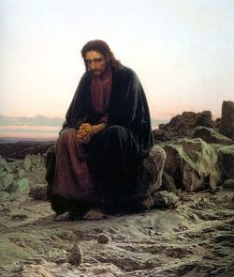
Lengths of a fast?
Biblical Examples -
1 day - 1 Sam 31:13
Three weeks - Dan 10:3
40 days - Ex 34:28 (Moses)
- 1 Kings 19:8 (Elijah)
- Matt 4:2 (Jesus)
Notes:
We can go to the Bible for examples of Fasting for various different lengths of time;
- After burying the bones of Saul and his sons, 1 Sam 31:13 shows us a fast for 1 day by the valiant men of Jabesh Gilead
- During the time that Daniel was morning over his people, a fast of 3 Weeks can be seen in Daniel 10:3
- And 40 Days can be seen in several places, with Moses in Ex 34:28, Elijah in 1 Kings 19:8 and Jesus Christ in Matt 4:2
- Though there is not a known origin of the practice of Fasting for Spiritual means, there are many examples of Fasting in the Old and New Testaments, and we can ask the question; “What place does Fasting have in the life of a Christian Today? Should we do it? Are we Commanded?”

Slide 5
Old Testament Fasting
Penitence / Repentance-
Nehemiah 9:1, Jeremiah 14:11-12, Jeremiah 36:9, Jonah 3:5, 1 Samuel 7:6, Esther 4:1-3, Joel 2:12
Distress-
2 Samuel 12:15-23, Judges 20:26
Sorrow / Grief / Mourning-
Esther 4:1-3, 1 Samuel 31:11-13, 2 Samuel 1:11-12, Nehemiah 1:4-7, Nehemiah 9:1
Seeking The Lord’s Guidance-
Ezra 8:21-23
Petitioning / Requests-
2 Chronicles 20:1-3
Sincerity / Consecration-
Joel 1:13-14
Seeking Help / Deliverance-
Judges 20:26, 2 Samuel 1:11-12, Nehemiah 1:4-7, Psalm 35:13, Psalm 69:10, Daniel 6:18, Daniel 9:1-3
Humbling Self / Discipline-
Judges 20:26, 1 Kings 21:27-28, Psalm 69:10
Notes:
Examples of Spiritual Fasting - Old Testament / it was Commanded
- In the Old Testament, we see many instances of Fasting for various reasons and under many difference circumstances for many different outcomes.
Penitence / Repentance - The Word of The Lord came to Jeremiah in Jeremiah 36:9 to write all the inequities of Judah and to have them read aloud, when they were read, a fast was called as a sign of penitence, sincerity and repentance.
Seeking The Lord’s Guidance - Ezra proclaims a fast to humble self and seek God’s Guidance looking for “the right way for us and our little ones.” in Ezra Chapter 8 verse 21-23
Sorrow / Grief / Mourning - In Esther 4:1-3, Esther requested Mordecai tell all the Jews in Shushan to fast, and that her maids and her would fast when she was to approach the king over the decree made against the Jews. Great sorrow and grief and mourning fell over the people in their time of distress.
Humble Self /Discipline body - 1 Kings 21:27-28, King Ahab fasts as a means to humble himself for his sin
Seeking Help or Deliverance - The Psalmist in Psalm 35:13 would fast and pray for those who are sick
Distress in a given circumstance - In Judges 20:26 we see a day of fasting called in their time of distress as a sign of sincerity and to discipline their bodies for Israel’s war with the Benjamites was at hand
Petition The Lord / Requests - Jehoshaphat would proclaim a fast for all of Judah to petition The Lord to save them from their enemies in 2 Chronicles 20:1-3
Sincerity / Consecrating of self - Then in the book of Joel, chap 1:13-14, The Word of The Lord would come to Joel to tell all the inhabitants of the land to consecrate themselves with a Fast
We might tend to have the idea that the Jews under the Old Law were told to fast all the time because of the many instances we see in the Old Testament of people fasting, and for a variety of reasons. There were many Fasts in the Jewish tradition, for celebration and for tribulation, but only one that was commanded.

Slide 6
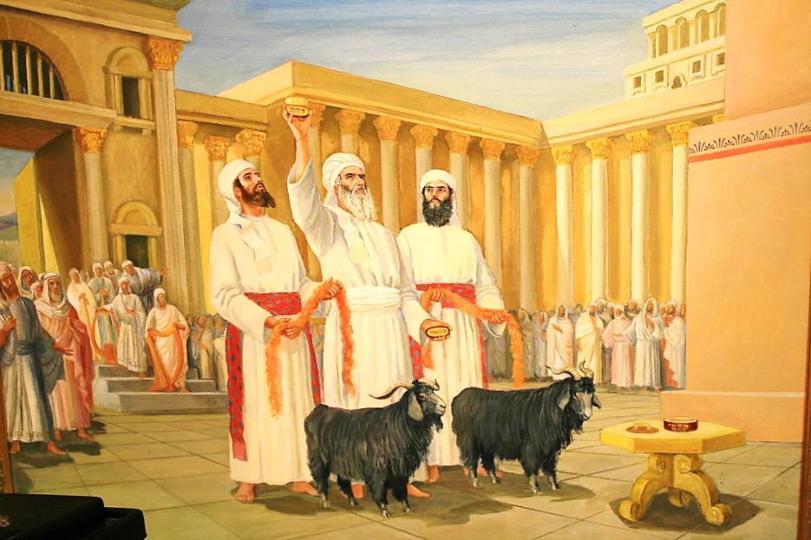
Old Testament Command
Day of Atonement -
Leviticus 16:29-31
Each year on the Day of Atonement, the Israelites were to “afflict their souls.”
This signified Humbling themselves and Isaiah 58:3 tells us this can include Fasting
Notes:
- There is only one instance of a recurring Fast being made a Command.
- Day of Atonement in Leviticus 16:29-31, Each year on the Day of Atonement, the Israelites were to “afflict their souls.” This signified them lowering or humbling themselves and in Isaiah 58:3 we can see that included a Fast.

Slide 7
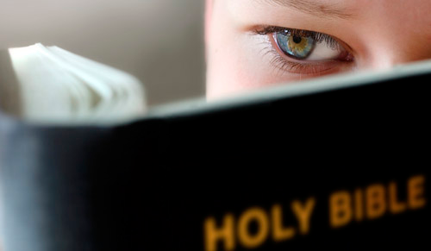
Are we commanded to fast today?
Notes:
Examples of Spiritual Fasting - New Testament / not Commanded but Commended/Recommended
- There are false religions in the world today who practice recurrent Fasting, even to the extent that they bind and command their followers of error to fast for given periods of time throughout the year.
- The great apostasy of Catholicism and many mislead and erroneous protestant denominations bind a partial fast for 40 days a year, known as lent.
- The pagan belief of Islam binds Fasting as one of the 5 pillars or principles of Islam, along with prayer, giving charity, pilgrimage and to testify that allah is the only god and muhammad is his prophet.
- But what of those in The Lord’s Church today? Are we bound to Fast as a practice of our Faith?

Slide 8
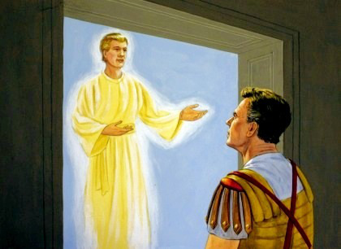
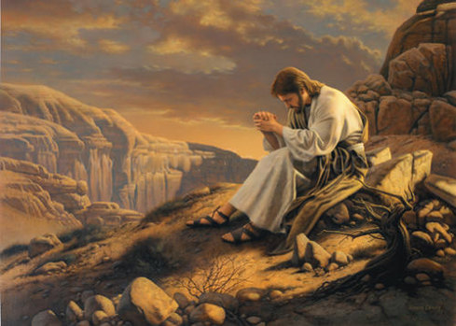
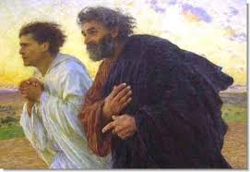
New Testament Fasting
Our Lord Fasted -
40 days - Matt 4:2
Jesus Fasted to complete His Work
Matt 17:21
Those seeking The Lord Fasted -
Cornelius fasted seeking out The Lord - Acts 10:30
The Apostles Fasted -
Requesting Help and Guidance when sending Paul and Barnabas - Acts 13:1-3
Commending others to The Lord - Acts 14:21-23
Notes:
Besides the instances of Fasting we see in the Old Testament which give us many situations when those who were faithful to God partook in the act of Fasting, there are many instances of those in the New Testament practicing Fasting.
- Our Lord Fasted - Jesus fast for 40 days - Matthew 4:2
- Jesus Fasted to complete His work - Jesus drives out a demon with prayer/fasting - Matthew 17:21
- Those who seek The Lord will Fast - Cornelius fasts for 4 days seeking out The Lord - Acts 10:30
- Requesting Help and Guidance from The Lord - Paul and Barnabas are sent out - Acts 13:1-3
- Commending others to the care of The Lord - Paul and Barnabas Petition The Lord on behalf of the elders they appointed - Acts 14:21-23

Slide 9
New Testament Fasting - Commended, Not Commanded
Teachings on Fasting -
Jesus Instructs His Followers
Matt 6:16-18
This suggests His disciples will at times Fast
Jesus is questioned about Fasting
Matt 9:14-15
Here we see that there are times appropriate for Fasting
Paul Instruction to those Married
1 Cor 7:5
Very practical and beneficial instructions for Spiritual edification
Notes:
Fasting in the New Testament is not Commanded, but Commended or Recommended - Teachings on Fasting -
- Matthew 6:16-18, Jesus instructs how to Fast (this would suggest that His disciples will Fast)
- Matthew 9:14-15, Jesus is asked why His followers do not Fast (this shows that there is a time for Fasting)
- 1 Corinthians 7:5, Paul instructs on Fasting and Prayer in Marriage (this instruction shows how fasting can be beneficial in a very practical way not only to our Spiritual life, but our physical life and relationships)

Slide 10
Practical Physical benefits of fasting
Improves Immune System
Helps Regulate Insulin and Insulin sensitivity
Promotes Weight Loss
Trains body not to over-react to hunger
Improves Brain Functionality
Helps alter the function of some genes and hormones
Can improve Heart health
Can improve Cell health
Helps clear skin and Prevent skin problems
Water only fasting suggested to help Auto-immune system disorders
Notes:
Practical Benefits of both Physical and Spiritual Fasting
- While we should not be dishonest about our desires when we Fast, there are many known and proven physical benefits of fasting. Please understand that I am not a doctor, and before you undertake fasting, you should go to our Father in Prayer and consult your doctor to know if this is an acceptable activity for you. However, according to many medical journals, intermittent fasting has some of the following effects on the body:
- Promotes weight loss by allowing the body to burn through stores of fat and by increasing the body’s metabolism,
- Improves the Immune System,
- Helps Regulate Insulin and Insulin sensitivity,
- Helps train our body not to react to Hunger as aggressively by demonstrating what real hunger feels like and in contrast help us to know the difference between hunger and over-indulgence,
- Improves your brain functionality (i.e. greater focus and clarity),
- Helps to alter the function of some genes and hormones throughout the body
- Can improve heart health through stress and inflammation reduction
- Can improve cell regeneration and clearing of old/defective cells
- Helps clear skin and prevent skin problems as the body clears out toxins
- Some studies even suggest that Water only fasting for a period of several days to 3 weeks can help “reset” the body’s autoimmune system response to things like Rheumatoid Arthritis, Allergies, IBD, and other autoimmune related conditions

Slide 11
Greatest Benefit from Fasting
Notes:
- However, the Physical is not the sole reason why we should Fast. Truly, the most important benefit of Fasting is that it helps us to train our mind and body to deny it’s most basic need, that of eating, in the avenue of focusing our minds on God. By striving to win a Crown, like Paul said in 1 Corinthians 9:24-27, some translations say “I beat my body into submission”, if we can essentially train ourselves to overcome these (foods)

Slide 12
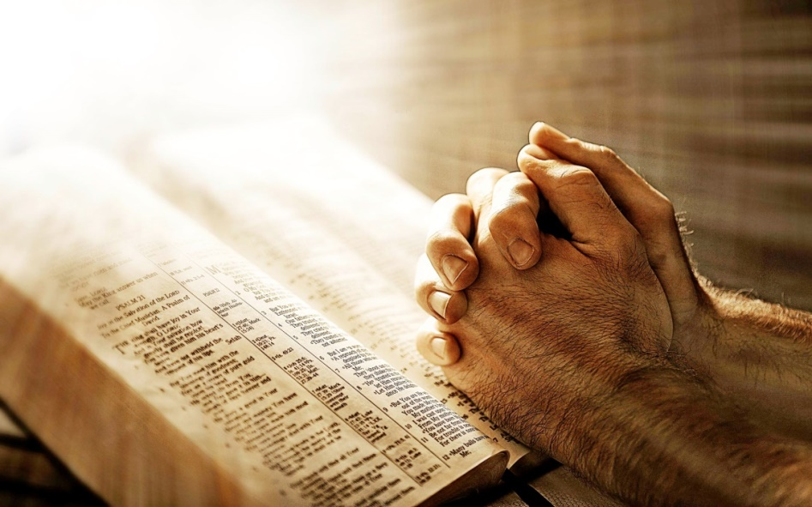
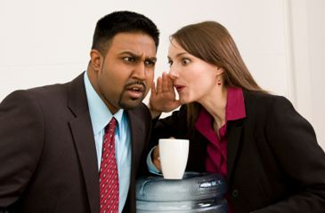
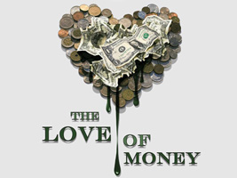
Greatest Benefit from Fasting
Notes:
than we can focus our mind toward spiritual endeavors and overcome these (sins). This is the best benefit of Fasting.

Slide 13
Faithfully Fast
Fasting can be Acceptable and Unacceptable -
Isaiah 58 - Fasting that Pleases God
Zechariah 7:1-7 - Unacceptable Fasting
Our intention should always be clear, pure and truthful. Never deceitful, dubious or Self-Glorifying
Notes:
Pitfalls of Fasting (with the wrong intention, or the wrong heart)
- If we should consider fasting as a regular practice in our lives, then as with any aspect of our Spiritual Walk, we should consider now only how to do it appropriately, but also how it can be done inappropriately so that we can avoid those pitfalls.
- Isaiah 58, Acceptable Fasting or Fasting that Pleases God ([They] delight to know My Ways, v. 2)
- Zechariah 7:1-7, What happens when our fast is not acceptable, and Obedience is Better than Fasting (... did you really fast for Me - for Me?, v.5)
- If our intention is to fast to be seen by men for the purpose of saying “look how holy and righteous I am, I am fasting 8 days a week!” then we Fast in vain. As with all things, God searches the Heart and knows the Mind (Romans 8:27) Our intention, whatever it may be, must be pure. If we are fasting for better physical health, that should be our clear intention, and when we talk about it, that should be what we say; “I’m fasting to promote my health.” There’s nothing wrong with periodically abstaining from all or certain foods to improve one’s health.
- But if we are fasting to improve our spiritual health, than as much as possible, we need to keep that fact hidden. For The Lord who sees what is done in secret will reward those openly (Matthew 6:6) We must go about our daily lives as though to an outside observer, there is absolutely nothing different. Then, through our obedience to God and seeking Him out diligently and in purity of Heart, He will find our Fast acceptable and bless us.

