Slide 1
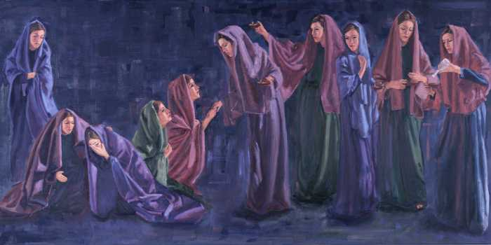
The Parable of the Ten Virgins
Matthew 25:1-13

Slide 2
Things We Cannot Do
We Cannot Neglect Preparation and Be Ready At the Lord’s Coming
We Cannot Borrow What Must Be Bought
We Cannot Recall Lost Opportunities

