Slide 1
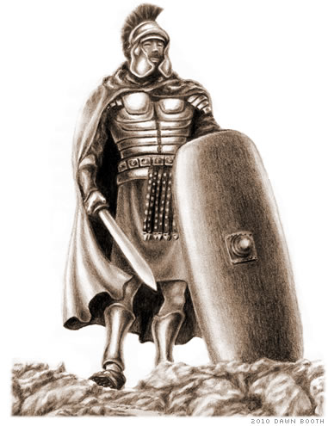
Using the Armor of God
Ephesians 6:13-17

Slide 2
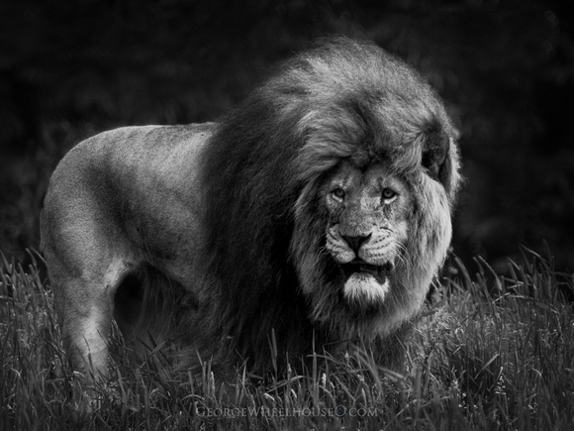
We Have An Enemy
Be sober, be vigilant; because your adversary the devil walks about like a roaring lion, seeking whom he may devour.
1 Peter 5:8

Slide 3
We Have An Enemy
He is a murderer and a liar (John 8:44).
He is a predator (1 Pet. 5:8).
He is not honest (2 Cor. 11:14).
He has men who do his bidding (2 Tim. 2:26).

Slide 4
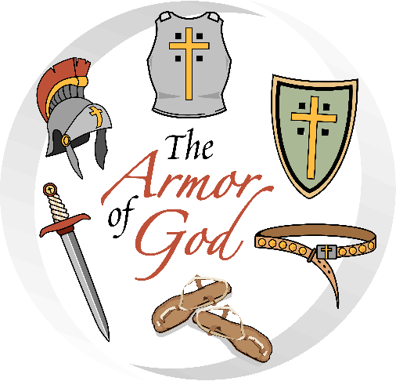
The Armor of God
Belt
Breastplate
Shoes
Shield
Helmet
Sword

Slide 5
The Armor of God
Belt
Breastplate
Shoes
Shield
Helmet
Sword
Truth
Righteousness
Gospel
Faith
Salvation
Word of God

Slide 6
The Armor of God is the Word of God
Belt of Truth - John 17:17
Breastplate of Righteousness - Ps. 119:172
Shoes, Gospel - “godspell” - word of God
Shield of Faith - Rom. 10:17
Helmet of Salvation - Rom. 10:13-17
Sword - Word of God - Heb. 4:12

Slide 7
How To Use the Armor of God
Belt of Truth – God’s word gives us absolute standards, we know our boundaries, we have our guidance.
Breastplate of Righteousness – God’s word in our heart will protect us against temptations and false accusations. Following it will make us people of character.

Slide 8
How To Use the Armor of God
Feet Shod With Preparation of the Gospel – we are to have our mind filled with a working knowledge of the Bible so we are ready to fight the good fight of faith.
Shield of Faith – God’s word supplies us with an answer for every attack, quenching the fiery darts of Satan.

Slide 9
How To Use the Armor of God
Helmet of Salvation – we need to strive to live in constant fellowship with God (1 John 5:13).
Sword of the Spirit
meet error with truth - 2 Cor. 10:3-5
meet the lost with the saving message of the gospel - Acts 8:4
meet erring brethren with correction and struggling brethren with comfort - 1 Thess. 5:14

