Slide 1
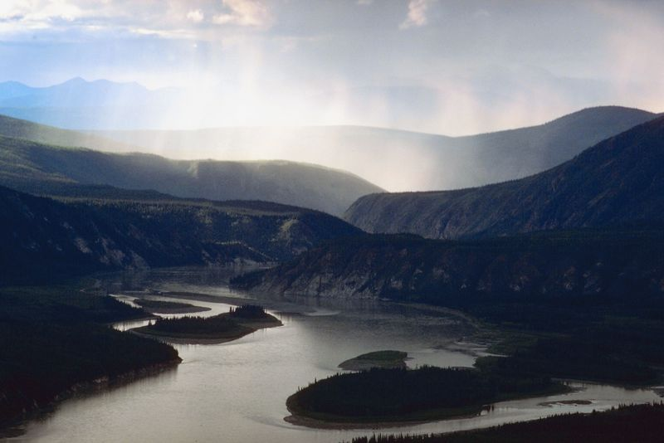
In the Valley But Not Forsaken
Psalm 37:23-26 – The steps of a man are established by the Lord; and He delights in his way. When he falls, he shall not be hurled headlong; because the Lord is the One who holds his hand. I have been young, and now I am old; yet I have not seen the righteous forsaken…
Notes:
Title Slide: In the Valley But Not Forsaken…(Psa.37:23-26}

Slide 2
Introduction
Yet to be discovered by many that the Lord’s people live in a different vein.
  1 John 5:15,16
The godly often expect life to be peaceful and often fear adversity.
  1 Peter 5:9
Notes:
Introduction:
Many have yet to discover that the Lord’s people live in a different vain. (1 Jno.5:15,16) Yes, we live in the world, but we’re not in love with the world.
The godly often expect life to be peaceful, and they often fear adversity. (1 Pet.5:9) We must expect both! (Matt.5:45)

Slide 3
Introduction
Paul made two statements:
  “Strengthening the souls of the disciples, exhorting them to continue in the faith, and saying, ‘We must through many tribulations enter the kingdom of God.’” {Acts 14:22}
Notes:
Introduction: Paul made two statements:
(1) Acts 14:22—”We must through many tribulations enter the kingdom of God.”

Slide 4
Introduction
Paul made two statements:
  “For God has not given us a spirit of fear, but of power and of love and of a sound mind.” {2 Timothy 1:7}
In this lesson, we want to show the depth of the valley and the magnitude of God’s grace.
Notes:
Introduction: Paul made two statements:
(2) 2 Tim.1:7—”For God has not given us the spirit of fear…”
In this lesson, we want to show the DEPTH of the valley and the MAGNITUDE of God’s grace.

Slide 5
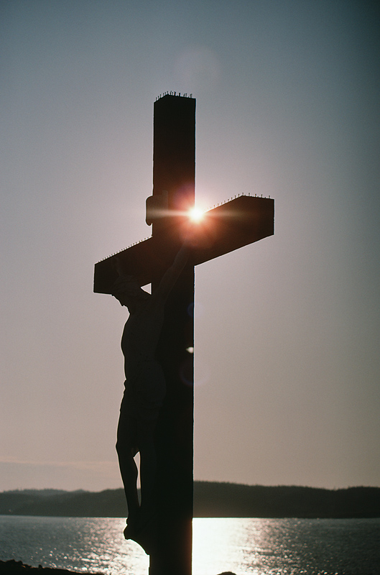
A. How Dark the Valley
Can Be!
Matthew 27:46 –
“And about the ninth hour Jesus cried out with a loud voice, saying,.. ‘My God, My God, why hast Thou forsaken Me?’”
Notes:
A. How Dark the Valley Can Be! Jesus’ crucifixion. (Matt.27:46)

Slide 6
How Dark the Valley Can Be
The words used in the Bible convey tremendous ideas.
The word forsake needs to be explained in more ominous terms.
  “To give up (something formerly held dear); renounce; abandon; leave altogether.”
Notes:
How Dark the Valley Can Be!
The words used in the Bible uses convey tremendous ideas. Words communicate powerful pictures.
The word forsake needs to be explained in more ominous terms. Defined as…

Slide 7
How Dark the Valley Can Be
“For Demas has forsaken me, having loved this present world, and has departed for Thessalonica…” {2 Timothy 4:10}
“At my first defense no one stood with me, but all forsook me. May it not be charged against them.” {2 Timothy 4:16}
Notes:
Paul understood HOW DARK the valley could get. 2 Tim.4:10; 4:16…

Slide 8
How Dark the Valley Can Be
God has promised that no matter how bad it gets, how dark the valley, He will never forsake us!
“For You will not leave my soul in Hades, nor will You allow Your Holy One to see corruption.” {Acts 2:27}
Notes:
God has promised that no matter how bad it gets, how dark the valley, He will never forsake us. David knew that the Father would not forsake the Son, Acts 2:27…Psa.16:8-10…

Slide 9
How Dark the Valley Can Be
Paul’s own life demonstrated for his fellow Christians, the effectiveness of God’s “not forsaking.”
“Persecuted, but not forsaken; struck down, but not destroyed—always carrying about in the body the dying of the Lord Jesus, that the life of Jesus also may be manifested in our body. For we who live are always delivered to death for Jesus' sake, that the life of Jesus also may be manifested in our mortal flesh.” {2 Corinthians 4:9-11}
Notes:
Paul’s own life demonstrates for his fellow Christians the effectiveness of God’s “not forsaking.” 2 Cor.4:9-11…

Slide 10
How Dark the Valley Can Be
Paul’s own life demonstrated for his fellow Christians, the effectiveness of God’s “not forsaking.”
“For we do not want you to be ignorant, brethren, of our trouble which came to us in Asia: that we were burdened beyond measure, above strength, so that we despaired even of life. Yes, we had the sentence of death in ourselves, that we should not trust in ourselves but in God who raises the dead, who delivered us from so great a death, and does deliver us; in whom we trust that He will still deliver us.” {2 Corinthians 1:8-10}
Notes:
Paul’s own life demonstrated for his fellow Christians, the effectiveness of God’s “not forsaking.” 2 Cor.1:8-10…

Slide 11
How Dark the Valley Can Be
Paul’s own life demonstrated for his fellow Christians, the effectiveness of God’s “not forsaking.”
“Are they ministers of Christ? --I speak as a fool--I am more: in labors more abundant, in stripes above measure, in prisons more frequently, in deaths often. From the Jews five times I received forty stripes minus one. Three times I was beaten with rods; once I was stoned; three times I was shipwrecked; a night and a day I have been in the deep… If I must boast, I will boast in the things which concern my infirmity.” {2 Corinthians 11:23-25,30}
Notes:
Paul’s own life demonstrated for his fellow Christians, the effectiveness of God’s “not forsaking.” 2 Cor.11:23-25,30…

Slide 12
How Dark the Valley Can Be
There is a basic principle that prevails as the extremity of faith itself.
“And as she was going to get it, he called to her and said, please bring me a morsel of bread in your hand. So she said, As the LORD your God lives, I do not have bread, only a handful of flour in a bin, and a little oil in a jar; and see, I am gathering a couple of sticks that I may go in and prepare it for myself and my son, that we may eat it, and die.“ And Elijah said to her, "Do not fear; go and do as you have said, but make me a small cake from it first...”
{1 Kings 17:11-13}
Notes:
There is a basic principle that prevails as the extremity of faith itself. 1 Kings 17:11-13…The widow had to trust Elijah—God’s prophet. We too must trust God’s word, no matter how bleak the situation appears.

Slide 13

B. How Great NOT Forsaken Can Be
Psalms 23:4-6 – Even though I walk through the valley of the shadow of death, I fear no evil; for Thou art with me; Thy rod and Thy staff, they comfort me. Thou dost prepare a table before me in the presence of my enemies; Thou hast anointed my head with oil; my cup overflows…
Notes:
B. How Great NOT Forsaken Can Be! (Psa.23:4-6)

Slide 14

B. How Great NOT Forsaken Can Be
There is much by the Psalmist that correlates with God’s extreme provision.
Paul’s own examples of affliction and comfort are in the context of this subject.
Notes:
How Great NOT Forsaken Can Be!
There is much by the Psalmist that correlates with God’s extreme provision.
Paul’s own examples of affliction and comfort are in the context of this subject…

Slide 15
How Great NOT Forsaken Can Be
“Blessed be the God and Father of our Lord Jesus Christ, the Father of mercies and God of all comfort, who comforts us in all our tribulation, that we may be able to comfort those who are in any trouble, with the comfort with which we ourselves are comforted by God. For as the sufferings of Christ abound in us, so our consolation also abounds through Christ.” {2 Corinthians 1:3-5}
Notes:
How Great NOT Forsaken Can Be! (2 Cor.1:3-5—discuss the highlighted words)

Slide 16
B. How Great NOT Forsaken Can Be
There is much by the Psalmist that correlates with God’s extreme provision.
Paul’s own examples of affliction and comfort are in the context of this subject.
Even in the midst of our enemies, God prepares a table where the cup overflows.
Notes:
How Great NOT Forsaken Can Be! (1) There is much by the Psalmist that correlates with God’s extreme provision. (2) Paul’s own examples of affliction and comfort are in the context of this subject…(3) God prepares a table even in the midst of my enemies, where the cup overflows! Even in the darkest of times—God can make my cup overflow!

Slide 17
B. How Great NOT Forsaken Can Be
4. Israel was a classic example of God taking care of His people.
5. This is promised even more abundantly after they betrayed Him!
Notes:
How Great NOT Forsaken Can Be!
(4) Israel was a classic example of God taking care of His people. How many times did they test His patience and rebel? Reject His prophets? But He kept sending them.
(5) This is promised even more abundantly after they betrayed Him. Read all the promises concerning the “remnant” and how God would again bless them. Because He loved them, He always held out hope. But they had to go through the VALLEY…

Slide 18
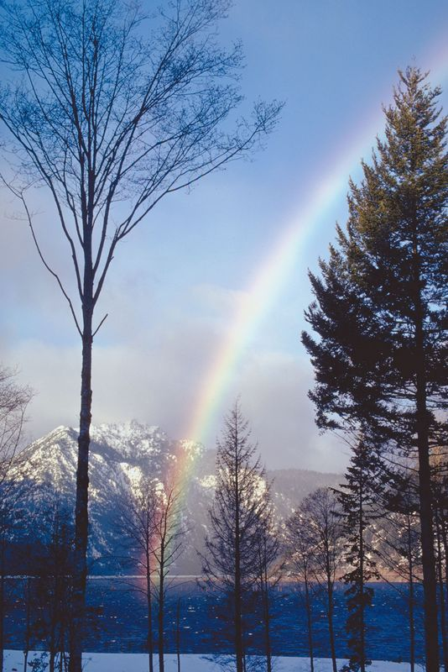
C. Further: Grace Upon Grace
John 1:14,16 –
“And the Word became flesh, and dwelt among us, and we beheld His glory, glory as of the only begotten from the Father, full of grace and truth… For of His fullness we have all received, and grace upon grace.”
Notes:
C. Further: Grace Upon Grace! (Jno.1:14,16)…

Slide 19

C. Further: Grace Upon Grace
People define grace as Unmerited favor. Something that is not merited or earned.
What then is “grace” upon grace?”
A regenerated life is ALL about God’s grace and His work in a person’s life.
Notes:
C. Further: Grace Upon Grace…
People define grace as unmerited favor—something that is not merited, earned, or deserved.
What then is “grace upon grace?”
A regenerated life is ALL about God’s grace and His work in a person’s life. Let us see how this is true…

Slide 20
C. Further: Grace Upon Grace
“But by the grace of God I am what I am, and His grace toward me was not in vain; but I labored more abundantly than they all, yet not I, but the grace of God which was with me.” {1 Corinthians 15:10}
Notes:
C. Further: Grace Upon Grace…
(1) 1 Cor.15:10…Like Paul, whatever we are, whatever we accomplish—without God’s grace, we’re nothing!

Slide 21
C. Further: Grace Upon Grace
4. God gives unequal return for service to Him.
5. God’s grace has MANIFOLD forms…
Notes:
C. Further: Grace Upon Grace…
(4) God gives unequal return for service to Him. We always receive more than what we deserve for our services. We get the best end of this deal.
(5) God’s grace has MANIFOLD forms…many-sided and expressed in many ways…

Slide 22
C. Further: Grace Upon Grace
“As each one has received a gift, minister it to one another, as good stewards of the manifold grace of God.” {1 Peter 4:10}
Notes:
C. Further: Grace Upon Grace…
(2) 1 Pet.4:10…We each have God-given ability and opportunities to use that ability. Sadly, many fail to properly use God’s gracious gifts in our service to Him.

Slide 23
C. Further: Grace Upon Grace
6. God promises to care for His own beyond what they request.
Notes:
C. Further: Grace Upon Grace…
(6) God promises to care for His own beyond what they request…

Slide 24
C. Further: Grace Upon Grace
“Now to Him who is able to do exceedingly abundantly above all that we ask or think, according to the power that works in us.” {Ephesians 3:20}
Notes:
C. Further: Grace Upon Grace…
(6) Eph.3:20…We cannot truly fathom the amount of grace God bestows upon us.

Slide 25
C. Further: Grace Upon Grace
7. The Spirit gives us special endowments. True Christians must make every effort to use their gifts.
Notes:
C. Further: Grace Upon Grace…
(7) The Spirit gives us special endowments. True Christians must make every effort to use their gifts…

Slide 26
C. Further: Grace Upon Grace
“Having then gifts differing according to the grace that is given to us, let us use them: if prophecy, let us prophesy in proportion to our faith; or ministry, let us use it in our ministering; he who teaches, in teaching…
Notes:
C. Further: Grace Upon Grace…
(7) Rom.12:6-8…We understand that the first-century church members received spiritual gifts. We don’t receive such gifts, but that doesn’t mean we don’t have “special gifts” in our day and time?

Slide 27
C. Further: Grace Upon Grace
“He who exhorts, in exhortation; he who gives, with liberality; he who leads, with diligence; he who shows mercy, with cheerfulness.” {Romans 12:6-8}
Notes:
C. Further: Grace Upon Grace…
(7) Rom.12:6-8…We understand that the first-century church members were given spiritual gifts. We don’t have such “gifts” today, but does this mean we don’t have “special gifts” in our day?

Slide 28
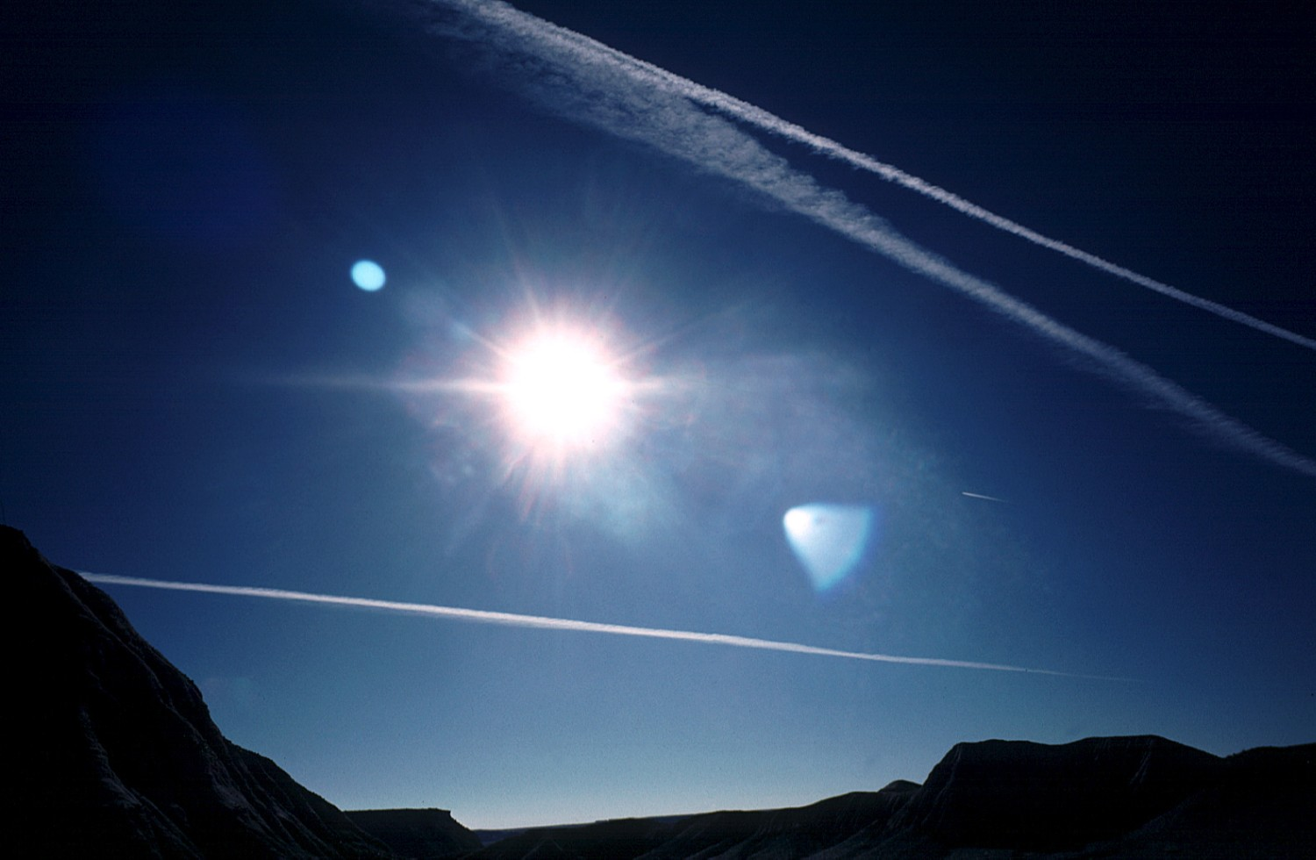
Invitation
Romans 1:17 – For in it the righteousness of God is revealed from faith to faith; as it is written, “But the righteous man shall live by faith.”
Notes:
Invitation…

Slide 29
Invitation
Hebrews 13:5,6– “Let your conduct be without covetousness; be content with such things as you have. For He Himself has said, I will never leave you nor forsake you. So we may boldly say: "The LORD is my helper; I will not fear. What can man do to me?”
Notes:
Invitation…

